Slide 1
Modelling transformations accounting for fixed capital
AUM 2012, May
Cambridge
Csaba Deák
São Paulo
SP, 2012 May 21

Slide 2
Rent theory, marginalism and the equilibrium assumption
Urban process is transformation
Ergo models on equilibrium assumption cannot represent them
but (after 25 yrs):
Models can (maybe) drop equilibium assumption
and focus on
Transformation: fixed capital and obsolescence
Ideology < > equilibrium
Equilibrium assumption:
Mainstream economics stress permanence
hide transient nature of society :: capitalism
Present ahistorical view of capitalism (‘natural order’)
“Society as we know it”
Keynes
Nobel prizes
Notes:
smaller font

Slide 3
The process of obsolescence
Transformation is not a continuous process -- permanence is said to be what happens between two transformations, during which under the surface, however , there is a growing tension between the permanence of the old under the pressure of introducing the new. This is the process of obsolescence, which is supported by physical structures that constitute fixed capital.
::
The nature of transformations
the anatomy of technical change
individual; collective levels
Production on land
price and rent for location
individual optimization and land use regulations
obsolescence of land use
Representation:
analytical, empirical
simplified, proxies
Changes … generally operate a long time in secret before they suddenly make themselves violently felt on the surface.
A clear survey of the economic history of a given period can never be obtained contemporaneously, but only subsequently…
Engels, 1995
The biggest advantage of modelling is the knowledge acquired in doing it about the process being modelled.

Slide 4
The anatomy of technical change
Fixed capital and best technique
Fixed and circulating capital
Fixed: more than one period of production
life time T , amortization
Circulating: returns after each period of production
ϕ rigidity composition of capital:
ϕ = K / k .
(T)he only essential distinction within his capital that impresses itself upon the capitalist is that of fixed and circulating capital.
Engels, in Capital III:75
Direct costs must be completely covered by the selling price... Supplementary costs must generally be covered by the selling price to a considerable extent in the short run. And they must be covered by it in the long run; for if they are not, production will be checked.
Marshall (1890):360, my emphases.

Slide 5

Return on investment according to an assumed (average) rate of profit, π :
R = (K/T + k) + (K + k) π (1)
T= projected life time of K (*)
Once fixed capital is in place, the rate of return r on circulating capital newly (re-) invested year by year will be
r = (R - k)/k
or with R from above
r = K / k·T + ( K/k + 1 ) · π ,
and, with the rigidity composition of capital ϕ such that ϕ = K/k
r becomes
r = ϕ ( 1/T + π ) + π (2)
Bygones are forever bygones, and we are always starting clear with a view to future
Jevons cca 1860
in Salter (1960):60
(*) In the case of components of fixed capital K _{i} , having different projected life times T_{i} , total fixed capital 'used up' in a 'used up' in a period of production is Σ^{i} ( K_{i /} T_{i} ), and T is therefore defined as
T = .

Slide 6
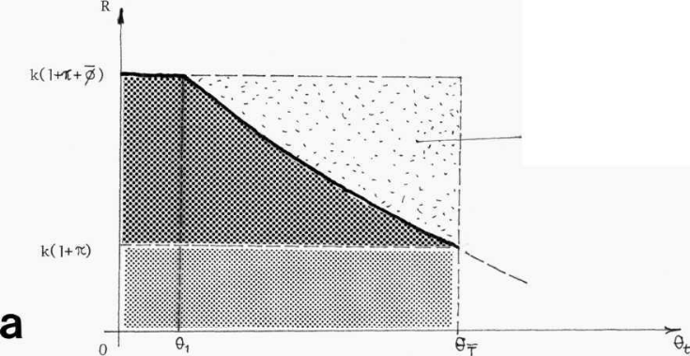

Erosion of the return
After one period of production there arises a new technique of production. Because this technique is more productive, it produces the same commodity at a lesser cost* that brings the market price down.
If θ_{t} is the accumulated increase in productivity up to t, the return of the old technique at the end of the same period of production is
R_{t} = t < T
so that the return of the old technique becomes a decreasing function of time.
However what we want is the rate of return on new capital k
(Jevons):
Instead of forecast constant returns through time (broken line), R falls with technical progress (solid line).
We assume this instead of an initial 'surplus profit' for the new technique which would then gradually fall to the 'average' rate throughout the period T, for simplicity only. Both formulations are equivalent: according to the second formulation, the condition of substitution is expressed as
(1 + π ) (1 + θ_{t} ) > 1 + π
that is, the new technique, by reducing the price of production in the proportion 1/(1 + θ_{t} ), increases the 'normal' return in the inverse proportion, to the extent of off setting the rate of return on circulating capital of the old technique (surplus profit here is t·(1 + π) ). This gives the same condition of substitution as (5) below.

Slide 7

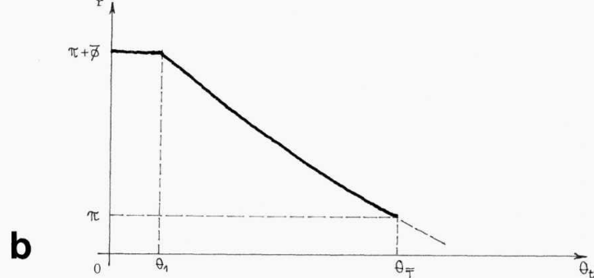


Rate of return on new investment
With R, the net rate of return on newly invested, that is, circulating capital, decreases as well, although remaining for some time above the assumed rate of profit π. At time t ,
r_{t} = (3)
devalorization
Substitution by current best technique
The old technique will be substituted by the current (best) technique when the current rate of return r_{t} on newly invested capital in production according to the old technique falls below the assumed profit rate
r_{t} < π (4)
that is, when the increase in productivity has eroded the whole of the excess return on the circulating capital of the old technique. Substituting r_{t} from above (3), comes
θ_{t} > (5)
or, with (2), the condition of substitution becomes finally:
θ_{t} > ϕ (6)
Figure 1 Obsolescence of the individual process of production –As the market price falls with the increase in productivity of labour θ_{t}, so falls the return R of an individual process of production (a) , and consequently also the rate of return r on its circulating capital (b). When the latter falls to the assumed rate of profit π, the technique becomes obsolete and must be substituted. At this stage, the corresponding fixed capital is wholly devalorized (darker area in diagram a is the contribution of fixed capital in total return R ) .

Slide 8
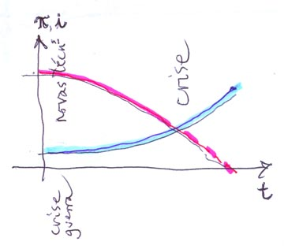
Rigidity of the production technique
For a given evolution of the techniques of production, the fulfilment of the condition of substitution will take the longer, the greater is the magnitude of the initial excess rate of return on circulating capital. For this reason, the same magnitude is a measure of the rigidity of capital as materialized in the fixed capital of the corresponding technique of production. In particular, if we denote this magnitude by , so that r = + π, with (2) above the rigidity of capital is expressed by
= ϕ ( 1/T + π ) (7)
Apart from intrinsic qualities of the individual production process: rigidity composition ϕ, and the life time T of fixed capital, its rigidity depends also on the (assumed) rate of profit in the economy, the very means of insertion of the individual process into the social process of production.
Times of recession: faster substitution/ scrapping
Crises originate a reverse movement of the profit rate and the interest rate during the intervening periods. When the profit rate is recomposed after a crisis with many new productive processes in place, the interest rate falls because the new fixed capitals produce high returns towards the 'reserve fund' and few new processes of production seek to use idle capital so constituted. As the period wears on, the interest rate starts to rise and because it is highly visible, it becomes the de facto regulator of the individual processes of production.

Slide 9
a) an old technique will be eliminated when
and no such new technique is available as can be introduced (see c) below);
b) an old technique is substituted by a new technique when
where the condition of introduction of the new technique (as below) is satisfied a fortiori, since the old technique is in production, so that r_{t} > _{t} (see above); and
c) a new technique is introduced, as for a new product and/or after a crisis, when
.
In other words an old technique t in the individual process of production will be substituted always when there exists a 'new' technique t_{t} such that it yields a return on total new capital advanced higher than the return yielded by the old technique also on new capital advanced, that is, on circulating capital only and higher also than the interest rate. As already noted, if no such new technique is available but the return on old technique has fallen below the interest rate, as in a crisis, the old technique is eliminated but production stops, waiting for the reorganization of social labour power, the result of which for individual capital will become manifest in the form of the 'emergence' of a new technique that satisfies the above conditions.
Note that this does not imply the de facto emergence of techniques newly arisen after the crisis: the mere fall of the interest rate may allow the introduction of pre-existing techniques that thitherto could not be introduced while i was high.
Salter: p = i
land use
scrapping
substitution
start new production
temporary uses
intensification of land use
new land use

Slide 10
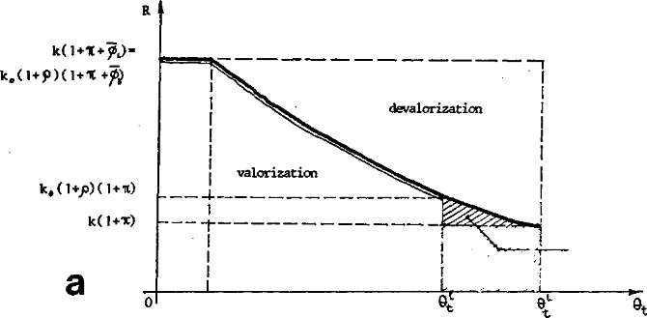

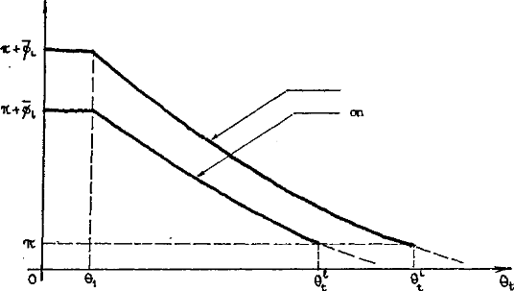


PRODUCTION ON LAND
Payment for the location
Price form: if price of location is L,
R = (K/T + k) + (K + L + k) · π, (1a)
giving, if λ = L / k :
θ_{t} > ϕ + (6a)
Rent form: if rent of location is l,
R = ( K/T + k + l ) + ( K + k + l ) π (1b)
gives, with ρ = l / k ,
θ_{t} > ϕ · (6b)
‘pure loss’ on
rented location
on owned location
on rented location
b
Price form vs rent form. - If a same technique is employed by two processes of production on equivalent locations, one owning the location and the second renting it, both processes yield the same return R (top) imposed by the market price, and falling equally with the improvement of technique t. The rate of return (bottom) on new investment (circulating capital) is however lower for the process on rented location, which must therefore go out of production before becoming obsolete, and suffer a "pure loss" over and above the normal devalorization of its fixed capital (top).

Slide 11
PRODUCTION ON LAND
Locational inertia and taxes
With costs of relocation G
and taxes z
R = (K/T +k + zL) + (K + L + G + k + zL) (8.1)
Costs of relocation: as fixed capital
increase rigidity
Taxes as circulating capital
reduce rigidity (means of regulation)

Slide 12
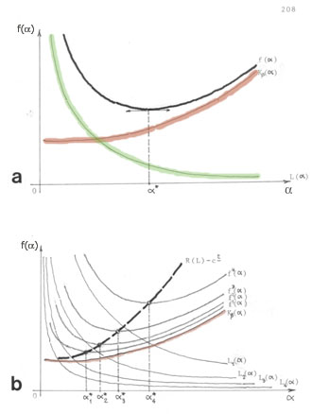
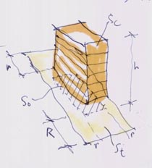
PRODUCTION ON LAND
Pattern of settlement:
individual optimization and land use regulations
Intensity of land use- Diagram a of optimization of density measured by plot ratio a, where a* is the individual optimum density of the best technique. Diagram b shows the variation of a* with the variation of the price of the land L1,L2,..., and the resulting price of production R(L) less a constant (that corresponds to the first group of terms independent of L, in equation 8.1), without a change in the state of techniques.
Pattern of settlement Legal restrictions on the pattern of settlement .

Slide 13
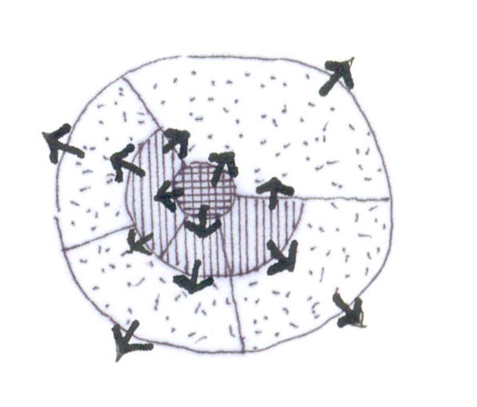
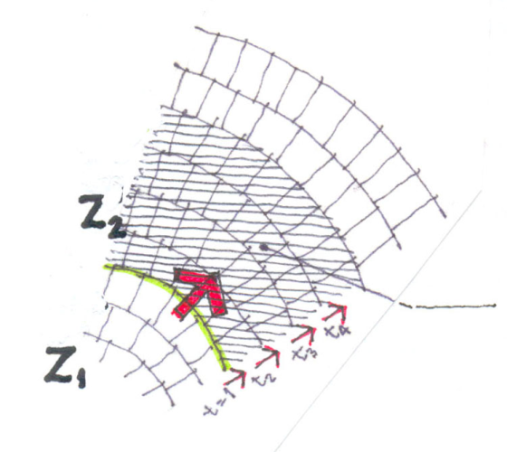
PRODUCTION ON LAND
Obsolescence of land use
Anarchic growth of urban agglomerations
Competition on the market for land uses would result in that the higher-ranking use outbids the adjacent lower ranking use (which in turn will do the same with the next use down the hierarchy of land uses) resulting in a pattern of 'spontaneous' growth in which the frontiers between neighbouring uses are constantly moving centrifugally ...
... having to constantly overcome the rigidity of fixed capital materialized in built structures (both within and without individual locations) .
At the limit between zones a zone of transition is formed which with time will be (infra)structured for the new use through state intervention.
This is the basis for speculation: land use change at some time in the future. Less planning, more speculation –and vice versa.
Temporary uses
Meanwhile: temporary uses in the transition zone.
The so-called 'Chicago school' is a phenomenological interpretation of precisely such spontaneous growth of cities in the heyday of American laissez-faire (e.g. Burgess', 1925, 'concentric zone theory' and Hoyt's 'sectoral pattern’
speculation zone
(zone of transition)
Temporary uses
The old has left
the new can not yet come
Ex: parking plots

Slide 14
Representation in modelling
analytical, empirical
det. land use K fix parameters
K (avg), k, T (avg)
simplified, proxies
estimates of rates of obsolescence
hipotheses
’educated’ guesses
The soul of a model is its assumptions
Lewis Carrol
A map which showed everything would cover the country
Alice in wonderland
It is better to be vaguely right than exactly wrong
Carveth Read 1898

Slide 15
References
Abstract
Transformation is the main object of urban modelling but most models are based on the equilibrium assumption according to which transformations obtain through frictionless transition from one equilibrium-state to another. This paper argues that the presence of fixed capital in all processes of production or reproduction –of which land use is a particular case– introduces an element of rigidity or friction or yet cost which must be accounted for. For if the adoption of a best technique is a reasonable assumption for any newly set up production process, the rigidity of the same prevents at any subsequent time all the processes in the economy to promptly adapt to and thus operate at the current best technique (in equilibrium), rather, those processes will be in varying states of obsolescence. Then we outline an account of the anatomy of the transformation of the individual process of production taking into account fixed capital, and finally raise the possibility of simplified representations of those transformations in urban land use modelling.
Deák, Csaba (1985) Rent theory and the price of urban land/ Spatial organization in a capitalist economy PhD Thesis, Cambridge University
Engels, Friedrich (1895) Inserted note in Marx, Karl (1895) Capital III, p.75. Several eds.
MARSHALL, Alfred (189O) Principles of economics, Macmillan, London
SALTER, W E G (1960) Productivity and technical change CUP, Cambridge

