Slide 1
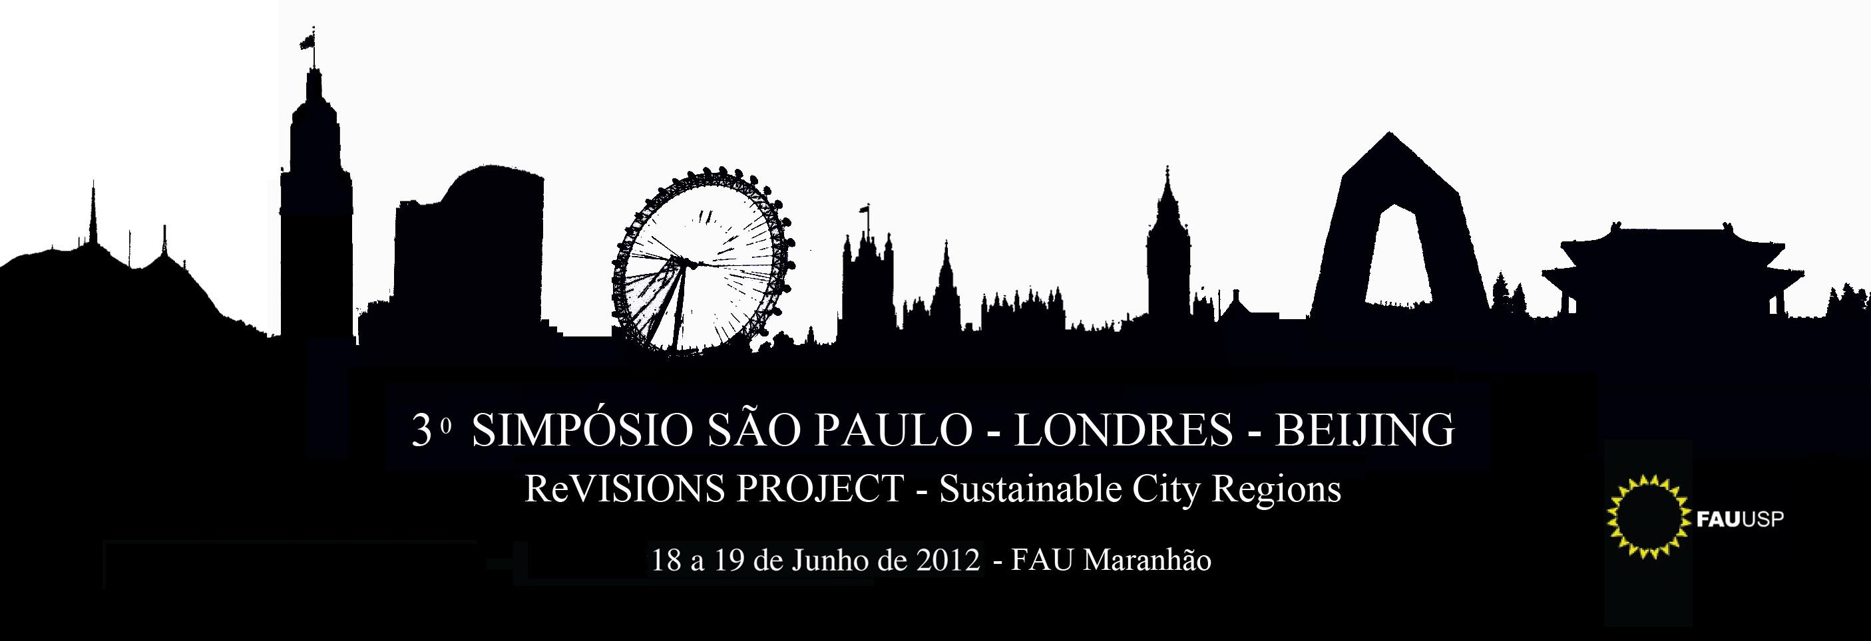
Long-term views in
London, Beijing, sÃo paulo
Csaba Deák
FAU, São Paulo
SP, 2012 June

Slide 2
1 London, Beijing, São Paulo a comparison
NOT of their intrinsic characteristics
size
income
climate...
BUT their place/ role in
world capitalism
world development
Position towards long-term perspectives of planet Earth
Will form their own view on long-term prospects
Notes:
smaller font

Slide 3
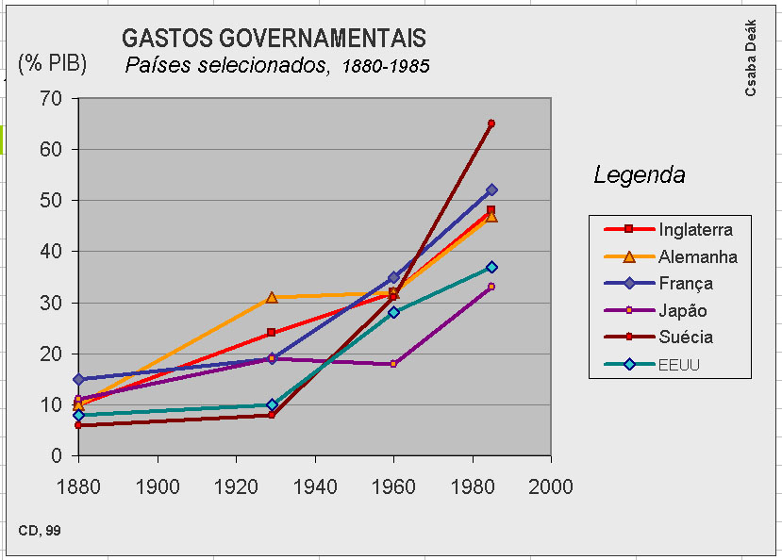
2 Long term prospects of capitalism
Development stages of capitalism
driven by the generalization of the commodity form
Extensive stage liberalism
Ext wage labour/ commodity prodn
High growth rates / urbanization
Intensive stage social democracy
Lower growth rate / Productivity of labour
Higher subsistence levels/ Welfare State
Increase State intervention
Contemporary crisis neoliberalism
Recommodification? (privatization–cum–subsidies etc.)
Privatization etc.: >> income concentration Ball et alii 1989
Desqualifying the State (and collective interest)
Stage Ideology
1880-1985 Selected countries
Share of the State in the GNP
World Bank World Development Report 1991, Washington
1970 | 1998
19% | 30%
1970-1998 OECD countries
Share of Gvt spending in the GNP http://www.worldbank.org/data/wdi2000/pdfs/tab1_5.pdf
Notes:
smaller font

Slide 4
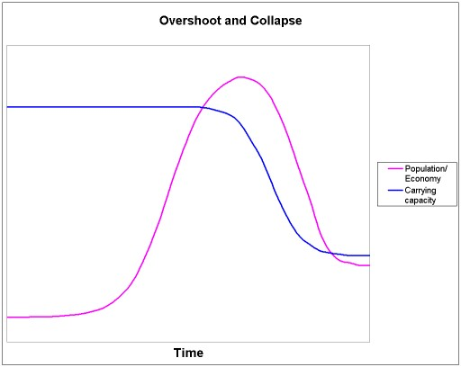
3 Limits of growth on planet Earth
-4000 Bible
Grow and multiply, and populate the Earth
Expanded reproduction
1798 Thomas Malthus
Geometric vs arithmetic growth
1972 The Rome club
Finite support capacity: limits of Growth
1992 Rio
Sustainable development?
Stiglitz says possible è Nobel prize
Tokyo protocol
US never signs
2012 Rio +20
(now on)
1972 Meadows, Meadows, Randers
Population vs carrying capcity
Report to the Club of Rome
The only computer scenarios which indicated human welfare could be sustained were ones in which growth was reduced. -- pop reduced!
The sustainable scale project

Slide 5
4 Thus to the crisis of capitalism a new crisis is added: of expanded reproduction
Sustainable growth: squaring the circle
capitalism: π = 0 (and falling)
planet Earth: finite & crowded
Neoliberal answers:
sustainable growth square circle
new techs to prevent Amb decay
green economy ecoprotectionism
‘responsible’ use of resources
steady state ‘catch up’ growth
growth only for poorer
‘Radical’
de-growth décroissance
Roegen, Serge Latouche
back to support capacity
Thermodynamics 2 nd law:
Closed system  entropy (equilibrium)
Georgescu-Roegen
Earth is not closed: energy from Sun
energy intake (‘renewable’):
hydroelectric
wind – eolic
solar
Direct
Marshall (1890):360, my emphases.

Slide 6
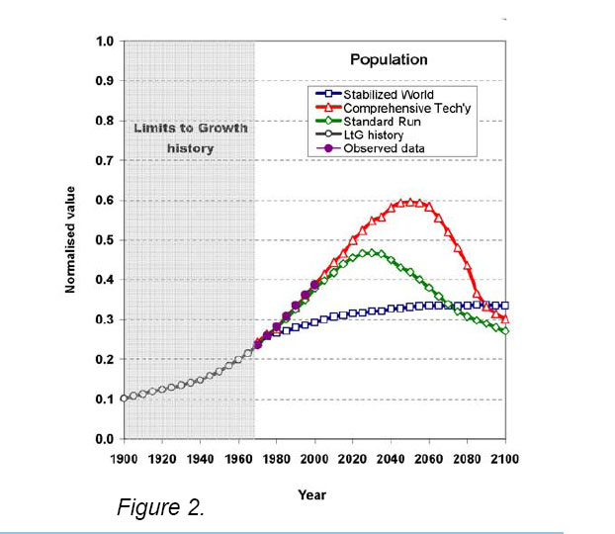


5 The last twenty years
Growth of consumption
1992 2010 Population 5.5 27% 7.0
Raw mats 40%
CO₂ 36%
world poor rich
Inc/capita 0% 40% -7%
The state of the world 2010
In/cap ftprint
G Britain 36 5.5
China 8 2.4
Brazil 12 3.1
US 48 9.6
World 12 2.7
A comparison of the Limits to growth with thirty years of reality
Graham Turner
New scientific evidence points to the gravity of the threats we face. New and emerging challenges include the further intensification of earlier problems calling for more urgent responses. Rio+20 Zero draft:11

Slide 7
6 Parameters of Earth’s capacity
Level of consumption Supported
(as) (bn)
Africa 9.5
Europe 3.0
US 2.7
China, Brazil 5.5
World 4.5
Alternative futures in Limits, 30 years update
Stabilized world’ (blue)
‘Standard run’ overshoot and depletion
(green)
Comprehensive severe overshoot and
techn (red) depletion
è
Comparison of observed data (solid circles ) for global population with the LtG model output for each scenario (“standard run” with open diamonds , “comprehensive technology” with open triangles , and “stabilized world” with open squares ). The calibrated model output over 1900–1970 is shown with open circles.
A comparison of the Limits to growth with thirty years of reality
Graham Turner
If a society is in fact successful in putting off limits through economic or technical adaptations, it runs the risk of later exceeding several limits at the same time. What such a society runs out of is the ability to cope.
MRM, 30 yr update

Slide 8
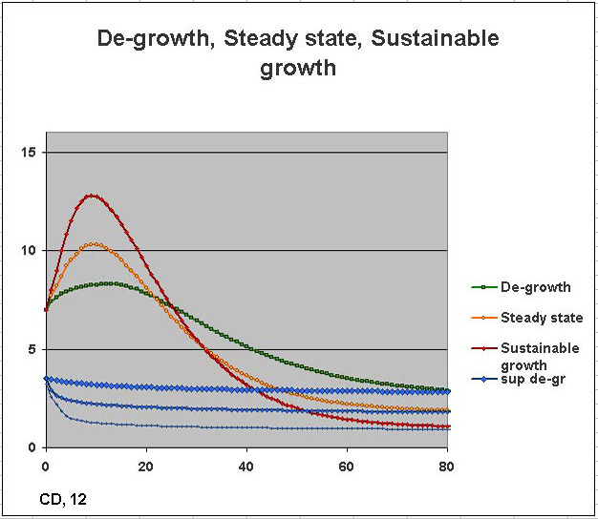
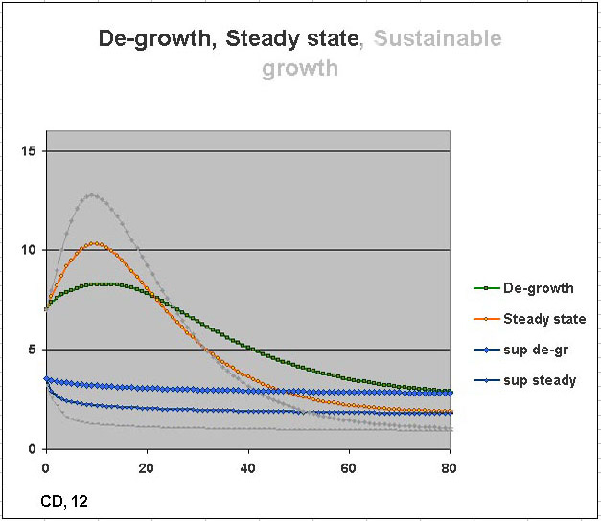
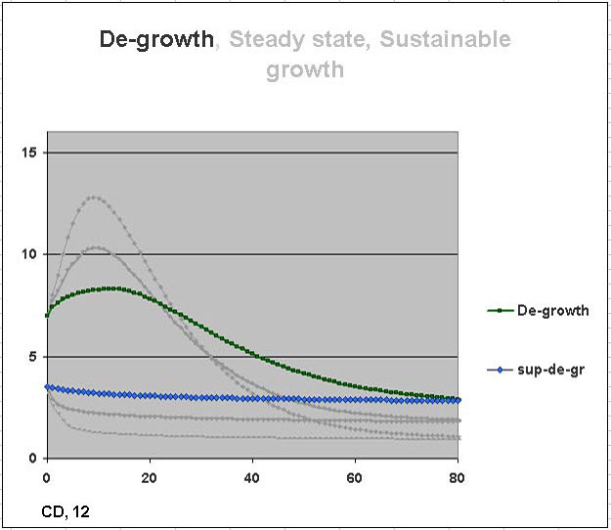
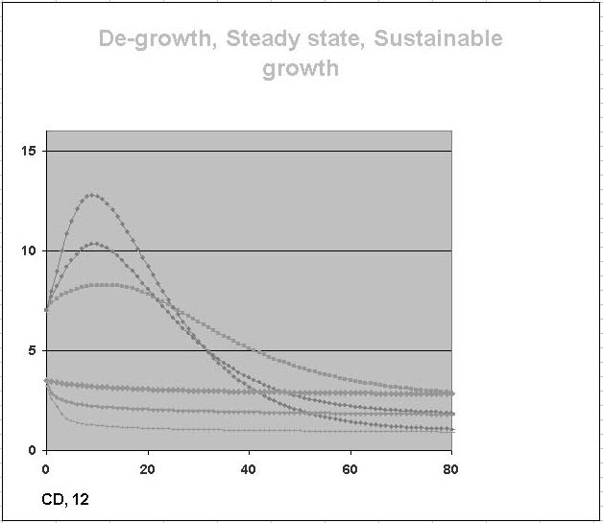
6 Parameters of Earth’s capacity
Level of consumption Supported
(as) (bn)
Africa 9.5
Europe 3.0
US 2.7
China, Brazil 5.5
World 4.5
The main policies simulated
showing also level of resources
De-growth immediate limitation and (green) then stoppage of growth
‘Standard run’ overshoot and depletion
(yellow)
Comprehensive severe overshoot and
techn (red) depletion
è
If a society is in fact successful in putting off limits through economic or technical adaptations, it runs the risk of later exceeding several limits at the same time. What such a society runs out of is the ability to cope.
MRM, 30 yr update

Slide 9
7 Where do we go from here: Utopia
The whole versus the parts:
long-term vs short term
At local level, short term interests prevail
Conflicts of local interests èèèèè
(London, Beijing, São Paulo:)
Great Britain: For the status quo
China: For catching up
Brazil: Idem, except... Rio +20:
Undaunted colossus ...
... Laying forever in splendid cradle ...
? get rid of aversion of full developmt built in colony t
It is clear that the present path of world development is not sustainable in the longer term, even if we recognise the enormous potentials of the market and of technological innovation.
Lip service, but clear statement
Club of R, 2012
Huxley The brave new world
Sovereignty of the nations of the past can not solve the problems of the present any more... The Community [European, of Steel and coal] is but a stage towards a new world of the future
Jean Monnet
wars
or
world regulation
9. We recognize the need to reinforce sustainable development globally through our collective and national efforts, in accordance with the principle of common but differentiated responsibilities and the principle of the sovereign right of states over their natural resources.
Rio + 20, 0 draft “Renewing political commitment “

Slide 10
8 Against ideology
The Rome Club itself: reservation but lip service towards market and progress
It is clear that the present path of world development is not sustainable in the longer term, even if we recognise the enormous potentials of the market and of technological innovation.
Other example of weak talk (on de-growth:)
World population to the hectare already 50% above what a hectare can bear → shows that population can not grow indefinitely
the obvious implication: ‘population must be reduced’ is weakened twice

Slide 11
9 FOR LONG TERM PLANNING
This is not to say that new more efficient techs are useless, it is just that
--are not enough to avoid collapse.
On the other hand,
In the face of a sustainable world order
local conflicts arise
which stem from short term interests.
Any conflict can only be solved at a higher level:
local interests at supra-local or social level;
short term interests in the perspective
(context) of long-term interests –again, of
society as a whole which today by and large
means –or should mean– world society.
In the long run, we are all dead.
J M Keynes
Prof. Wu Liangyong, Tsinghua University
2009 Symposium, Beijing:
(in China nowadays) there is Konfucius, but there are other thinkers equally worthy and in fact there are many lines of thought and all should be taken into account. Provided –and this must be the overriding concern and ultimate guideline of planning: not to let short term individual interests prevail in face of the long term interests of society as a whole.
The best way to bring to a common denominator the three differing points of view of the three countries of ReVisions is to keep long term view always and firmly in focus.

Slide 12
References
Abstract
BALL, Michael, Gray F & McDowell, L (1989) The transformation of Britain. Contemporary economic and social change Fontana, London
LATOUCHE, S. (2004), "Degrowth economics: why less should be much more", Le Monde Diplomatique, November
MEADOWS, Donella, J. Randers and D. Meadows (1972) Limits to Growth Universe Books, New York
––– (1992) Beyond the Limits Chelsea Green Publishing Co, White River Junction, VT
––– (2004) Limits to Growth: The Thirty Year Update Chelsea Green Publishing Co, White River Junction, VT
TURNER, Graham (2008) “A comparison of the Limits of growth with thirty years of reality” Socio-Economics and the Environment in Discussion CSIRO Working Paper Series 2008-09

