Slide 1
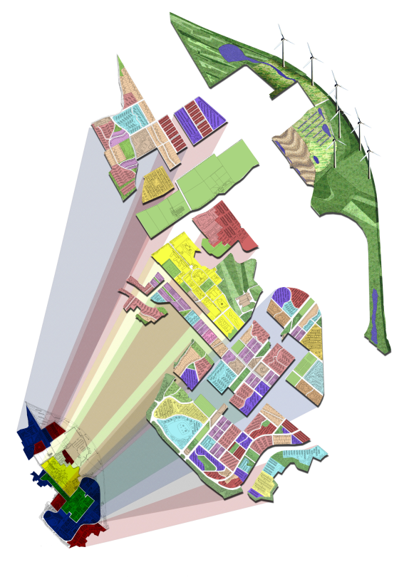




ReVISIONS
Regional Visions of Integrated Sustainable Infrastructure Optimised for Neighbourhoods
Project overview
Marcial Echenique
Sao Paulo International Symposium, USP, June 2012

Slide 2








Overview: Participants
Academic Partners
Prof. Marcial Echenique (Principal Investigator)
Prof. Koen Steemers and Dr. Tony Hargreaves, The Martin Centre
and Mr Michael Kitson, Judge Institute,
University of Cambridge
Prof. David Butler
Centre for Water Systems
University of Exeter
Prof. Mathew Leach
Centre for Environmental Strategy
University of Surrey
Prof. Adrian McDonald, Prof. Philip Rees, Dr Gordon Mitchell
and John Barton, Geography, Institute for Transport Studies
and Civil Engineering, University of Leeds
Dr Neil Thorpe
Transport Operations Research Group,
University of Newcastle
Prof. John Nelson
University of Aberdeen
Prof. David Kay and Dr. Lorna Fewtrell,
Centre for Research into Environment and Health,
Aberystwyth University
Non-academic Partners:
East of England Regional Development Agency
ONE Northeast Regional Development Agency
Department for Transport
Department for Communities and Local Government
Arup, Biffa Water Services, Environmental Agency, Northumbrian Water Ltd., Yorkshire Water Services Ltd. and others.
International Collaborators:
University of Tsinghua, China
University of Sao Paulo, Brazil
University of Southern California, USA
Associated Research in Cambridge:
Energy Efficient Cities initiative (EECi)
Dr. Ying JIN
ReVISIONS
Regional Visions of Integrated Sustainable Infrastructure Optimised for Neighbourhoods

Slide 3
Overview: Objectives
Develop a practical Integrated Framework for analysing spatial sustainability based on previous research work (SOLUTIONS)
Design and test options to forecast and assess their long term sustainability
Guidance and support tools for use by local and central government and other stakeholders based on case studies including international comparisons
ReVISIONS
Regional Visions of Integrated Sustainable Infrastructure Optimised for Neighbourhoods

Slide 4

ReVISIONS
Overview: Method
Regional Visions of Integrated Sustainable Infrastructure Optimised for Neighbourhoods
CASE STUDIES
SYSTEMATIC
OPTION DESIGN
Strategic
Trend
Compaction
Dispersal
Expansion
Local
Economies of scale
Decentralised services
Retrofit & new build
ASSESSMENT
(Indicators)
Economic
(Net benefit & feasibility)
Social Equity
(Distribution)
Environmental
(Protection)
Resources
(use)
ANALYTICAL TOOLS
Integrated quantitative
Modelling framework
(Forecasting)
Stakeholders/Researchers
GUIDANCE

Slide 5
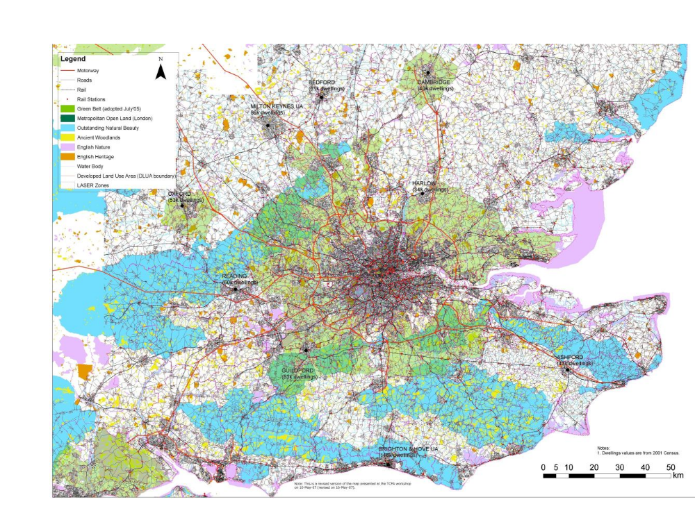
SOLUTIONS
Wider South East (WSE)

Slide 6
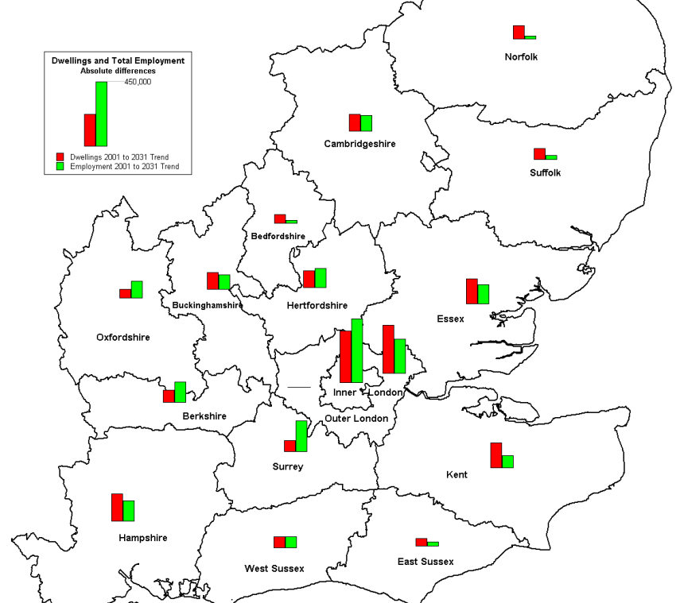
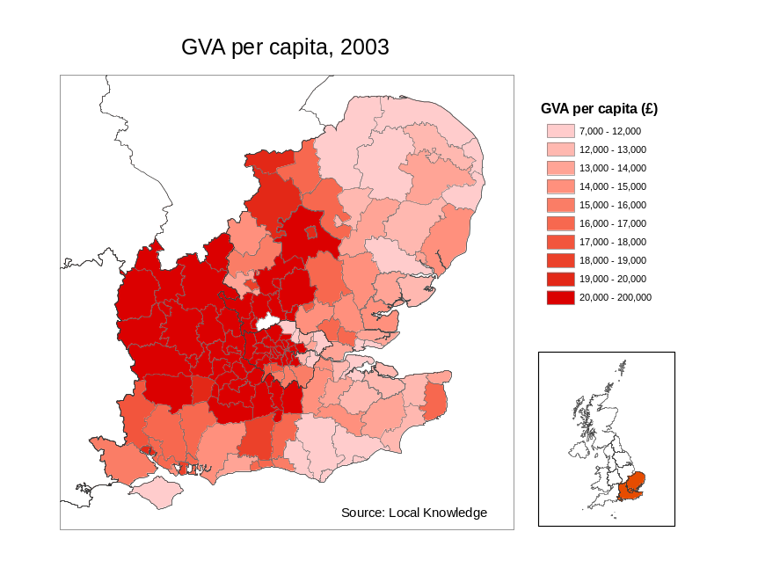
SOLUTIONS
SUSTAINABILITY OF LAND USE AND TRANSPORT IN OUTER NEIGHBOURHOODS
Trend 2031:
Disparity between
allocation of dwellings
(to the East)
and employment growth
(to the West)
Corresponds to the East- West
division of incomes in the
Greater South East
(source: Merrick/Cox EEDA)

Slide 7
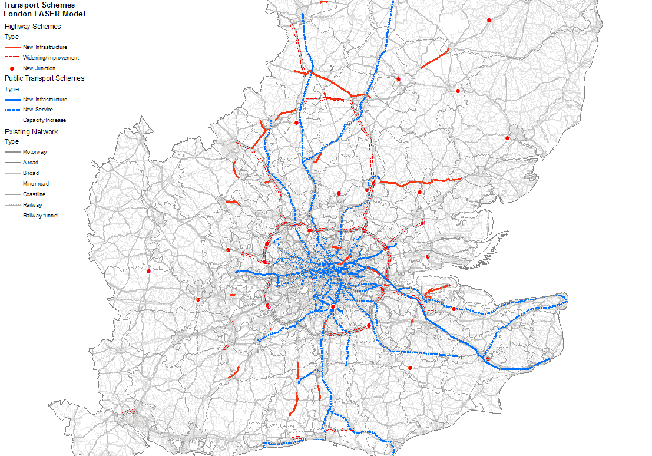
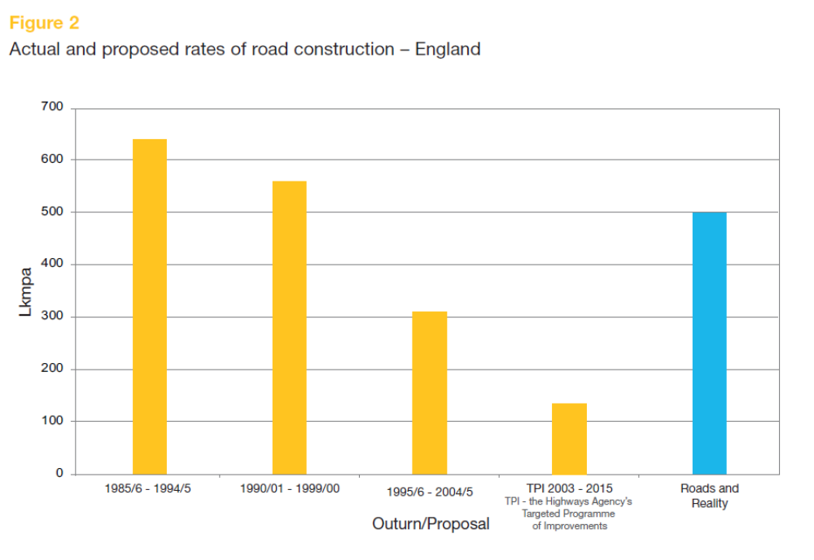
SOLUTIONS
Transport schemes to year 2016
SUSTAINABILITY OF LAND USE AND TRANSPORT IN OUTER NEIGHBOURHOODS
Estimated Trend investment beyond 2016:
£1bn/yr in highways and
£1bn/yr in rail and underground
Road capacity expansion 1985-2015
from over 600 lane km per annum
to 125 lane km per annum

Slide 8
Wider South East

Slide 9
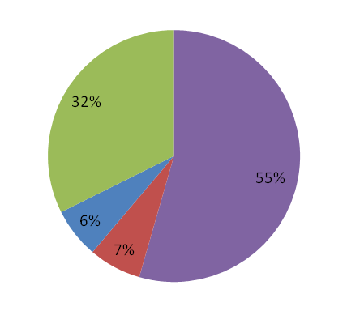
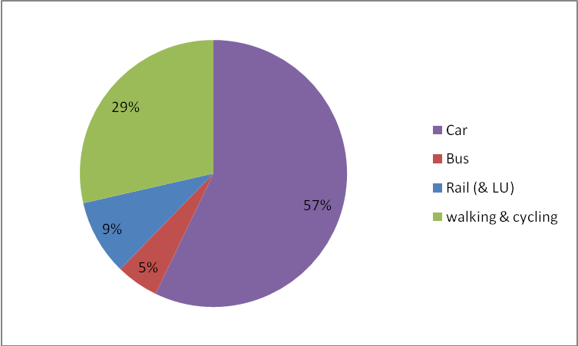
Transport modelling results
No. of person trips
No. of car
trips
1997 2031
WSE
+ 26%
+ 32%
Increase in the modal share of car trips 55% to 57%
Average trip distances increase from:
9.5 to 11.6km in WSE (12.4 to 13.5km for car trips)

Slide 10
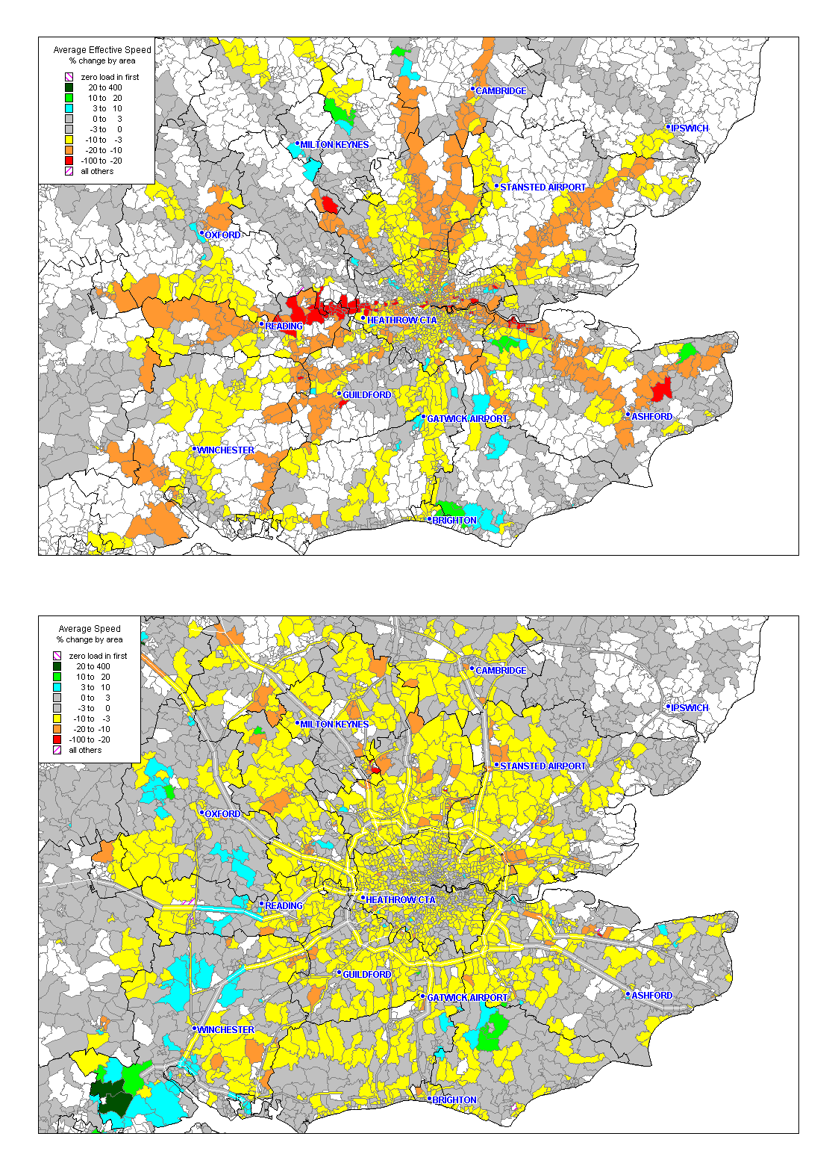
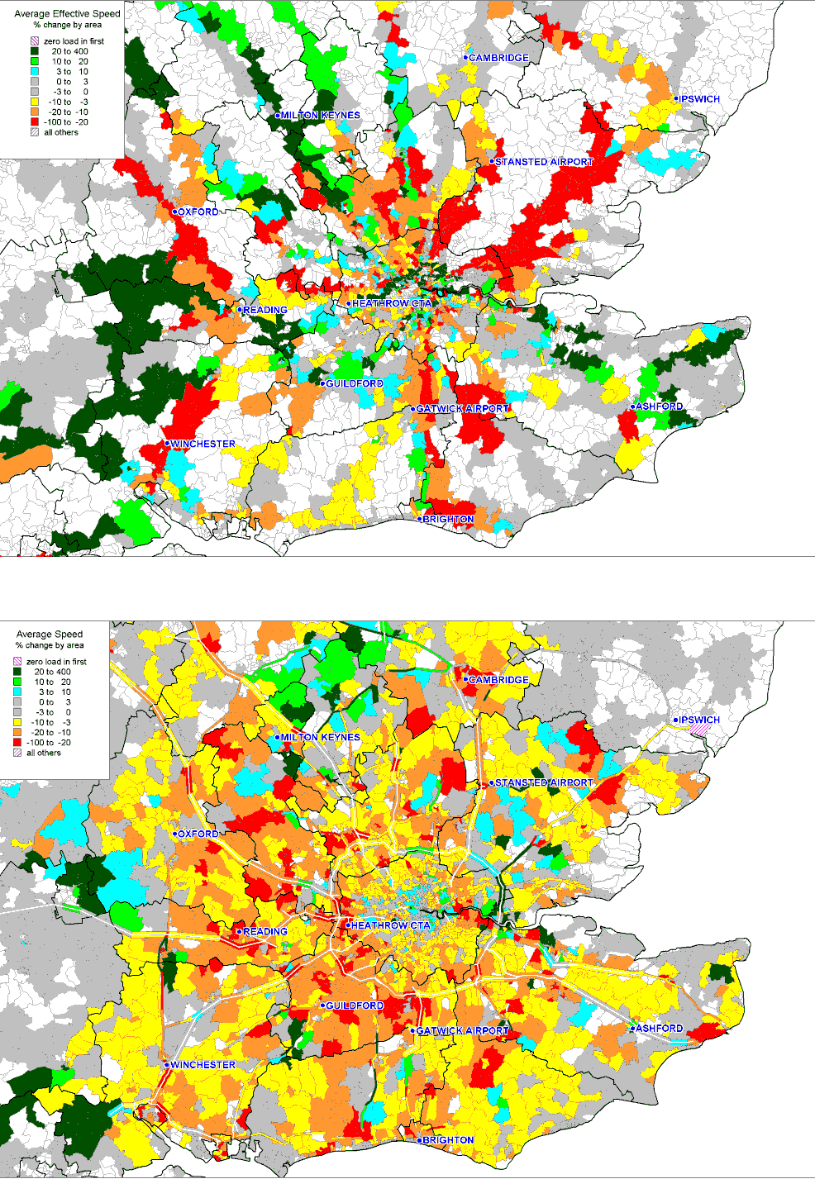
SOLUTIONS
Trend simulation 1997-31 resulting congestion
SUSTAINABILITY OF LAND USE AND TRANSPORT IN OUTER NEIGHBOURHOODS
Rail comfort is an aggregate measure of level of service and crowding
1998 - 2016
2016 - 2031

Slide 11
SOLUTIONS
SUSTAINABILITY OF LAND USE AND TRANSPORT IN OUTER NEIGHBOURHOODS
The economic effects of continuing with present policies:
Lead to higher costs of living and production for basic industry and non-working households, about £30 billion per annum due to insufficient supply of new dwellings and transport congestion. These costs would reduce competitiveness.
The social effects of continuing with present policies:
In Greater London there could be a substantial increase in crowding because higher density development results in smaller homes, fewer houses and more flats. The cost of housing could rise by 26% due to insufficient supply of dwellings and transport cost could increase living costs by around 14%.
The environmental effects of continuing with present policies:
Despite a substantial increase in rail patronage car kilometres travelled in the South East could rise by 43 per cent.
Fuel consumption could rise by around 30% due mainly to increases in travel distance and traffic congestion.
  Total carbon dioxide emissions could increase by 34%. Such increases would make it difficult for the government to achieve its targets for CO₂ reduction.

Slide 12
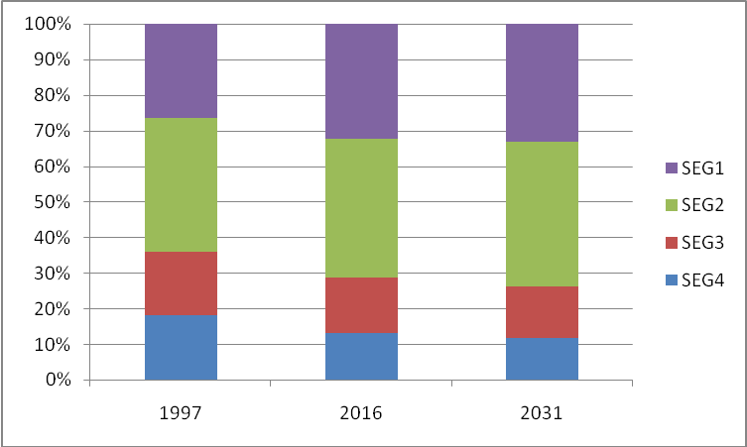
SOLUTIONS
SUSTAINABILITY OF LAND USE AND TRANSPORT IN OUTER NEIGHBOURHOODS
Active Household Socio Economic Group (%)
1997-2031 South East
Shifts to a service economy:
Fewer industrial and more service jobs.
Socio-economic shift, leads to increases in the numbers of people in professional and clerical occupations
  Results in greater mobility and demands for larger owner-occupied homes.
  Current financial set-backs are, of course, affecting employment and the housing market but are not expected to alter this long term trend towards service employment.

Slide 13


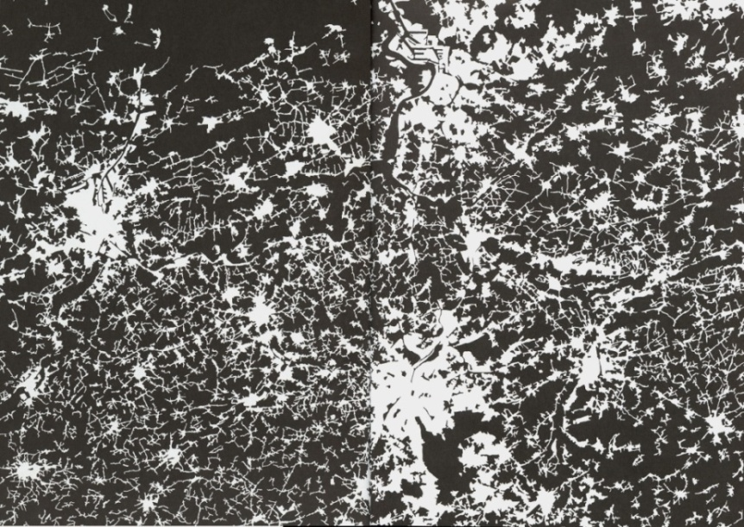
Overview: Spatial design options
Compaction
(Rogers)
Edge
Planned
Extensions
London Region
(Corine land cover maps European Environment Agency)
Flemish Region
Corridor
New settlements
Free market
(Barker)
ReVISIONS
Regional Visions of Integrated Sustainable Infrastructure Optimised for Neighbourhoods

Slide 14
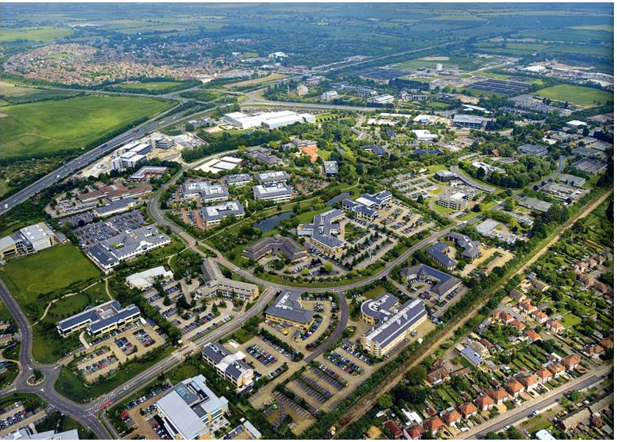
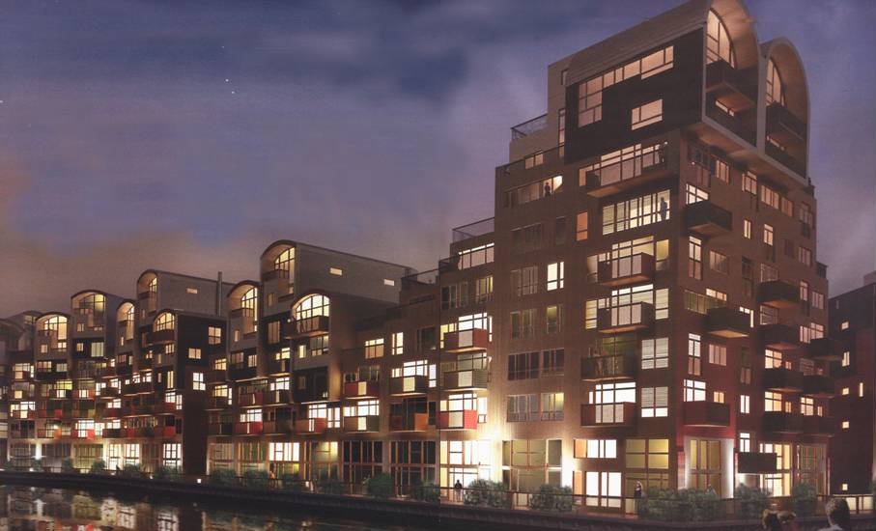
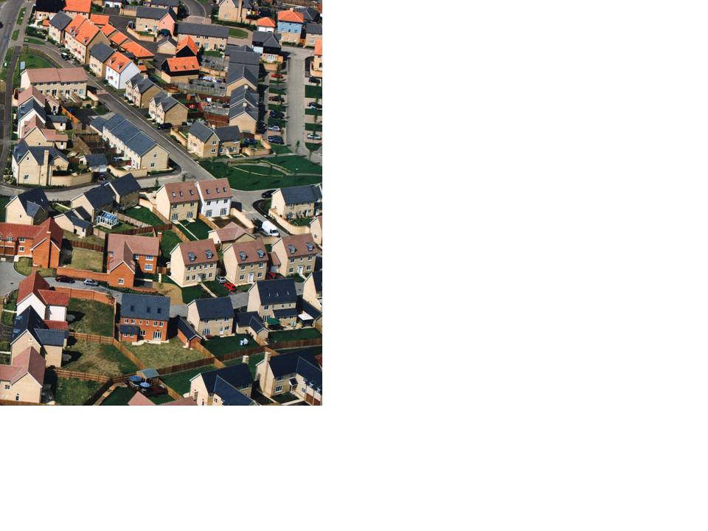
Slide provided by Dr. Tony Hargreaves
Spatial planning policy and urban form
Sustainability potential when considering;
travel, energy, water and waste?
(photographs from Harrison, 2008).
Urban form affects
Settlement size
Clustering
Density
To estimate potential of ‘green technologies’ we need to represent the variation of buildings and patterns

Slide 15
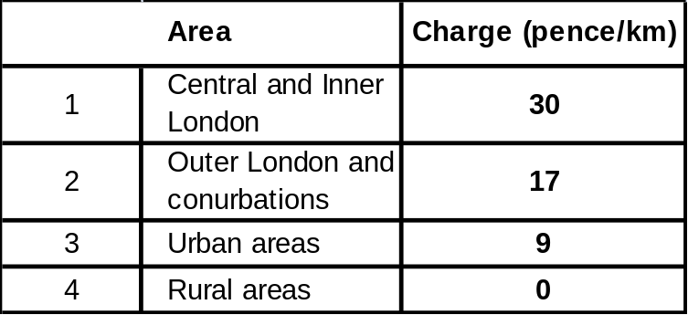
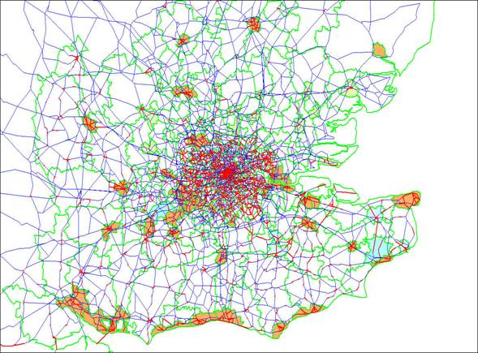
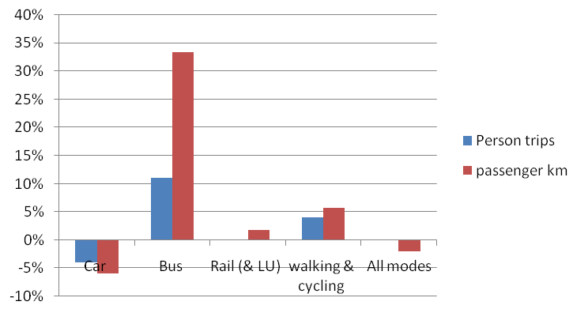
Road User Charging sensitivity test
WSE

Slide 16
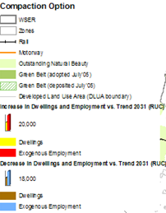
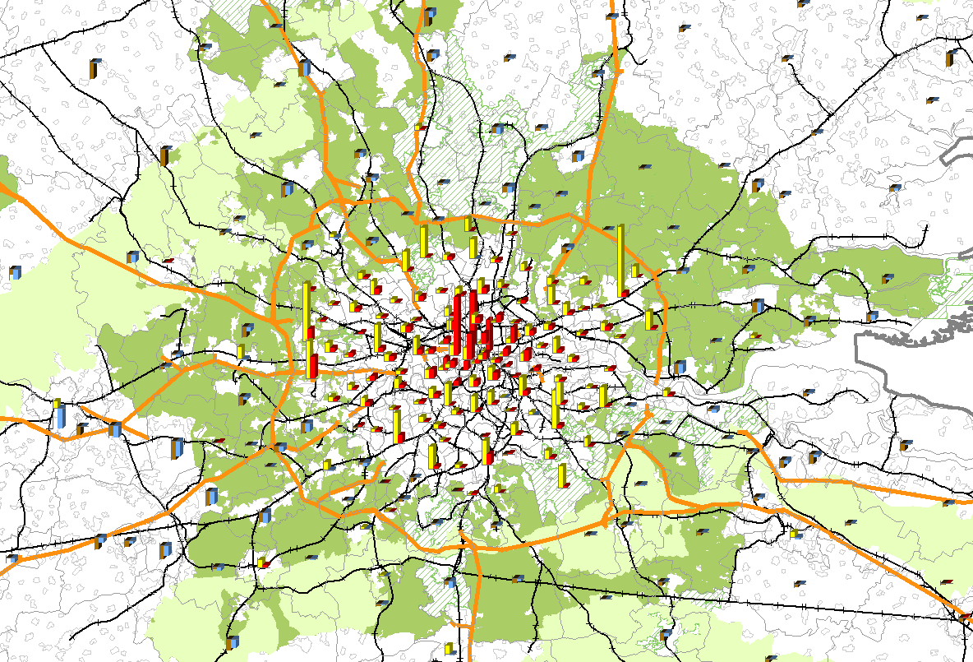
WSE
Compaction Option

Slide 17
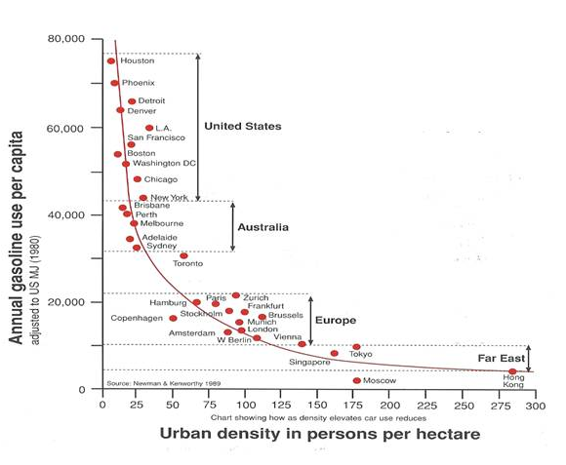
SOLUTIONS
Compact city: Newman & Kenworthy
SUSTAINABILITY OF LAND USE AND TRANSPORT IN OUTER NEIGHBOURHOODS
Theory: causal argument
  Higher density reduces transport energy
Reality: causal argument
  Lower transport cost reduces density

Slide 18
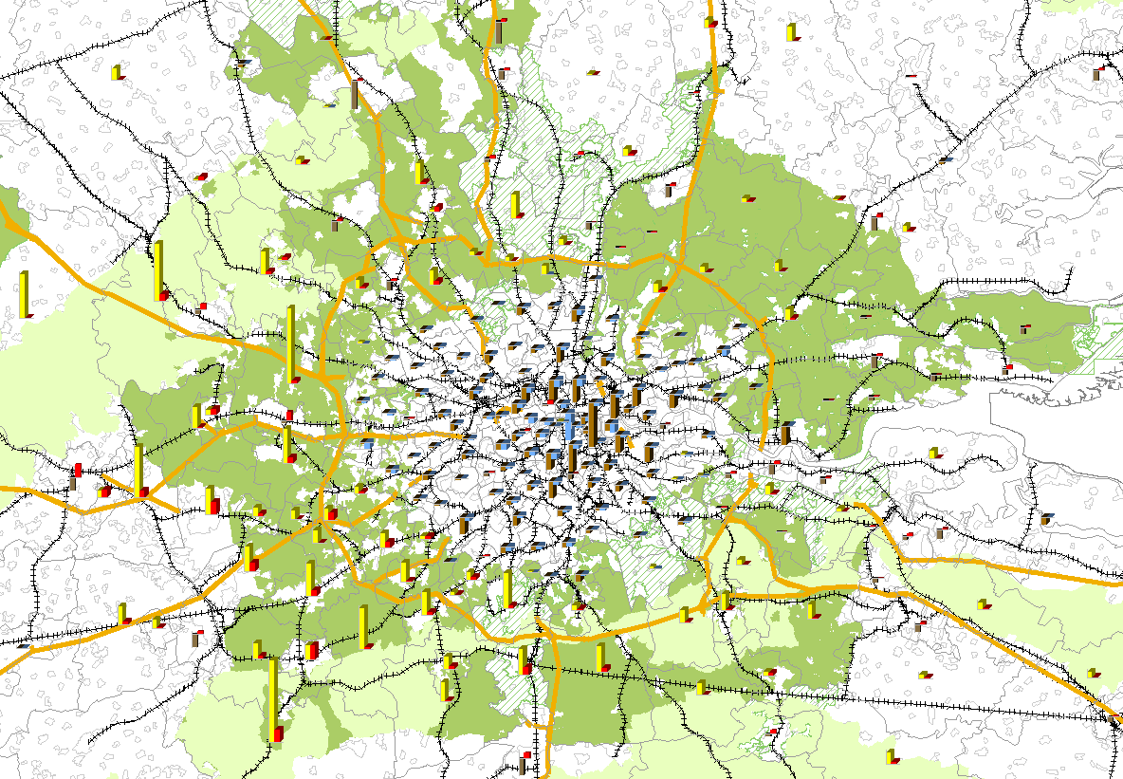
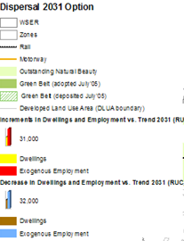
WSE
Dispersal Option
Assumes a relaxation of greenbelt constraints

Slide 19
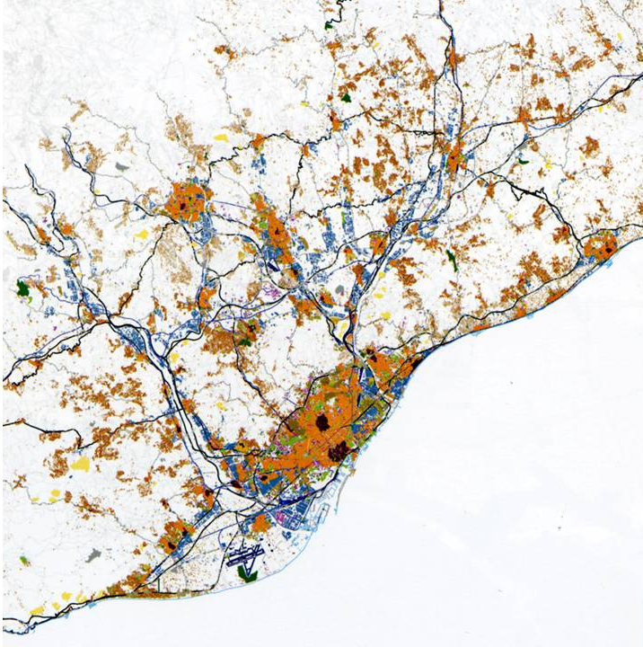
Dispersal: Barcelona
Highest urban density in Europe
Increase in mobility
  Car ownership
  Motorways (tunnels)
Dispersal
Reduction of density

Slide 20
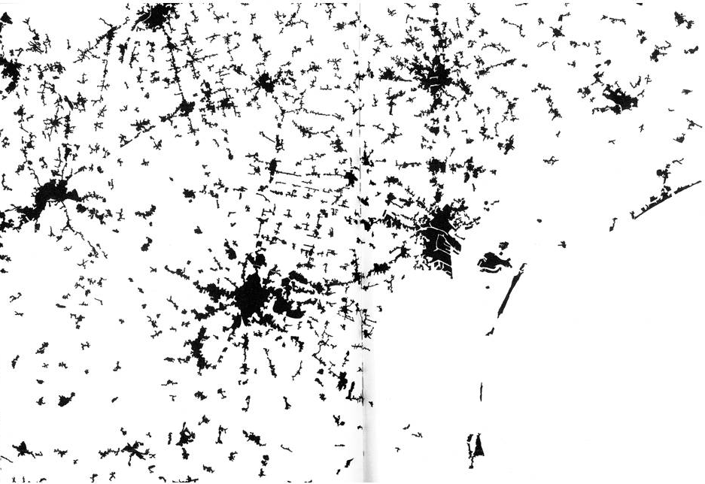
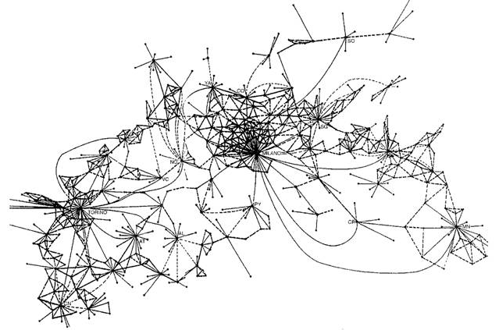
Dispersal of cities in Italy
Veneto
  Venice, Mestre,
  Padua, Treviso,
  Vicenza
  Dispersing
Padania cities
  Milan, Turin
  Polycentric structure
  Dispersing
High mobility and lower density

Slide 21
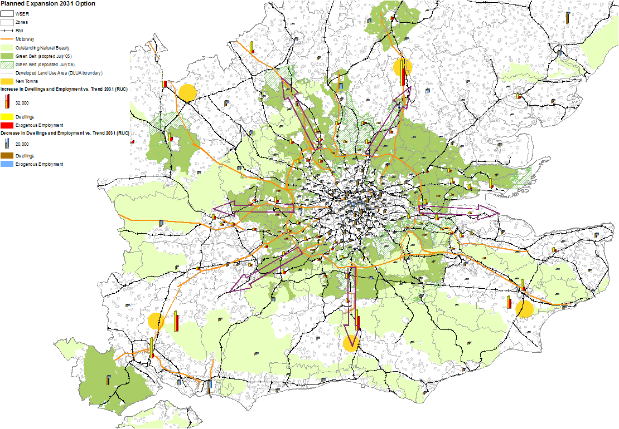

WSE
Expansion Option
Diagrammatic Corridors
Relaxation of green belt constraints in transport corridors around London
and for new settlements

Slide 22
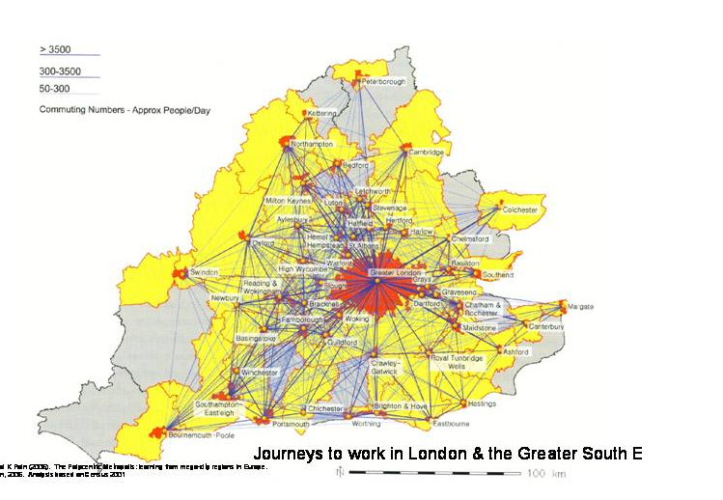
London & WSE:
emerging polycentric structure

Slide 23
WSE
Comparison of the options
on socio-economic costs
Against the trend in 2031

Slide 24
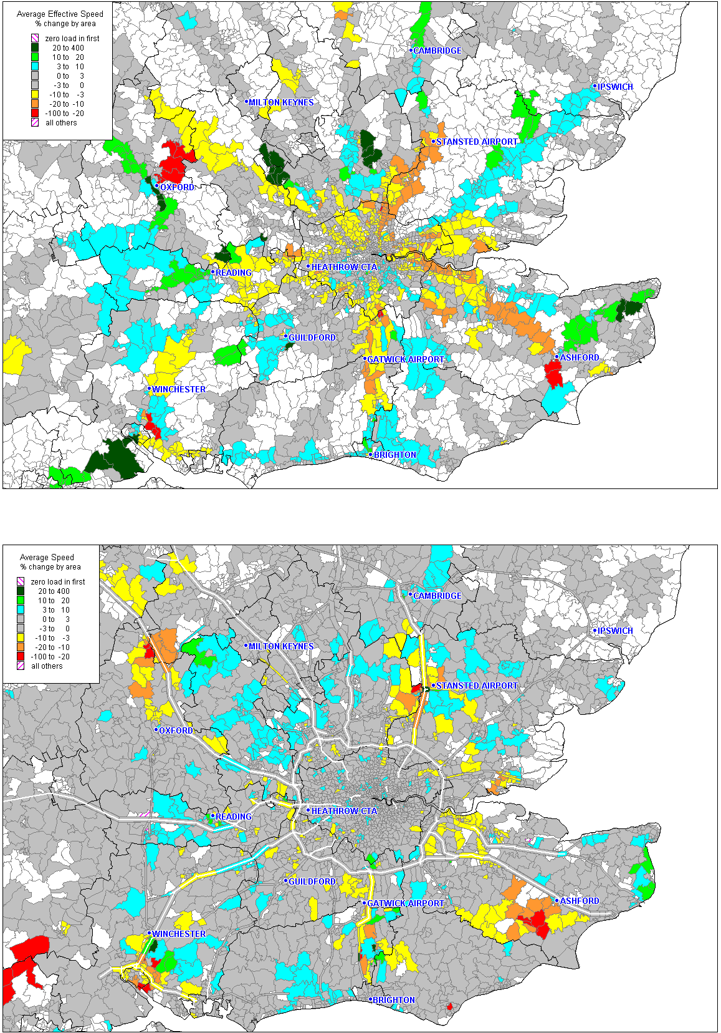
Congestion compared to the Trend 2031
Rail
Rail
Road
Compact City
Dispersal
Expansion

Slide 25
SOLUTIONS
SUSTAINABILITY OF LAND USE AND TRANSPORT IN OUTER NEIGHBOURHOODS
Overall conclusions
Relatively small differences between the three land use options are overwhelmed by rising incomes, a shift from manufacturing to service employment and other socio-economic trends.
Current strategic land use and transport policies have virtually no impact on long term increases in land use and energy consumption. But they do tend to increase costs and reduce economic competitiveness.
Environmental sustainability - the options have only a small effect: 5% either way.
Compact development results in a small reduction in resource use and environmental damage but has negative social and economic impacts.
Market led dispersal has a negative impact on resource use and on some of the environmental indicators but has social and economic benefits.
Planned extension lies between the other options and gains as much as dispersal option in living space and economic efficiency but with less environmental impact.

Slide 26
SOLUTIONS
SUSTAINABILITY OF LAND USE AND TRANSPORT IN OUTER NEIGHBOURHOODS
The benefits to be gained from land use and transport planning are modest
It follows that improvements to the environmental sustainability are likely to require technological improvements and behavioural changes.
  Changing behaviour would demand strong incentives or penalties and could have detrimental social and economic effects.
  Technology developments is more promising and could contribute order of magnitude reductions in CO₂ emissions from transport (King, 2007) and in buildings (MacKay, 2009).
While patterns of land use and transport policies do not, in themselves, contribute to significant changes in sustainability they do determine what technologies are practical.
  Ground source heat pumps and solar power, for instance, are most practical in relatively low density development.
  Combined heat and power is better suited to towns that are compact.
Research into the effects of spatial planning on the applicability of ‘green-technologies’ will be explored in ReVISIONS, a forthcoming EPSRC Sustainable Urban Environment research programme.

Slide 27
Overview: Model Framework
LOCATIONAL
TRANSPORTABLE
Firms & Households
Flows
Demand for land, buildings, water, energy, waste, etc.
Demand for travel,
water, energy and
waste flows, etc
DEMAND
generated
Price and disutility
Congestion, losses & costs
Buildings, space,
decentralised
infrastructure
Networks
feedback
Business floorspace
& dwellings
Transport, water, energy & waste networks
SUPPLY
Land, buildings, water, drainage, & energy
accessibility
Quantitative land use transport interaction model
(Behavioural market simulation)
ReVISIONS
Regional Visions of Integrated Sustainable Infrastructure Optimised for Neighbourhoods

Slide 28
GDP
ReVISIONS
Regional Visions of Integrated Sustainable Infrastructure Optimised for Neighbourhoods
Slide provided by Dr Vadim Grinevich
Author's own calculations using data by ONS and OBR
FORECAST
24 | 05 | 2012

Slide 29
Employment by Broad Sector
ReVISIONS
Regional Visions of Integrated Sustainable Infrastructure Optimised for Neighbourhoods
Slide provided by Dr Vadim Grinevich
Source: Author’s own estimates using EU KLEMS database
FORECAST
24 | 05 | 2012

Slide 30
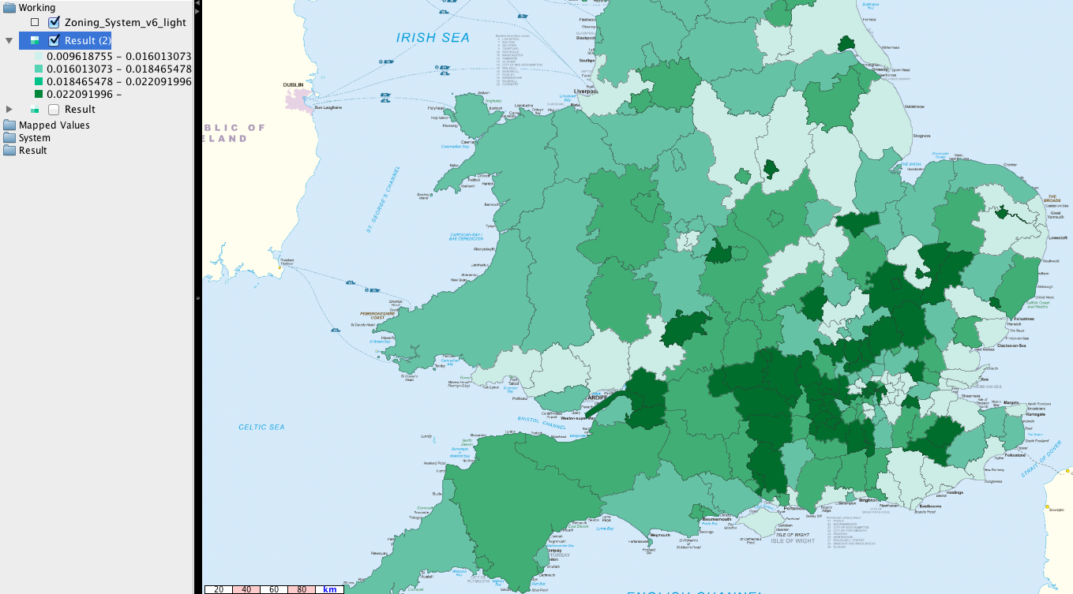
ReVISIONS
Regional Visions of Integrated Sustainable Infrastructure Optimised for Neighbourhoods
GVA per capita
Trend to 2031
Difference
Slide provided by Vassilis Zachariadis
SCENARIO COMPARISON
24 | 05 | 2012

Slide 31
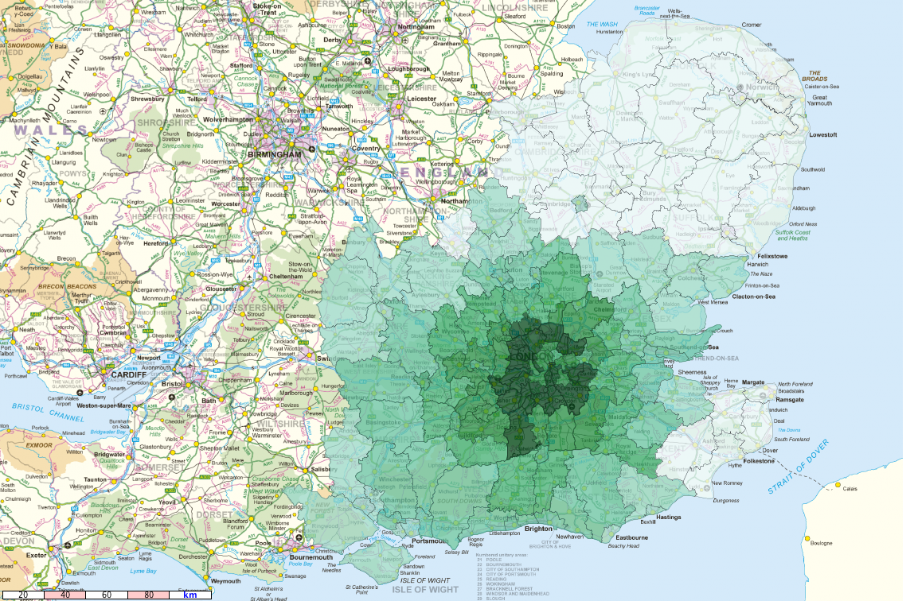
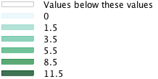
ReVISIONS
Regional Visions of Integrated Sustainable Infrastructure Optimised for Neighbourhoods
Comparison
Trend to 2031
Household Living Costs -SEC01
Difference
Slide provided by Vassilis Zachariadis
SCENARIO COMPARISON
24 | 05 | 2012

Slide 32
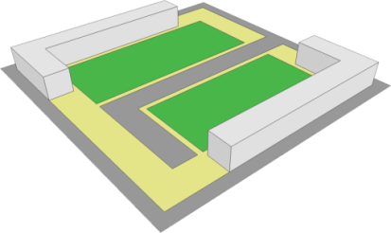
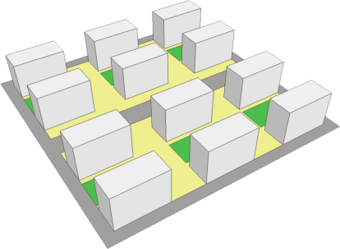
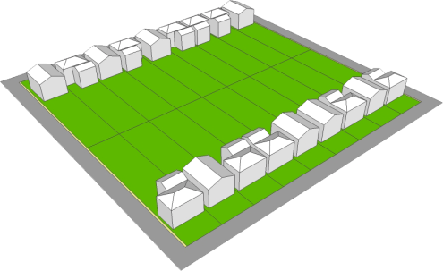
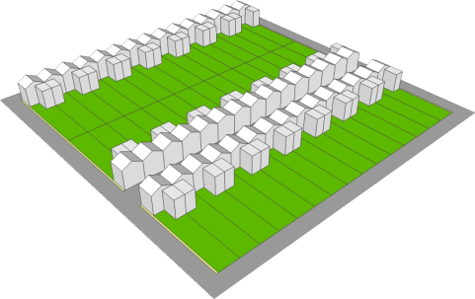
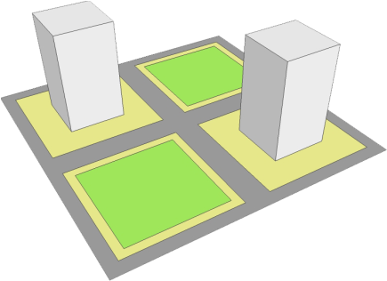
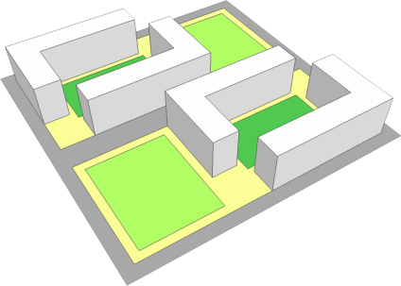
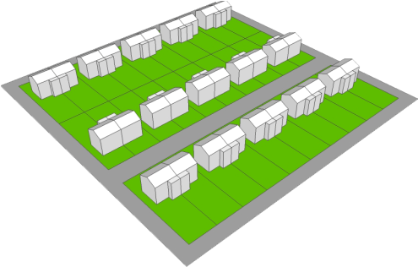
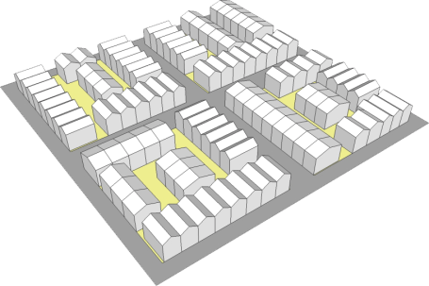
Generic Tiles, (each tile is 1 hectare)
Slide provided by Dr. Tony Hargreaves
Density of plots (dwelling per hectare)
9
20
30
50
117
220
390
460
1200
Detached House
Courtyard Flat
Slab Block
Tower Block
Terrace House
Semi-detached House
ReVISIONS
Regional Visions of Integrated Sustainable Infrastructure Optimised for Neighbourhoods

Slide 33
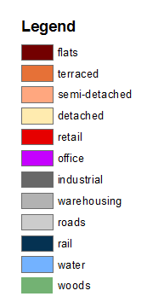
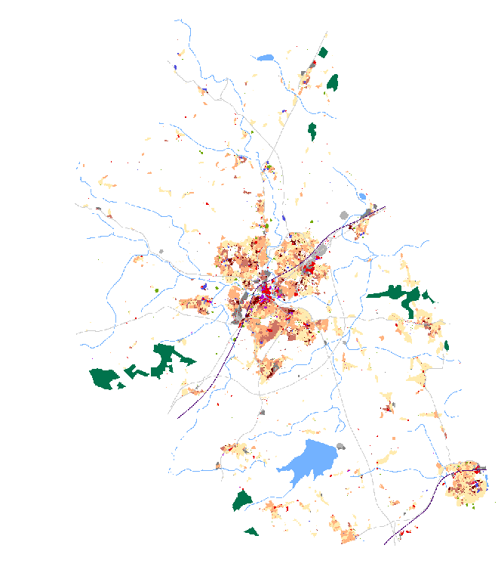
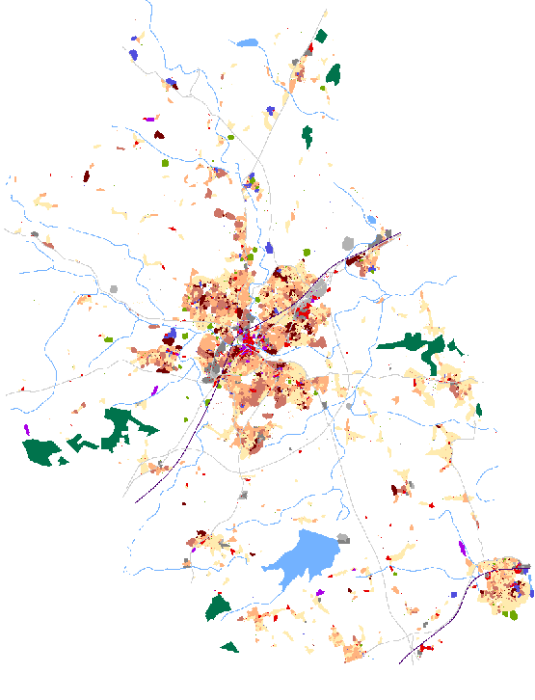
Cellular Automata modelling of Chelmsford
Slides provided by Dr Kiril Stanilov,
Department of Architecture,
University of Cambridge
2001 – existing land use
2031 – Trend land use

Slide 34

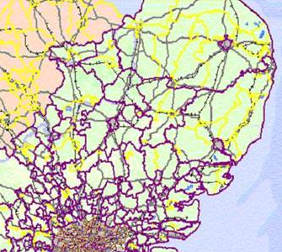

ReVISIONS
King’s Lynn
Alternative (ii)
Dispersed
Low density
Private/Public
Transport
Polycentric
Norwich
Peterborough
Thetford
Ely
Diss
Bury St Edmunds
Cambridge
Study Area
Bedford
Milton Keynes
Ipswich
Stevenage
Bishop Stortford
Luton
Colchester
St Albans
Harlow
Chelmsford
Basildon
Southend-on-sea
London

Slide 35
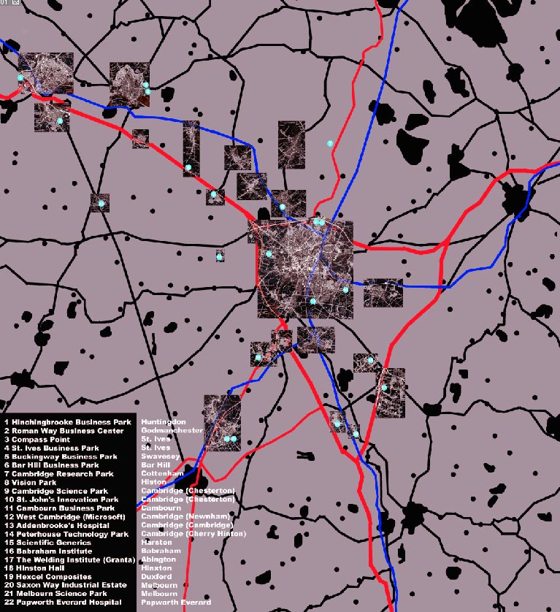
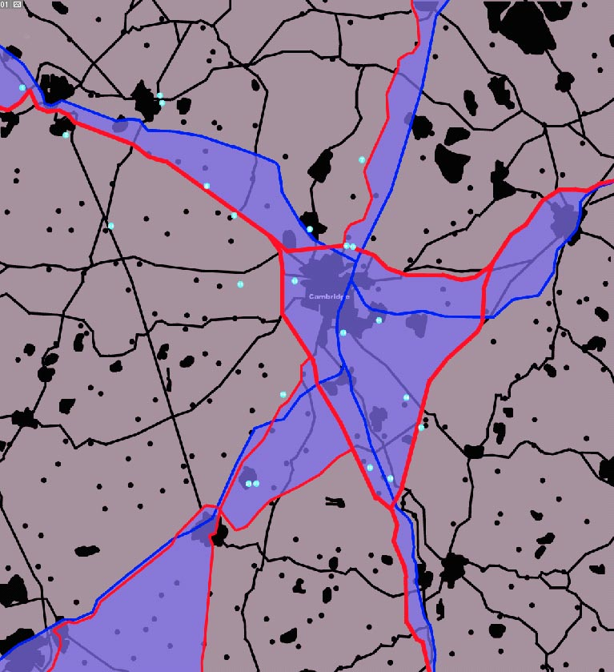

ReVISIONS
Dispersed CORRIDOR DEVELOPMENT- Cambridge Case Study
High level services
Highway
Public Transport
Office/Research Parks Development Possibility
Designing Cites of the Future

Slide 36

ReVISIONS
Eco – town
Energy micro-generation
Solar
Wind
Geo-thermal
Waste processing
Water
Harvesting
Reuse
Grey water recycling
Waste
Processed on site
Use for energy
Recycling
Transport
Local cycling/pedestrian
Long distance (regional centre by Public transport, elsewhere by car)
Materials
Renewable (e.g. timber)
Self built or kit assemblage possibilities
Designing Cites of the Future

Slide 37
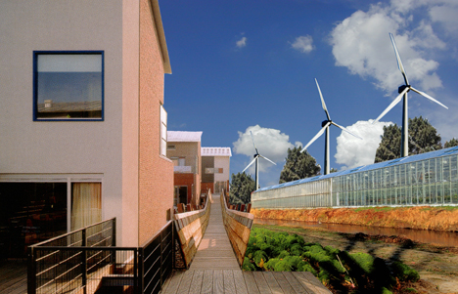
ReVISIONS
Low energy development: renewable materials, grey water, ground source, wind & solar power
Designing Cites of the Future

Slide 38
Other contributions
Dr Tony Hargreaves : Modelling built form
Dr Raziyeh Farmani : Water aspects
Professor John Nelson: Transport aspects
Dr Vicky Cheng: Energy aspects
Not included in this symposium: Waste, Assessment and Guidelines
ReVISIONS
Regional Visions of Integrated Sustainable Infrastructure Optimised for Neighbourhoods

Slide 39
ReVISIONS
Regional Visions of Integrated Sustainable Infrastructure Optimised for Neighbourhoods
Thank you
www.regionalvisions.ac.uk
Sao Paulo International Symposium, USP, June 2012

