Slide 1
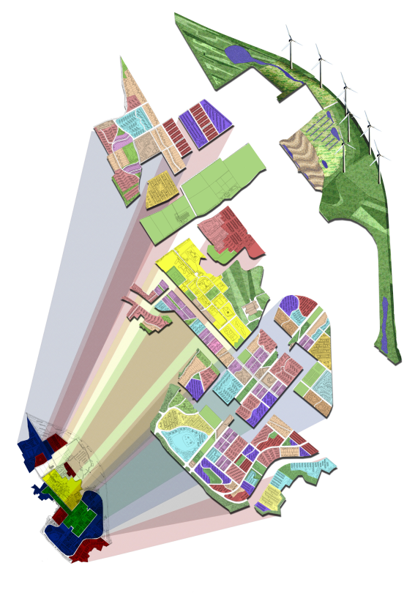




ReVISIONS
Regional Visions of Integrated Sustainable Infrastructure Optimised for Neighbourhoods
ReVISIONS research project
Modelling and perspectives
Tony Hargreaves
International Symposium, Sao Paulo, 18th June 2012

Slide 2


ReVISIONS
Overview: Method
Regional Visions of Integrated Sustainable Infrastructure Optimised for Neighbourhoods
REGIONAL
CASE STUDIES
SYSTEMATIC
OPTION DESIGN
Strategic
Trend
Compaction
Dispersal
Expansion
Local
Economies of scale
Decentralised services
Retrofit & new build
ASSESSMENT
(Indicators)
Economic
(Net benefit & feasibility)
Social Equity
(Distribution)
Environmental
(Protection)
Resources
(use)
ANALYTICAL TOOLS
Integrated quantitative
Modelling framework
(Forecasting)
Stakeholders/Researchers
GUIDANCE

Slide 3

ReVISIONS
Regional Visions of Integrated Sustainable Infrastructure Optimised for Neighbourhoods
Overall Integrated Modelling Framework
Spatial Planning Policy option
Spatial demand per activity
Demands
Supply
Heat
Supply
Demands
Exports
Regional characteristics
(climate, soil topography, etc)
Energy conversion
Power
Infra-structure selection module
Buildings
Space
Socio-economic location choice module
Demographics
Water services
Clean water
Investments
Grey water
Transport
Travel
Public sector
Waste services
waste
Technology scenario
Supply characteristics (costs & emissions)

Slide 4

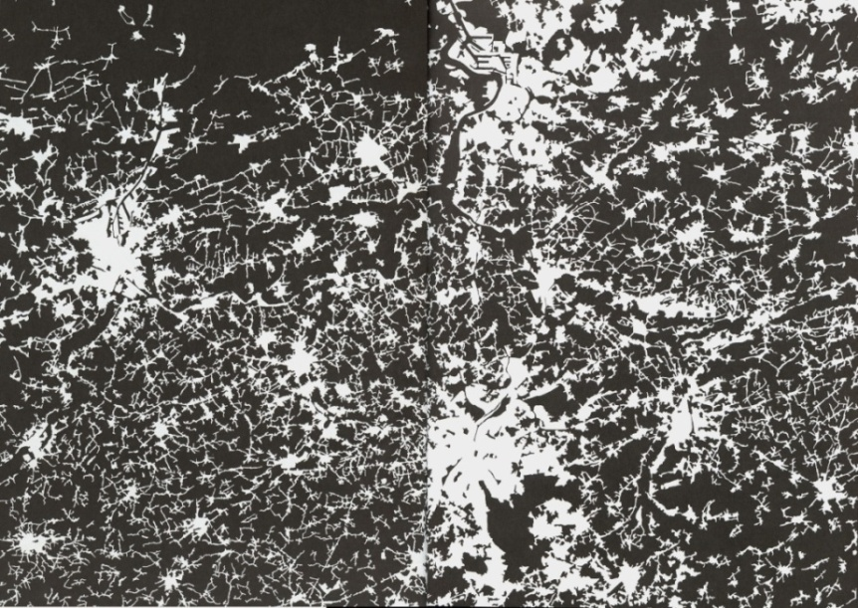
Overview: Spatial design options
Compaction
(Rogers)
Edge
Planned
Extensions
London Region
(Corine land cover maps European Environment Agency)
Flemish Region
Corridor
New settlements
Free market
(Barker)
ReVISIONS
Regional Visions of Integrated Sustainable Infrastructure Optimised for Neighbourhoods

Slide 5
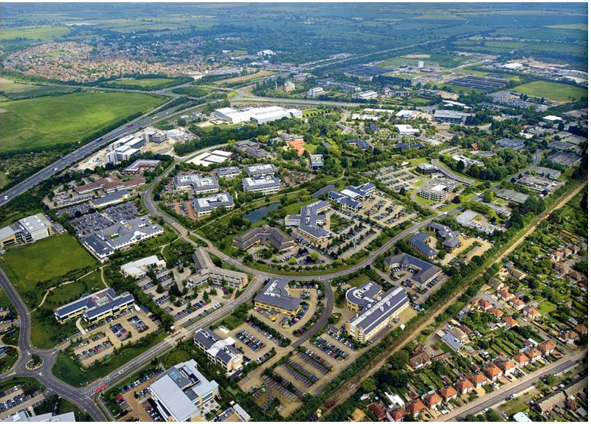
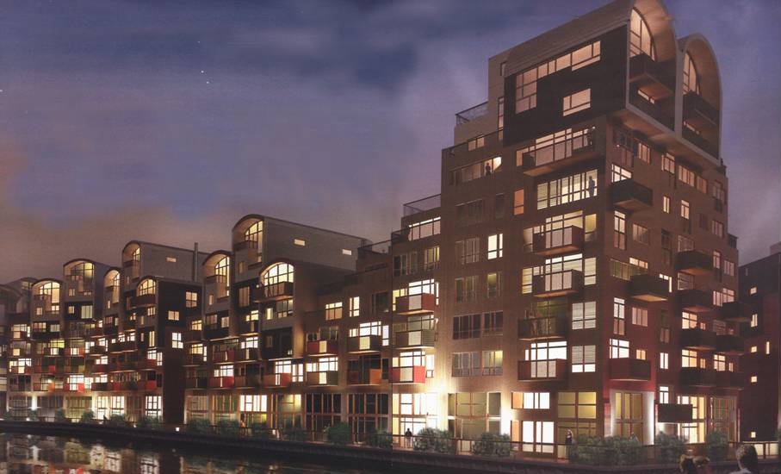
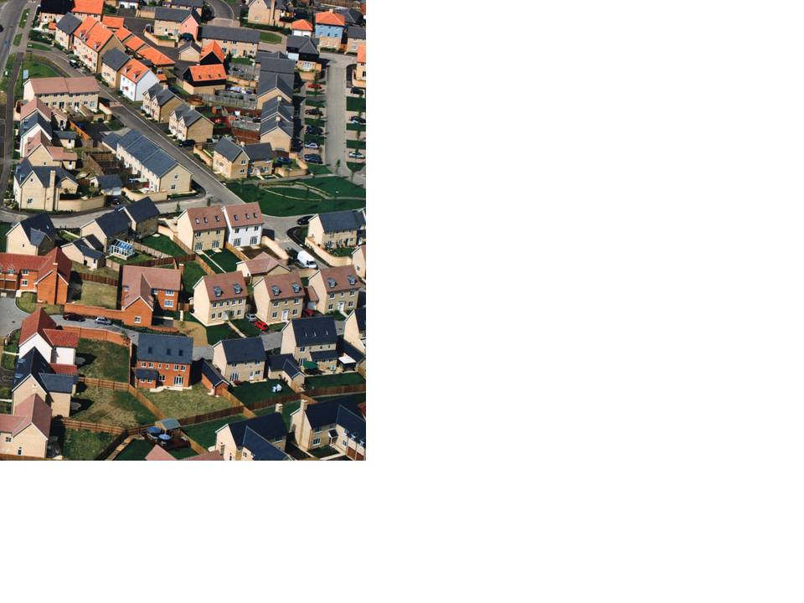
Spatial planning policy and urban form
Sustainability potential when considering;
travel, energy, transport, water and waste?
(photographs from Harrison, 2008).
Urban form affects
Settlement size
Clustering
Density
To estimate potential of ‘green technologies’ we need to represent the variation of buildings and patterns

Slide 6
ReVISIONS
Regional Visions of Integrated Sustainable Infrastructure Optimised for Neighbourhoods
The land scenarios
Trend: government population, household and employment forecast. Location of development at Ward level will aim to represent the Local Development Framework policies in the case study areas.
Market led: assumes a greater release of land in areas with pressure growth. Greater release of green field land but outstanding natural beauty areas would be protected.
Compaction: only previously developed land in urban centers with good public transport accessibility considered for development.
Planned settlements and urban expansion: This is similar to the market led option but planned to avoid sprawl and settlements large enough for self containment
Scenarios

Slide 7
Technology scenarios
ReVISIONS
Regional Visions of Integrated Sustainable Infrastructure Optimised for Neighbourhoods
These fall into three main categories:
Trend – continuation of current rates of introduction and investment
Environmental – emphasis on achieving environmental targets. This favours green technologies that achieve the greatest potential for reducing environment impacts.
Austerity – emphasis on cost effectiveness. This assumes that there will be less funding for subsidies and major investment schemes and imported materials become more expensive.

Slide 8
Forecast years and Independent scenarios
ReVISIONS
Regional Visions of Integrated Sustainable Infrastructure Optimised for Neighbourhoods
Forecast years
  Base year 2001
  Main forecast year 2031
  Less detailed forecasts to 2051
Climate
  UKCP medium emissions 90% probability scenario
Economic growth
  OBR ‘lost decade’ forecast
  OBR central forecast

Slide 9
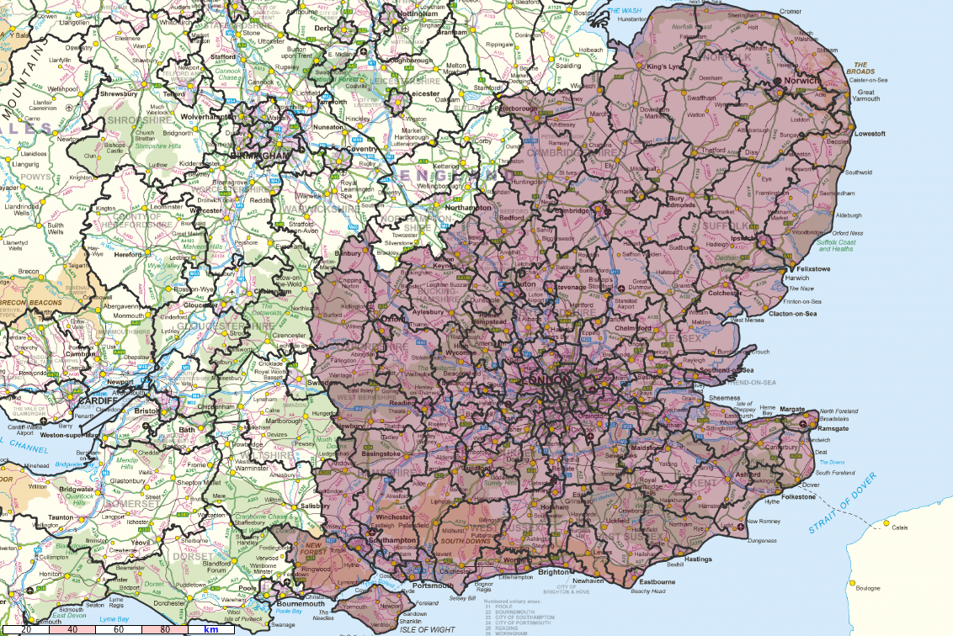
District scale land use model zones
ReVISIONS
Regional Visions of Integrated Sustainable Infrastructure Optimised for Neighbourhoods
Implementation

Slide 10
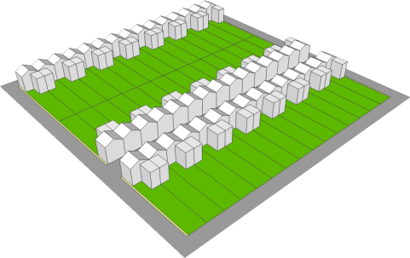
Converting District forecasts into built form per Ward
For the 2001 Base year
The mix of dwellings and average densities come from the Census and General Land Use Database mapping
Use English House Condition Survey to estimate the density distribution per dwelling type
Approximate these distributions using a mixture of discrete 1 ha tiles
This provides an account of the building stock per Ward.
The tiles include the building and plot dimensions, and the demands and supply characteristics for energy water and waste
For the forecast year
Estimate the average densities of development per District using land inputs and Land Use model household and employment forecasts
Estimate the mix of building types using the frequency distributions established from the base year data
Output the tiles to represent the future building stock
A similar method is used for non-domestic buildings based on
Valuation Office Agency data

Slide 11

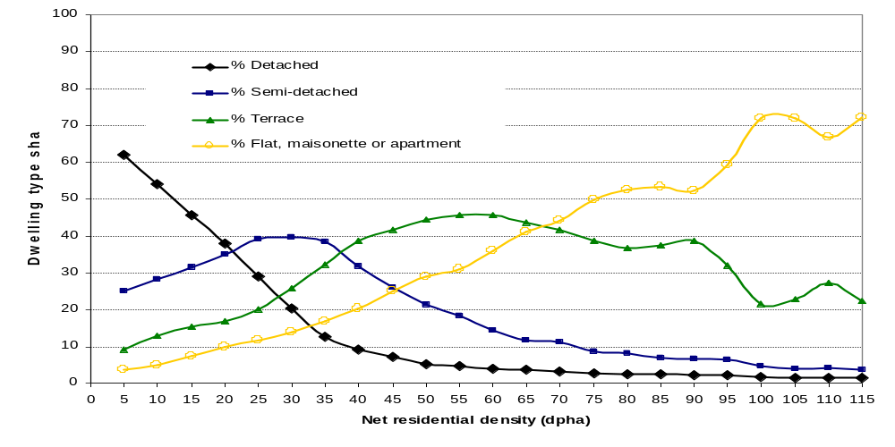
English House Condition Survey dwelling
and area type data categories
Average mix of dwelling types versus net density (Census & GLUD)
Dwelling Type
1 | End terrace
2 | Mid terrace
3 | Semi detached
4 | Detached
5 | Bungalow
6 | Converted flat
7 | Purpose built flat, low rise
8 | Purpose built flat, high rise
Nature of Area
1 |  | Urban - commercial city / town centre
2 |  | Urban - urban
3 |  | Urban - Suburban residential
4 |  | Rural - rural residential
5 |  | Rural - village centre
6 |  | Rural - rural
Rural Urban Morphology (COA)
1 |  | Urban > 10k
2 |  | Town and fringe
3 |  | Village
4 |  | Hamlet & isolated dwellings
Distribution of densities of a given dwelling and area type
ReVISIONS
Regional Visions of Integrated Sustainable Infrastructure Optimised for Neighbourhoods

Slide 12
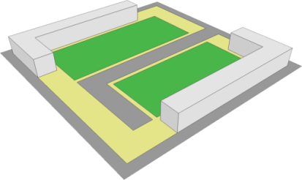
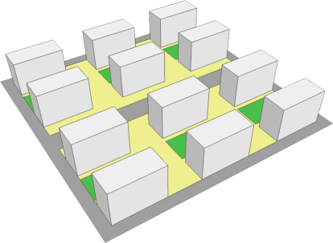
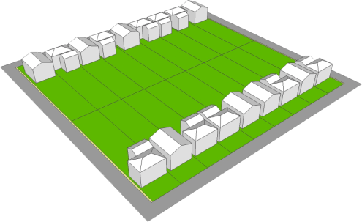
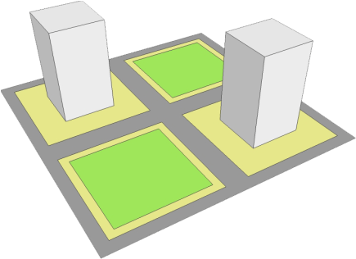
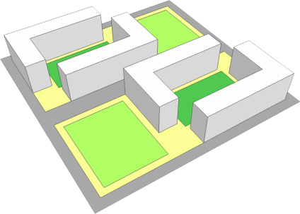
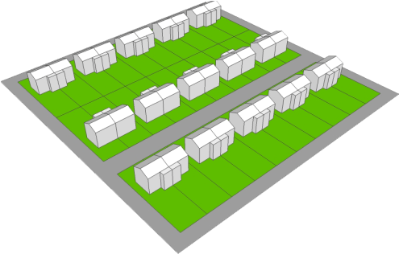
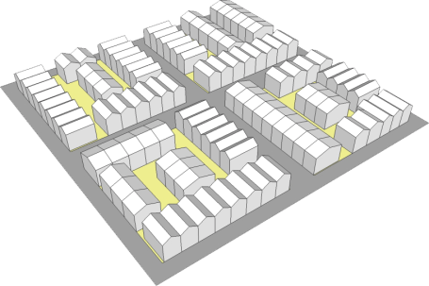
Generic Tiles, (each tile is 1 hectare)
Density of plots (dwelling per hectare)
9
20
30
50
117
220
390
460
1200
Detached House
Courtyard Flat
Slab Block
Tower Block
Terrace House
Semi-detached House
ReVISIONS
Slide provided by Dr. Vicky Cheng
Regional Visions of Integrated Sustainable Infrastructure Optimised for Neighbourhoods

Slide 13
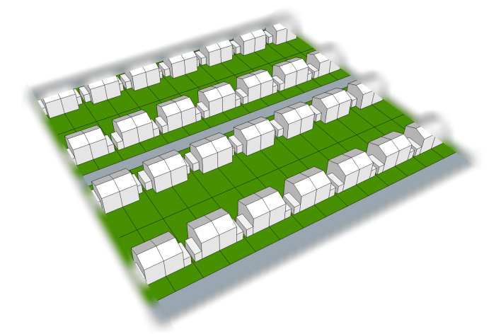
Generic Tiles Dataset
Tile S4: Semi-detached
Gross Density (dph) | 41.7
Net Density (dph) | 60.0
Floor area (m²) | 85
Building height (m) | 6 (2 storeys)
Land Use (%) | Domestic building Domestic garden Greenspace Road and path Other land | 20.04 49.68 0 30.28 0
Domestic energy demand (kWh/year/dwelling) | Space heating Water heating Cooking – gas Cooling – electricity Electrical appliances Lighting Total | 8780 1846 627 385 2036 506 14180
ReVISIONS
Slide provided by Dr. Vicky Cheng

Slide 14
Purpose of the tiles
ReVISIONS
Regional Visions of Integrated Sustainable Infrastructure Optimised for Neighbourhoods
The range of building types is represented by the mix of tiles
The tiles encapsulate the demand and decentralised supply
characteristics for energy, water and waste.
Supply characteristics depend on the area type, technology
scenario and whether buildings are as existing, retrofitted,
intensification or new build.
Spatial planning options change the land inputs to the land use
District scale model and this affects the density of households and
employment and therefore the mix tiles at neighbourhood scale.
The demand and supply characteristics are automatically
recalculated and aggregated based in area type and tile type for
each scenario.

Slide 15
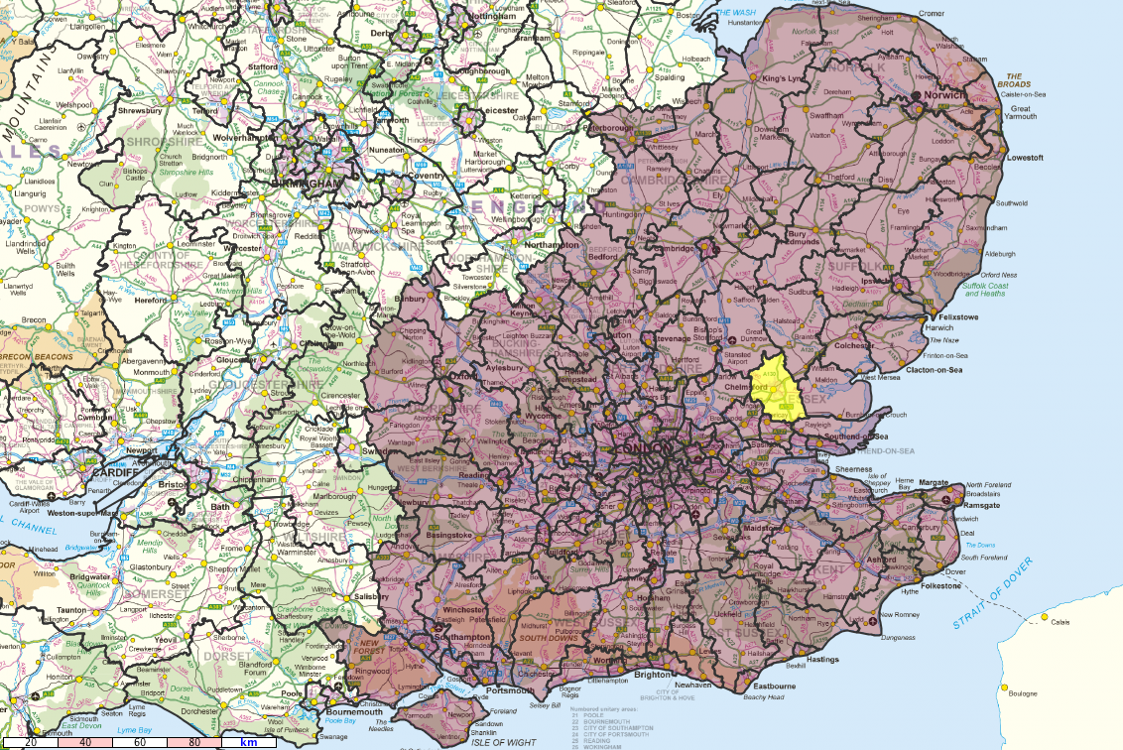
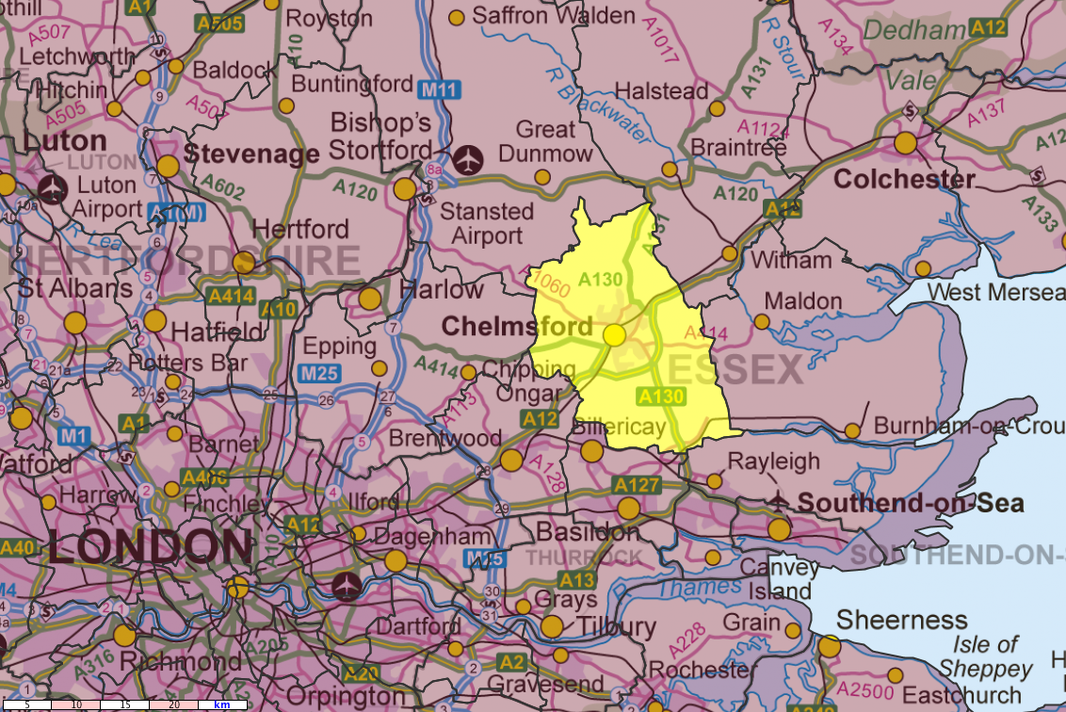
ReVISIONS
Regional Visions of Integrated Sustainable Infrastructure Optimised for Neighbourhoods
Chelmsford
URBAN FORM
24 | 05 | 2012

Slide 16
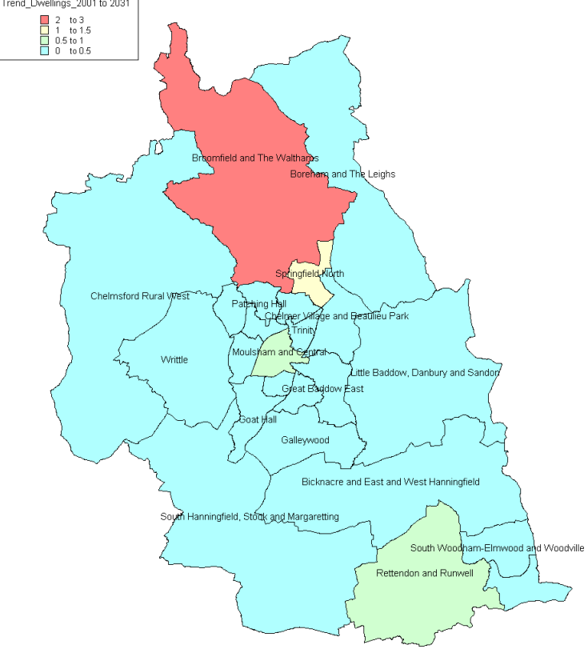
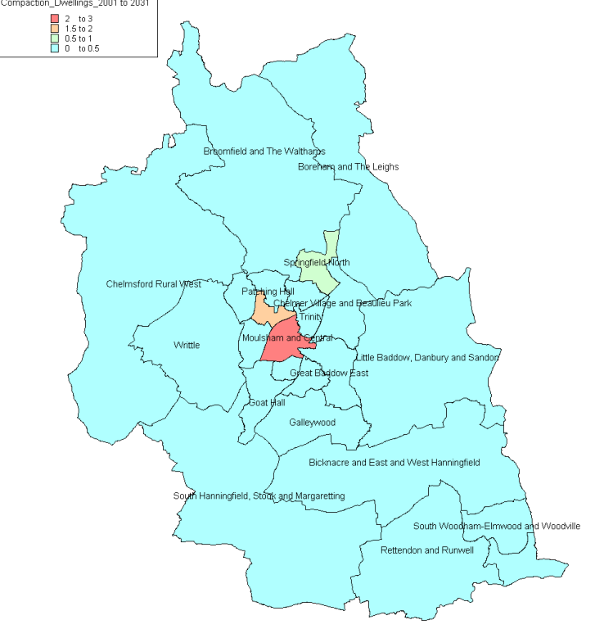
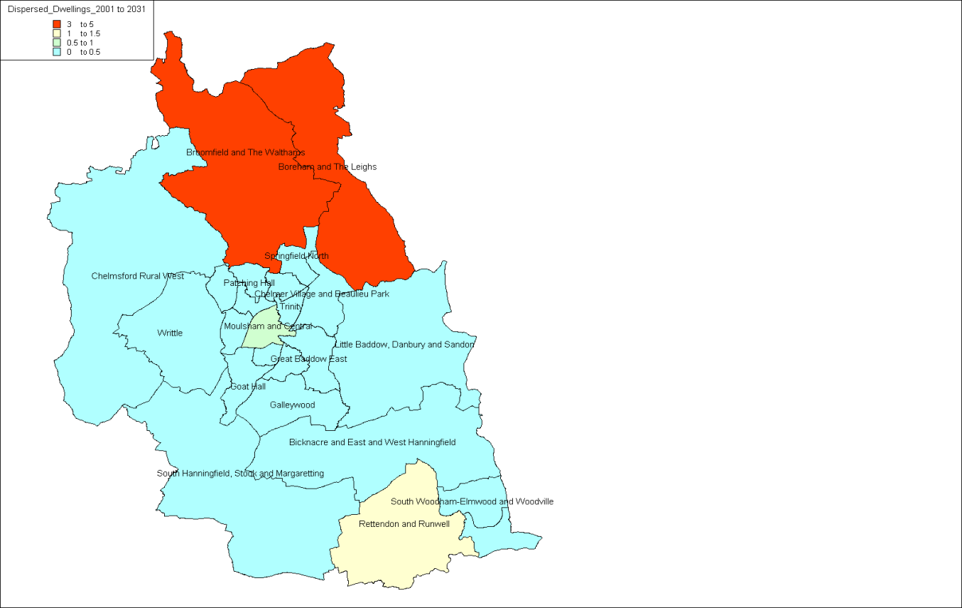
ReVISIONS
Regional Visions of Integrated Sustainable Infrastructure Optimised for Neighbourhoods
Increase from 2001 to 2031
(1=100%)
Trend
Compact
The dwellings are targeted for each spatial policy are based on local planning policy informed by the Office for National Statistics Ward categories, (simplified into Central, Urban, Suburban and Rural)
Market led

Slide 17
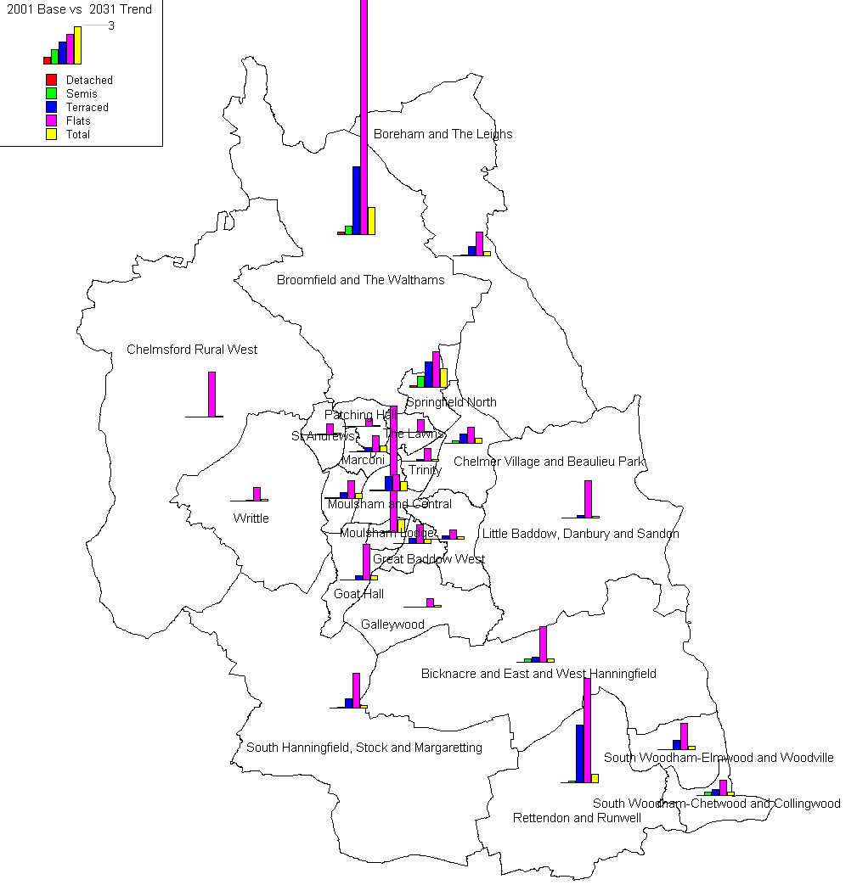
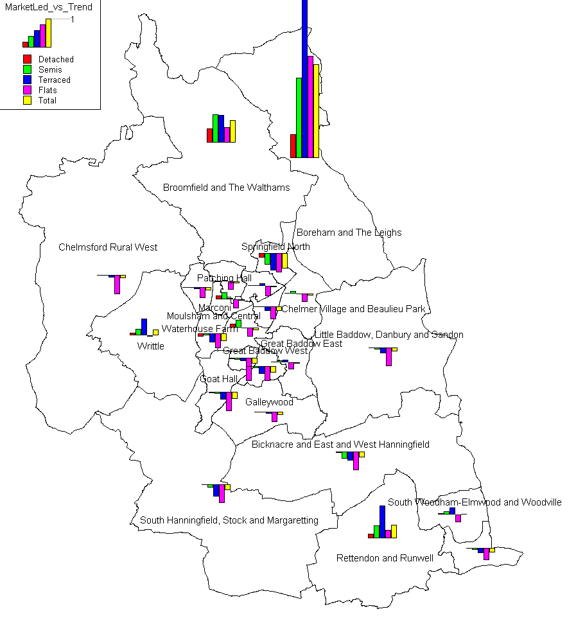
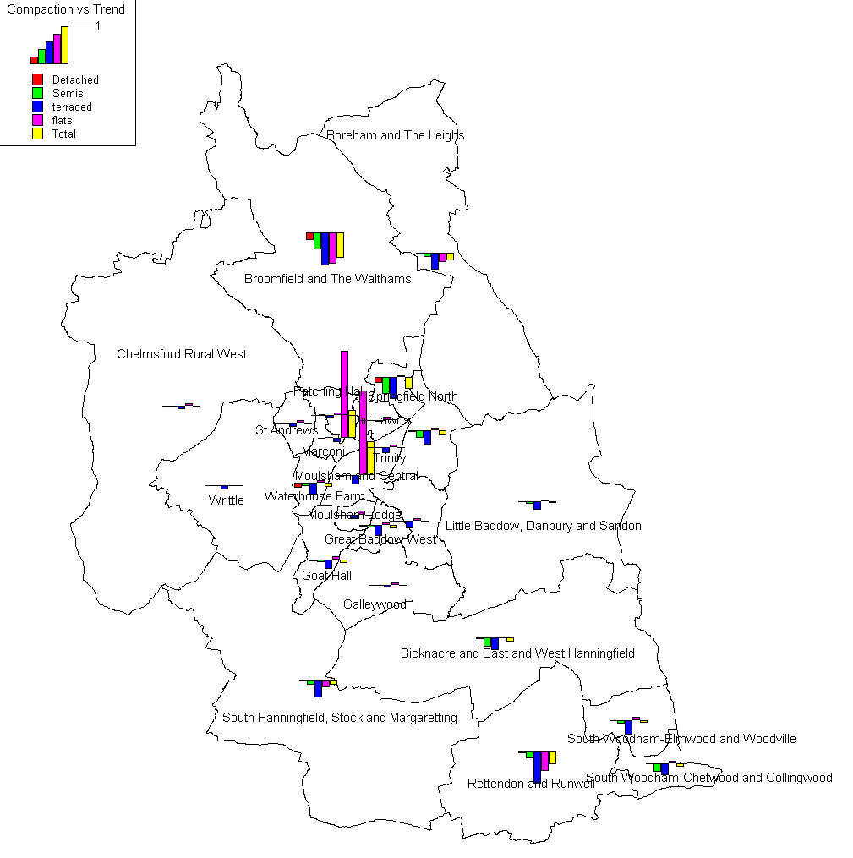
Proportional changes in dwellings by type
2031 Trend vs 2001 Base year
Market Led vs Trend
Compaction vs Trend

Slide 18
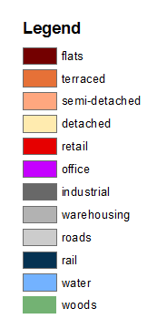
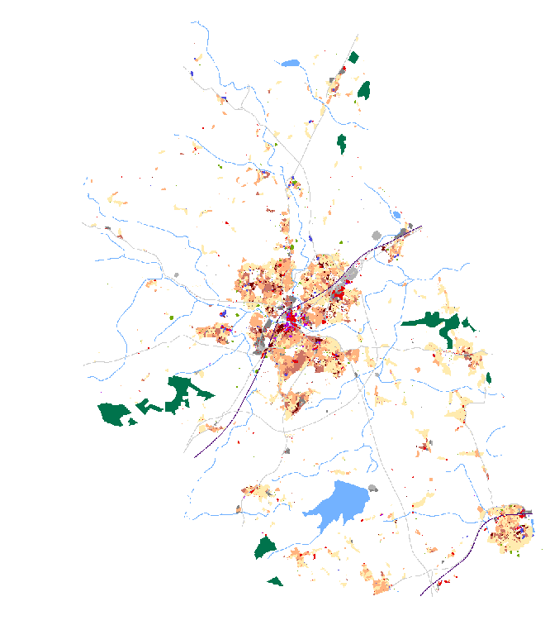
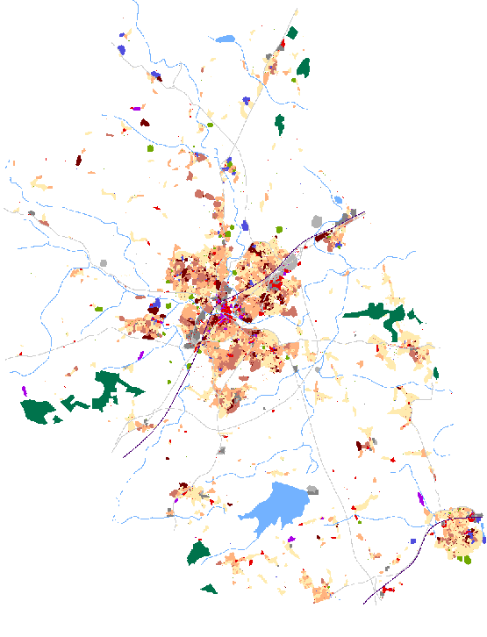
Cellular Automata modelling of Chelmsford
Slide provided by Dr Kiril Stanilov,
Department of Architecture,
University of Cambridge
2001 – existing land use
2031 – Trend land use

Slide 19
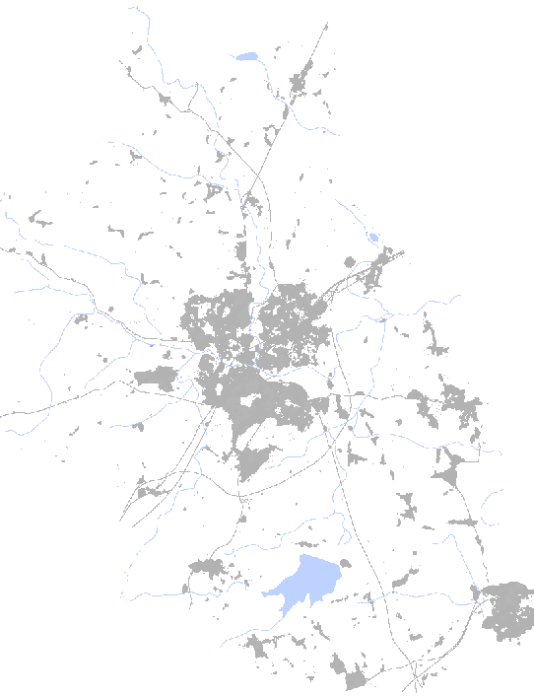
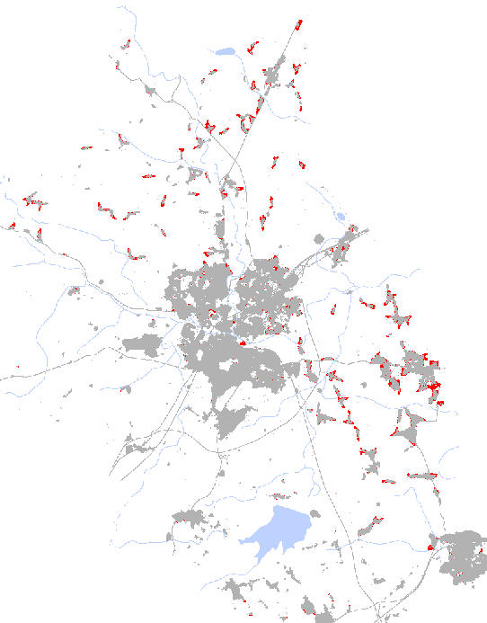
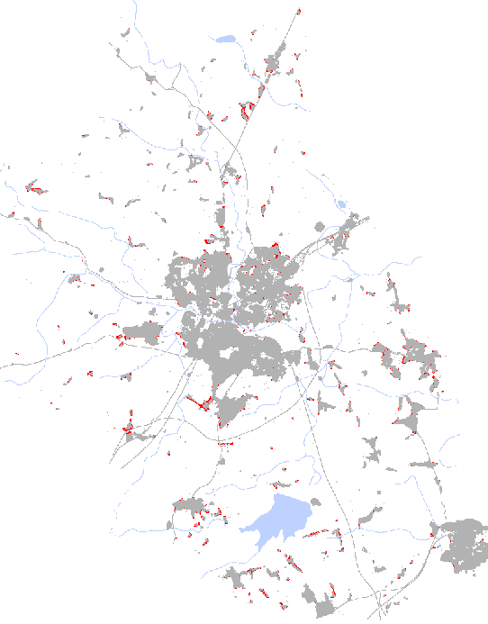
ReVISIONS
Regional Visions of Integrated Sustainable Infrastructure Optimised for Neighbourhoods
2031 Options – detached houses
Trend
+955 du
Compact
+14 du
Market led
+2,580 du
Slide provided by Dr Kiril Stanilov,
Department of Architecture,
University of Cambridge

Slide 20
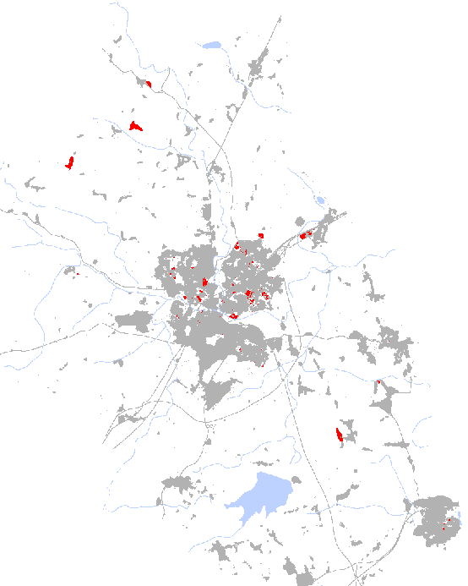
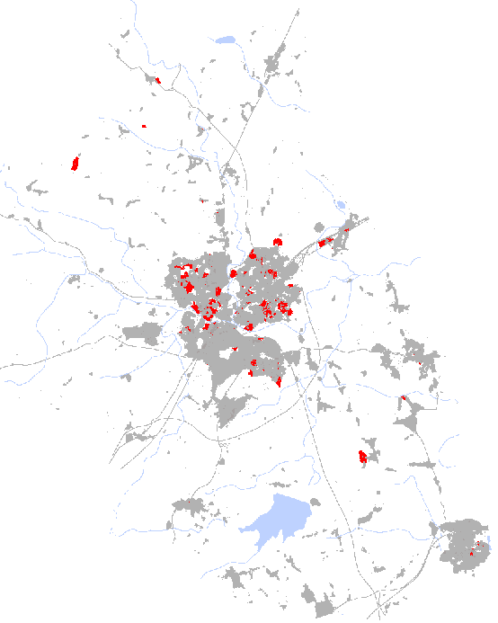
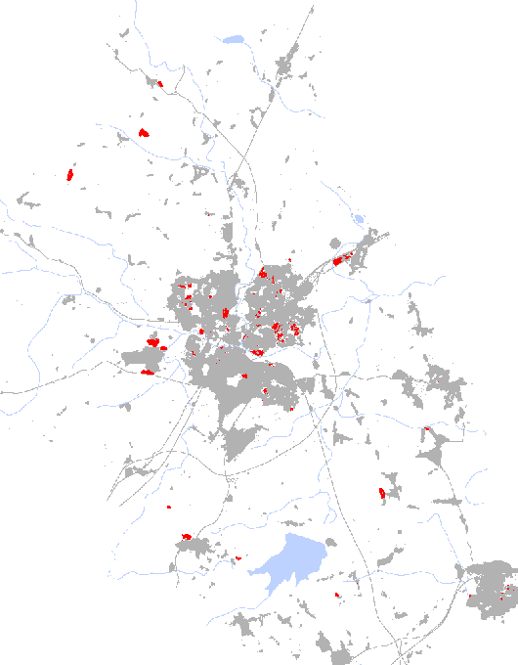
ReVISIONS
Regional Visions of Integrated Sustainable Infrastructure Optimised for Neighbourhoods
2031 Options – flats
Trend
+2,599 du
Compact
+3,817 du
Market Led
+1,803 du
Slide provided by Dr Kiril Stanilov,
Department of Architecture,
University of Cambridge

Slide 21
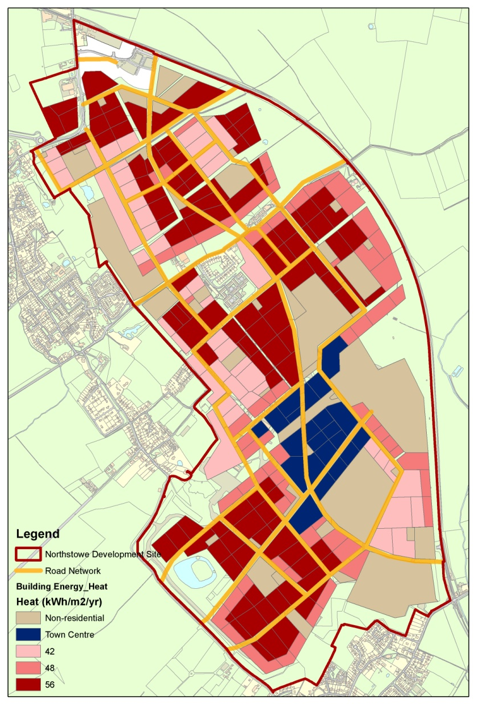
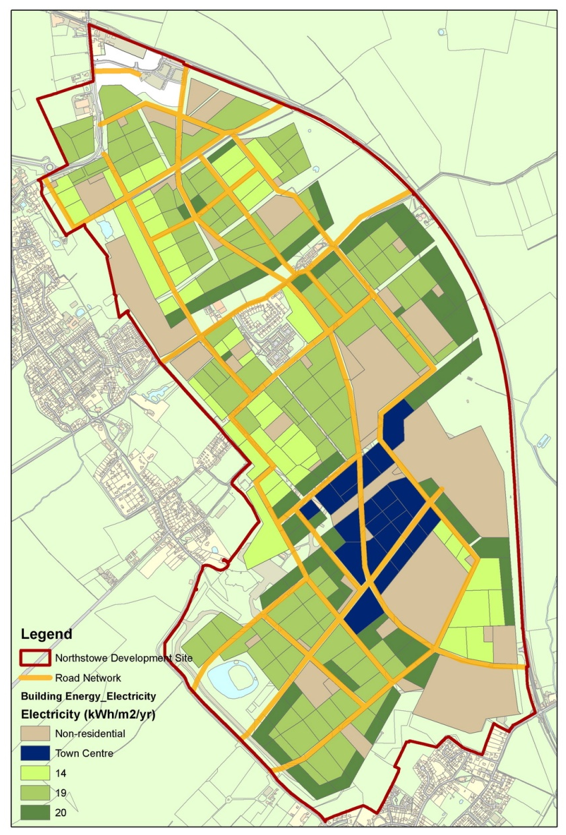
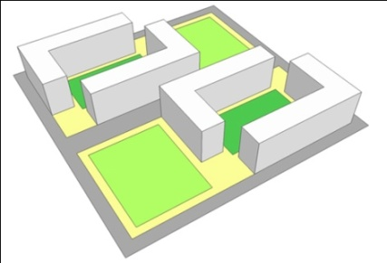
ReVISIONS
Regional Visions of Integrated Sustainable Infrastructure Optimised for Neighbourhoods
Building Energy Demand
Heat
Town Centre
(mixed used)
Electricity
1000 dwellings
(1638 MWh)
Tile D7
Shops
(10608 MWh)
Services
(655 MWh)
Restaurants
(7162 MWh)
Hotel
(2083 MWh)
Cinema
(2415 MWh)
Provided by Dr. Vicky Cheng

Slide 22
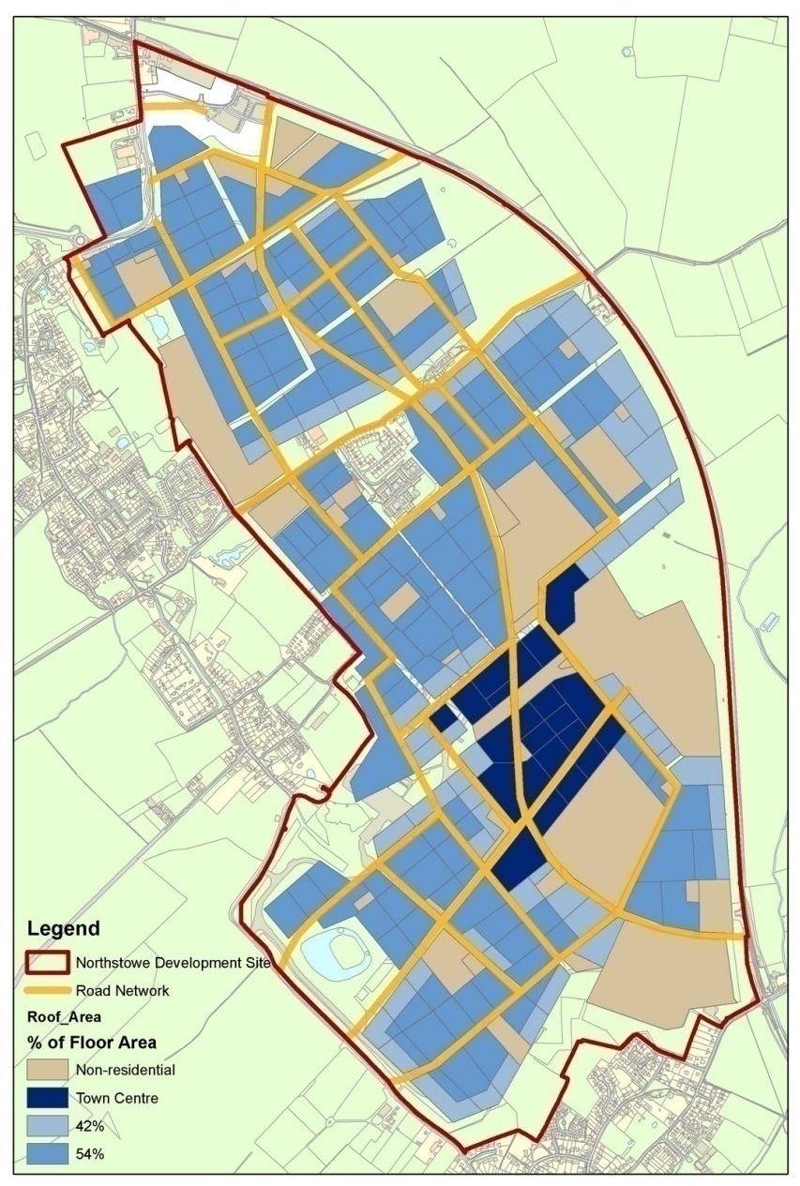
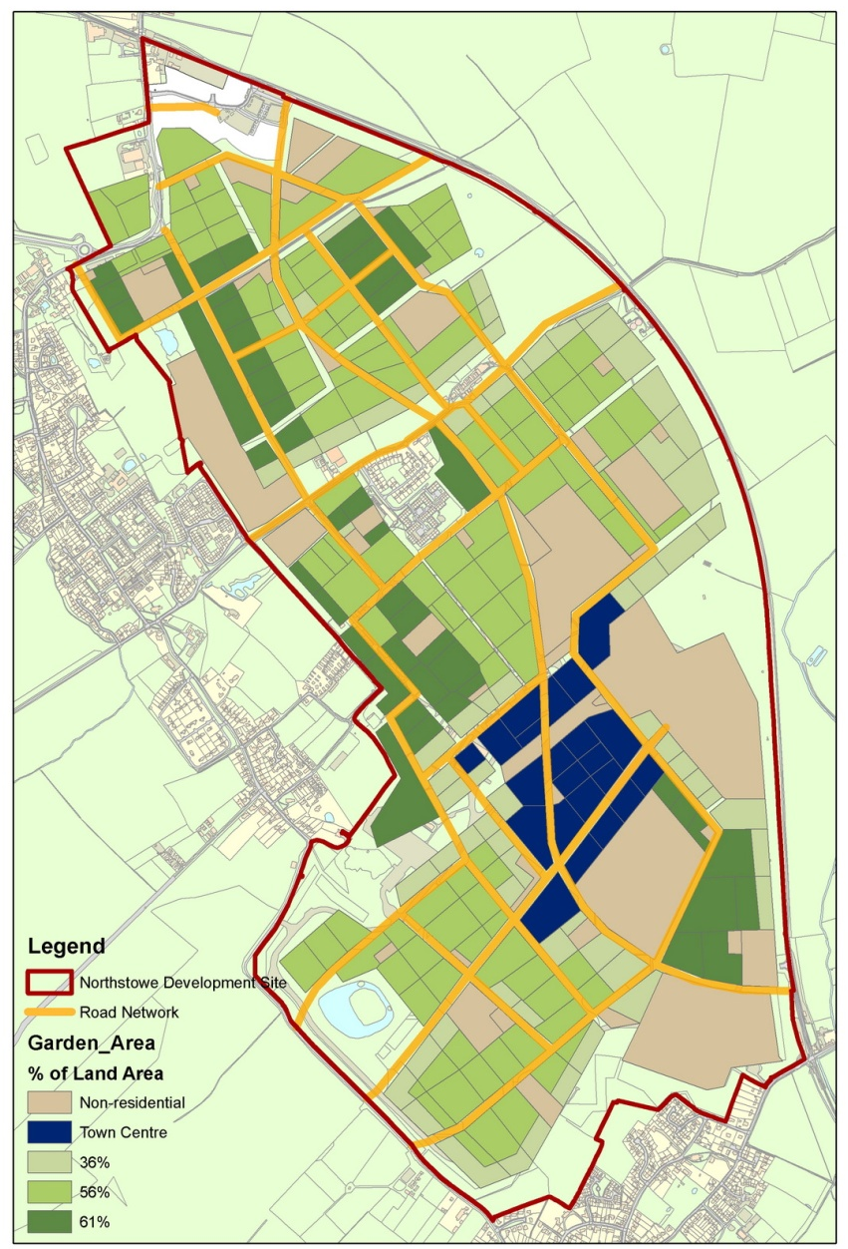
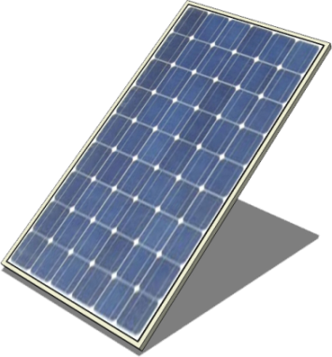

ReVISIONS
Regional Visions of Integrated Sustainable Infrastructure Optimised for Neighbourhoods
Low Carbon Energy Technology Potential
Roof Area
Garden Area
Technology
ReVISIONS
Slide provided by Dr. Vicky Cheng
Regional Visions of Integrated Sustainable Infrastructure Optimised for Neighbourhoods

Slide 23

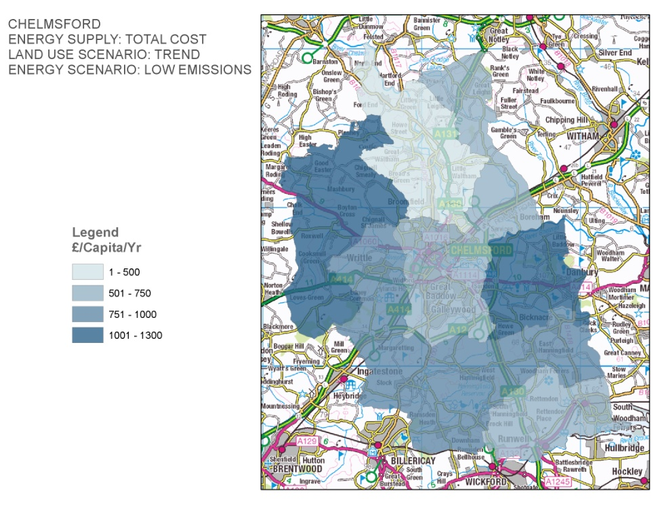
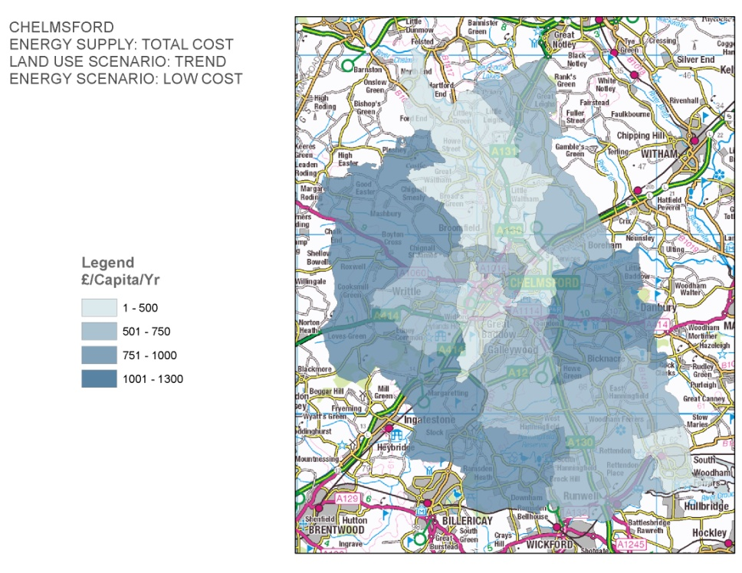

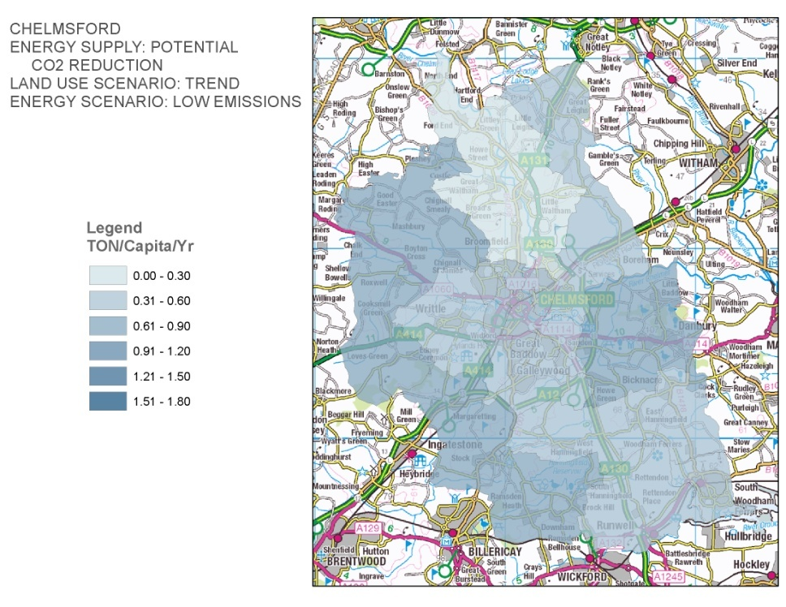
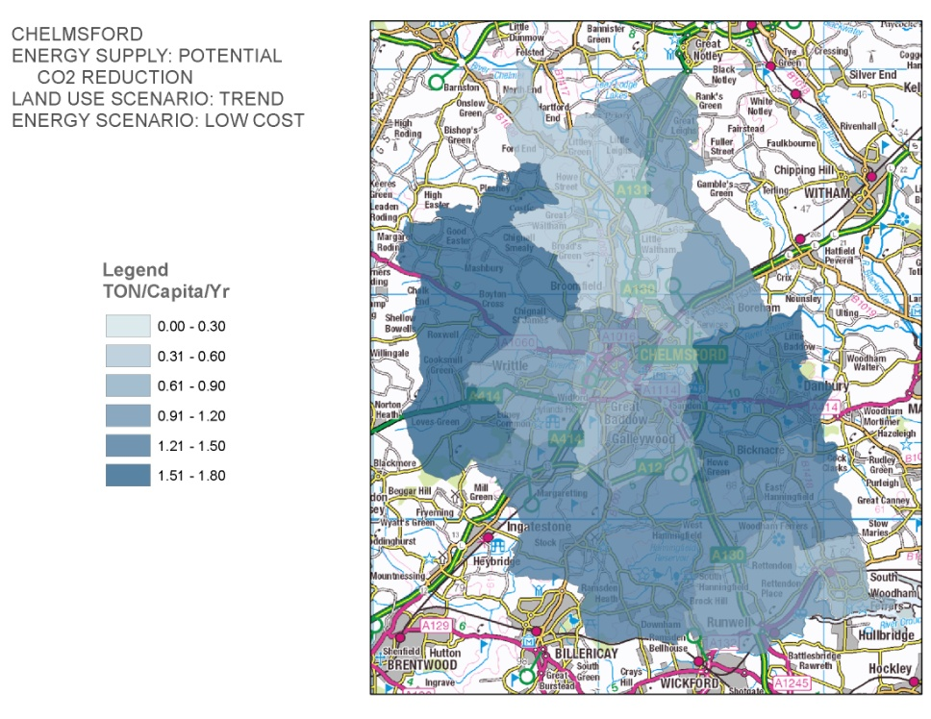

Local example: Chelmsford
Scenario: Low CO₂ Low Cost Highly Electric
Cost
CO₂ emissions

Slide 24


Flow chart for modelling framework
Clustering as patterns
Tiles per Ward
Land use per District
Domestic & commercial demand profiles per supply requirement
Demands as ‘tiles’ per zone by residential & mixed-use type
Spatial policy -changes in area type
Total demands of activities by modelled time period per sq.m per zone and land-take
Industrial processes demand profiles per supply requirement
Demand per industrial sector per time period/zone
Integrated socio-economic and spatial interaction model
Technologies, constraints, & supply policies
Supply module
Demand module
Total supply by modelled time period per LU zone – costs per unit, CO₂ & renewables
Supply profiles for industrial processes cost & quantity of supply
Supply per industrial sector per time period/zone
Supply for residential & mixed-use per time period/zone
Supply profiles for domestic and commercial
cost & quantity of supply
Technology selection
Costs & emissions per tile
Aggregate to Sub region

Slide 25
Examples of forecast outputs
ReVISIONS
Regional Visions of Integrated Sustainable Infrastructure Optimised for Neighbourhoods
Land use modelling – employment & household location, GVA, costs of living and production by household type and industrial sector per District
Transport– travel time and costs by mode, energy consumption and emissions or different technologies.
Tiles – buildings by type, dimensions, floorspace, land areas, occupancies.
Buildings – energy demands by type, time and season for existing, retrofitting and new build
Energy conversion – costs and emissions for different decentralised technology scenarios
Water – water demands and supply technologies costs, CO₂ emissions, and potential of decentralised measures to reduce water stress
Waste – waste arising, energy and nutrients recovery, materials recycling and global and UK GHG emissions
Multi criteria assessment will be used to trade off the economic, health, social and environmental impacts, using stakeholder value judgements.

Slide 26
ReVISIONS
Regional Visions of Integrated Sustainable Infrastructure Optimised for Neighbourhoods
Thank you
www.regionalvisions.ac.uk
International Symposium, Sao Paulo, 18th June 2012

