Slide 1
Recent process of Metrô Planning in São Paulo

Slide 2
Who I am
João Carlos Scatena
Civil Engineer
32 years working in transportation planning for São Paulo Metrô Company
Last 9 years partner of Millenia Engineering, working as consultant in Asia, Africa and South America

Slide 3
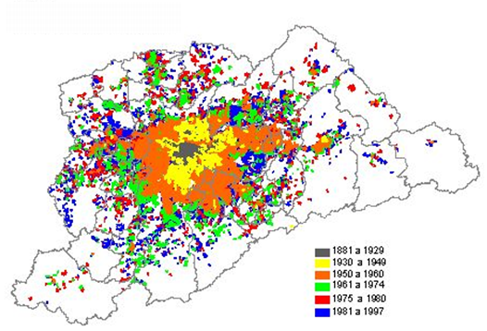
Urban Area Expansion

Slide 4
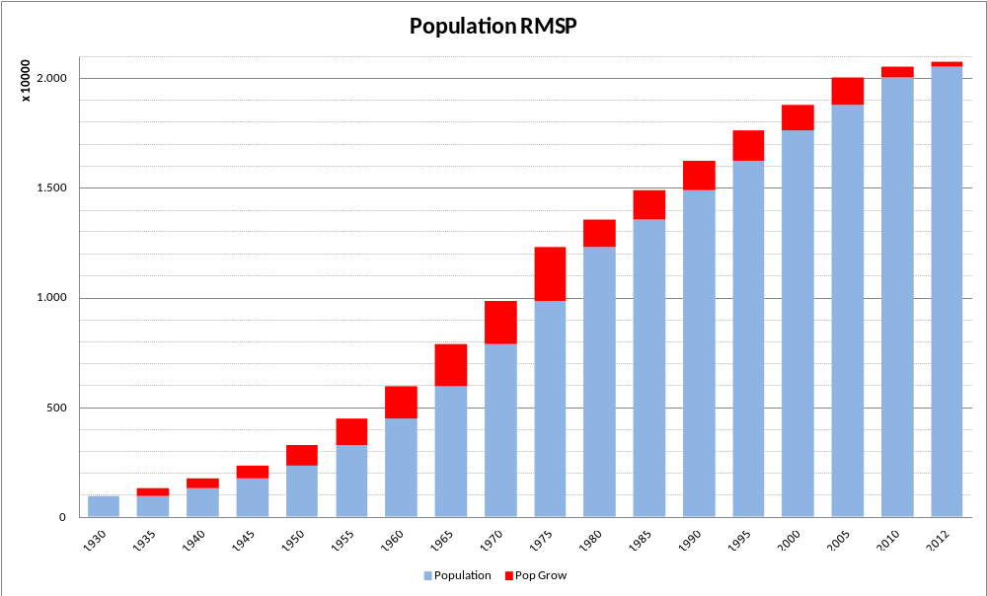
Population

Slide 5
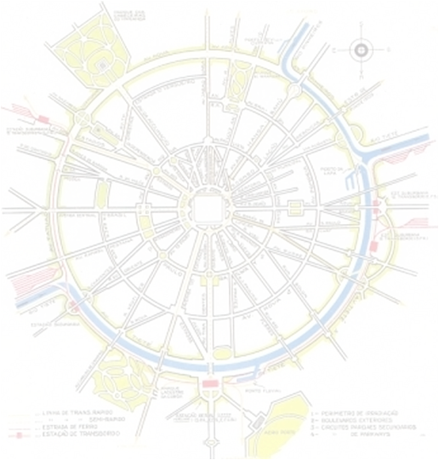
Origins of Urban and Transportation Planning
Developing Oriented by the land market
30’s and 40’s – First road plan and ideas of mass transportation
1947 - 1st household origin and destination survey in São Paulo
1967 – 2nd Household Survey
1968 – Metro Company creation

Slide 6
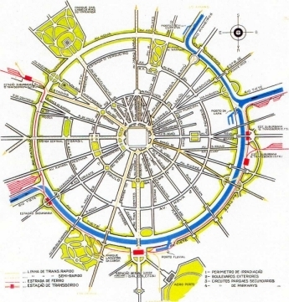

Slide 7
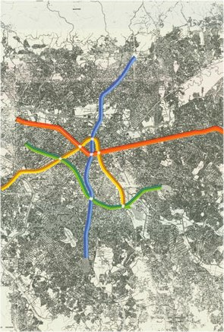
Metro Network Planned 1968 (HMD)

Slide 8
Transportation Planning in the Metro
1968 – HMD consortium make the plan of the first network using the new computing tools for transportation analysis developed by FHWA
1969 – Starts the transportation planning in the Metro Company
1971 – Starts using the TRIPS package, with transit network analysis
1973 – 1975 – Transit network analysis for metro lines feeder buses.
1973 – Opinion survey to forecast the metro fare

Slide 9
Transportation Planning in the Metro
1973 – Created the São Paulo Metropolitan Area (RMSP) with 39 municipalities
1977 – RMSP household origin and destination survey (EMPLASA)
1978 – UTPS package
1980 – Land use model (MUT)
1985 – Review of metro network plan
1986 – ABD BRT corridor design
1987 – RMSP household origin and destination survey

Slide 10
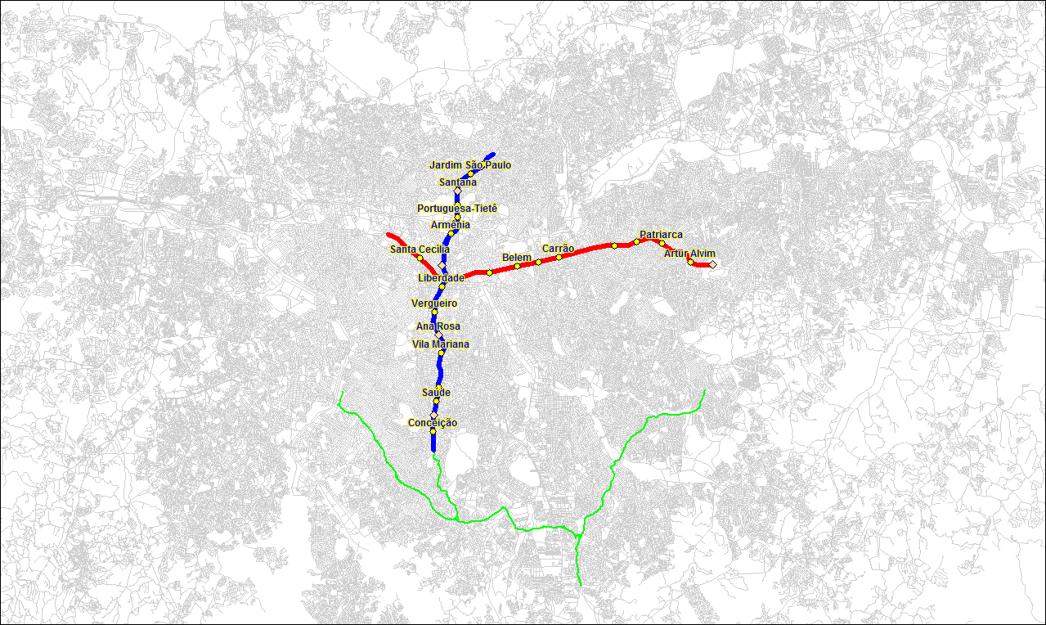
BRT Corridor

Slide 11
Transportation Planning in the Metro
1991 – Tranplan package
1991 – Review of metro network plan
1991 – Establishment of Secretary of Metropolitan Area Transportation (STM)
1995 – GIS software
1997 – RMSP household origin and destination survey
1998 – EMME transportation planning software

Slide 12
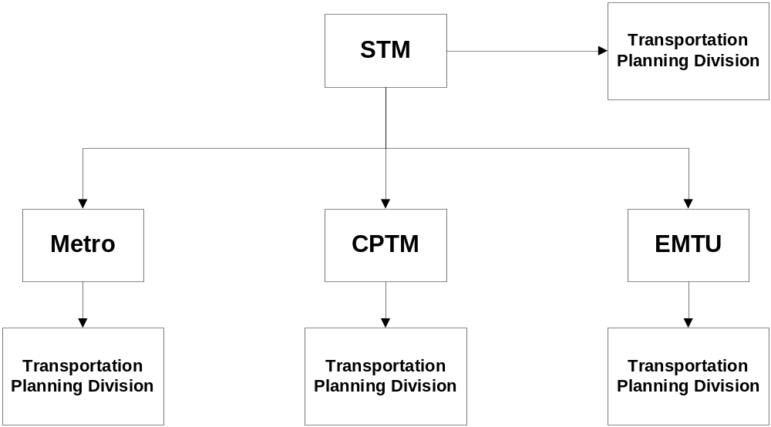
Planning Framework After STM

Slide 13
Transportation Planning in the STM
1999 – PITU 2020 (Plan of Integration of Urban Transportation)
20 years forecast for the urban transportation, bus, rail and road system
Integrate the planning divisions of Metro, CPTM, EMTU
Make a strategic long term plan for all the transportation system

Slide 14
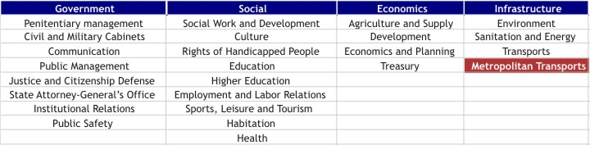
PITU – Main Assumptions
Plan a better city for the citizens
Improve the accessibility for all the public transportation users
Reduce the travel time

Slide 15
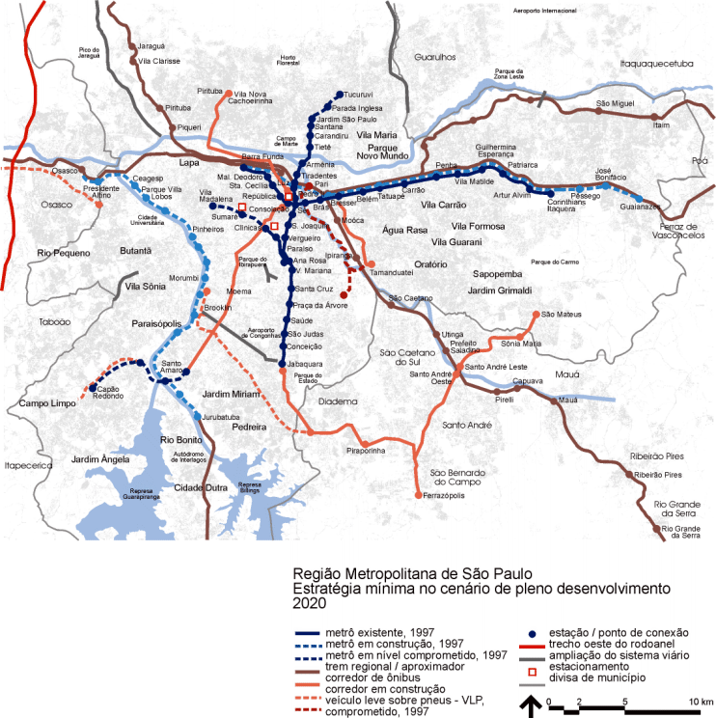
PITU 2020 – Scenario Minimum

Slide 16
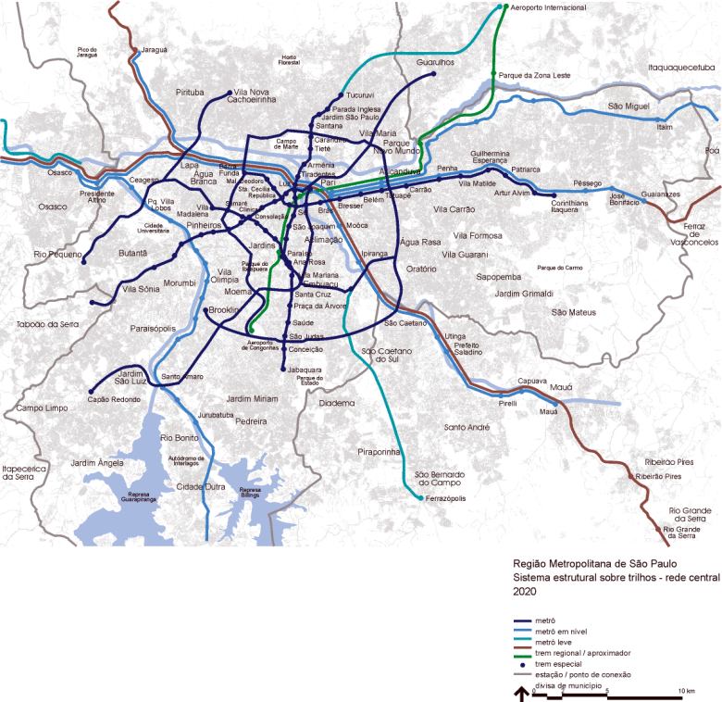
PITU 2020 – Central Network

Slide 17
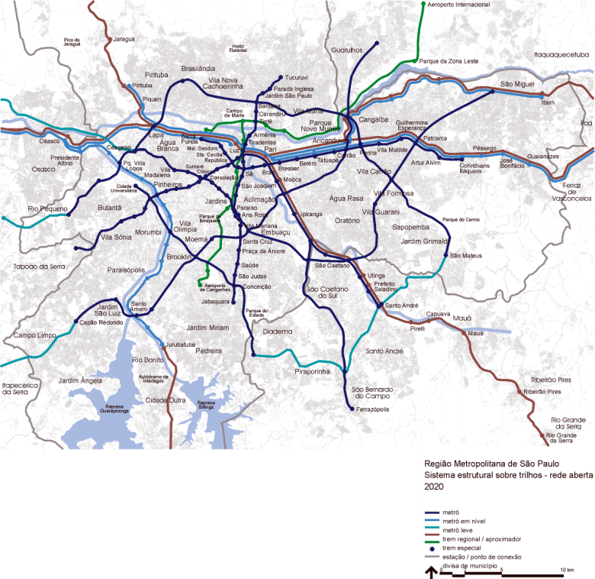
PITU 2020 – Open Network

Slide 18
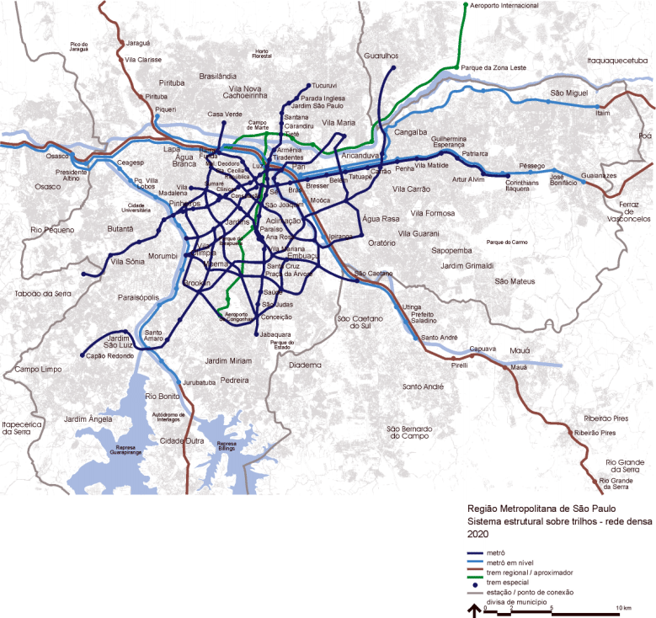
PITU 2020 – Dense Network

Slide 19
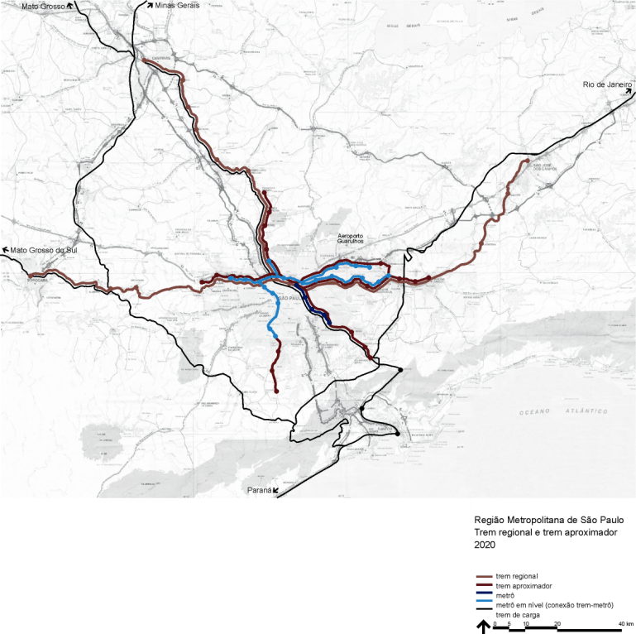
PITU 2020 – Regional Trains

Slide 20
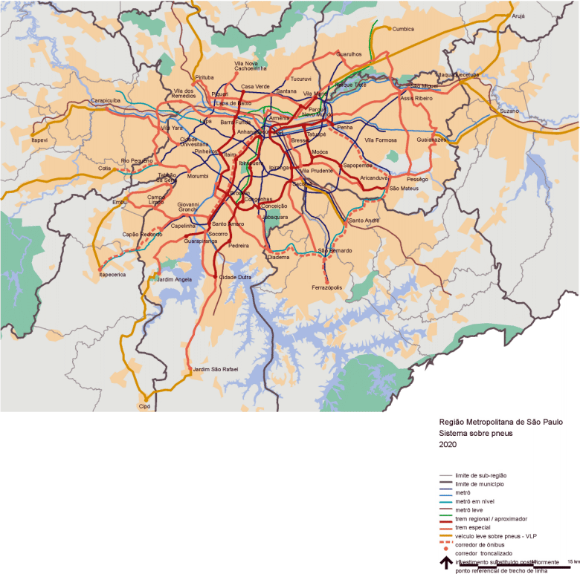
PITU 2020 – BRT and Bus corridors

Slide 21
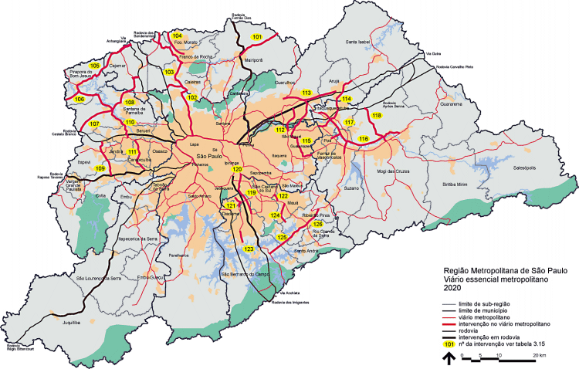
PITU 2020 – Structural Roads

Slide 22
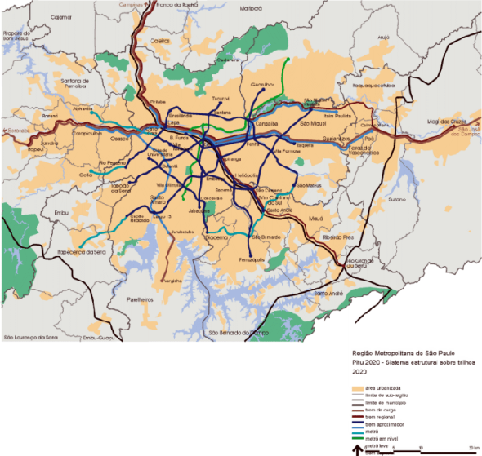
PITU 2020

Slide 23
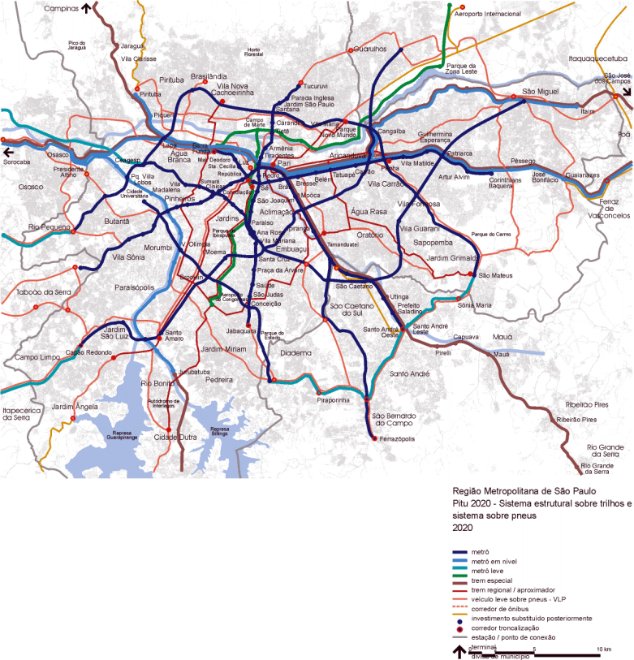
PITU 2020 – Structural Transit System

Slide 24
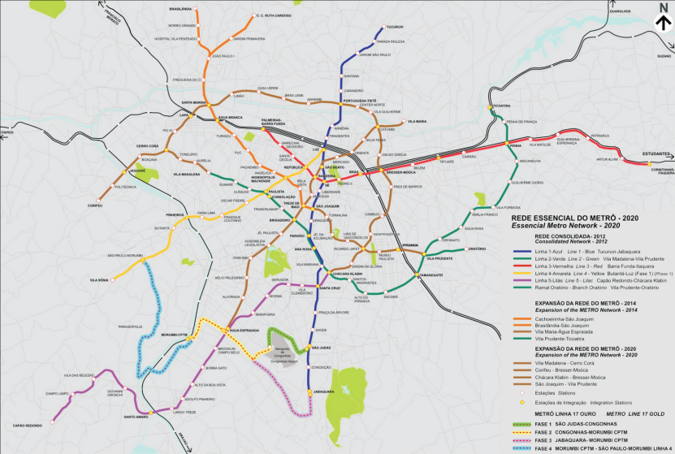
PITU – 2020 / Metro analysis (essential network)

Slide 25
Transportation Planning in the Metro
2002 – Household origin and destination survey with reduced sample
2004 – Update the models
2006 – PITU 2025
Land use and transportation model – TRANUS

Slide 26
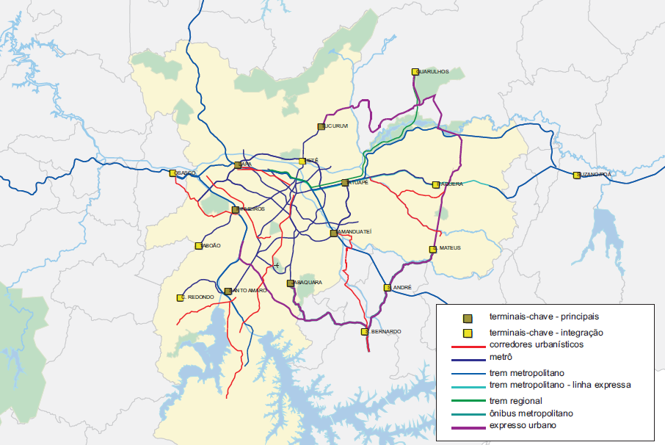
PITU 2025 – Main Corridors (Rail and BRT)

Slide 27
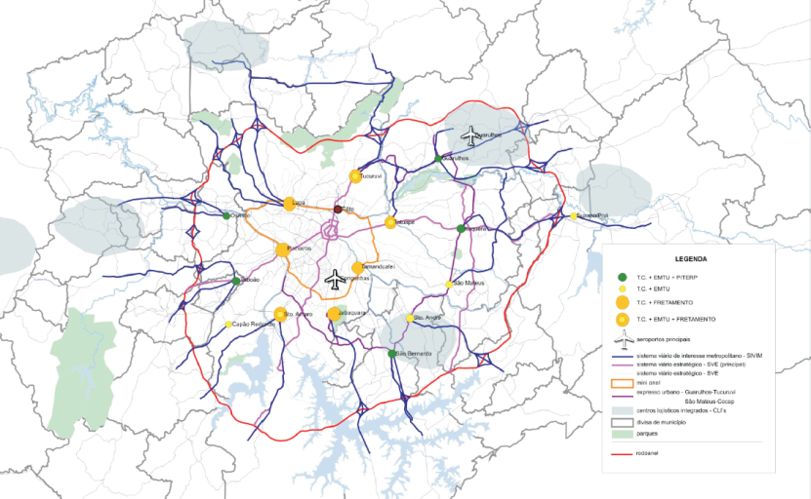
PITU 2025 - Road system and bus terminals)

Slide 28
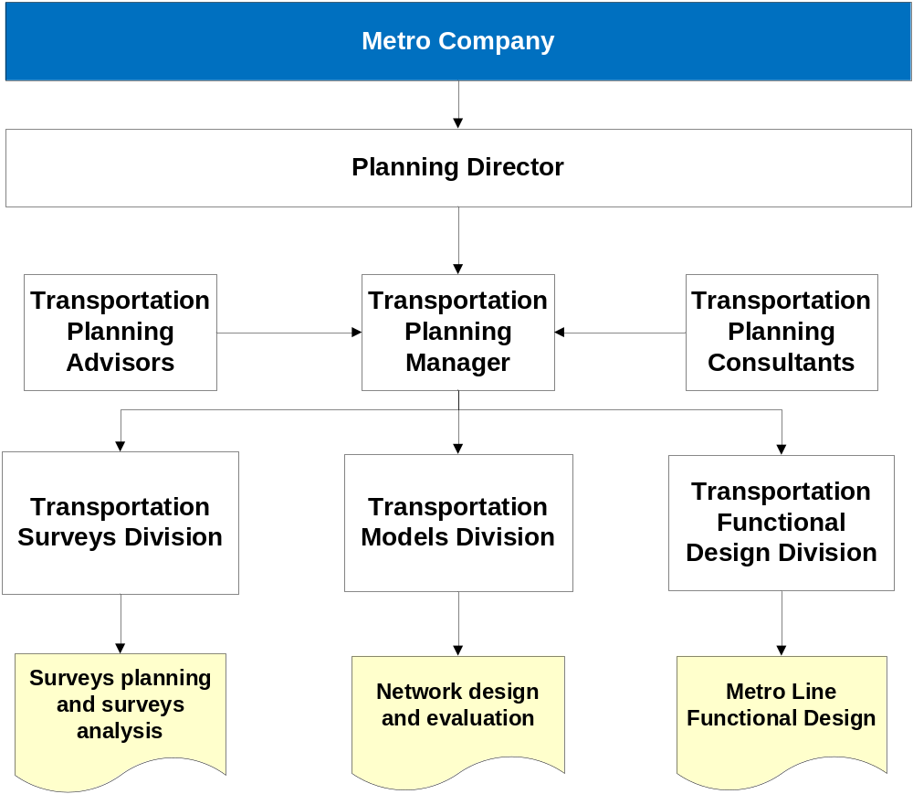
Transportation Planning in the Metro

Slide 29
Transportation planning in the Metro
2007 - RMSP household origin and destination survey
New model based on EMME software
Four steps model
No land use model

Slide 30
Transportation planning in the Metro
The network is sponsored by Metro with some general guidelines
  Improve the Metro network
  Improve the connections with the CPTM
  Accessibility for regions with poor road system
  Improve the connections with the BRT and bus system

Slide 31
Transportation planning in the Metro
General Guidelines
  The network is based in the PITU 2025 with some change based in the 2007 OD Survey analysis
Include the lines planned by CPTM
In the demand forecast for network evaluation are included the BRT corridors of RMSP
The selection of construction sequence is done using a multi-criteria matrix

Slide 32
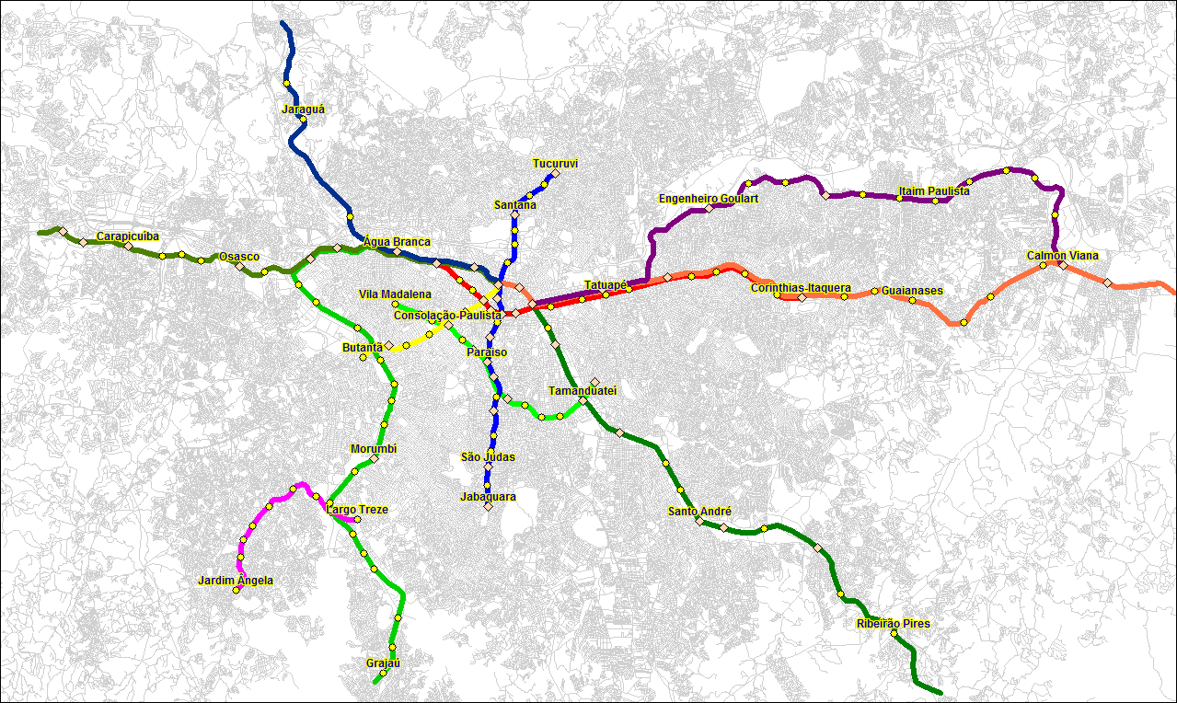
Today’s Rail Network (Metro/CPTM)
275 km

Slide 33
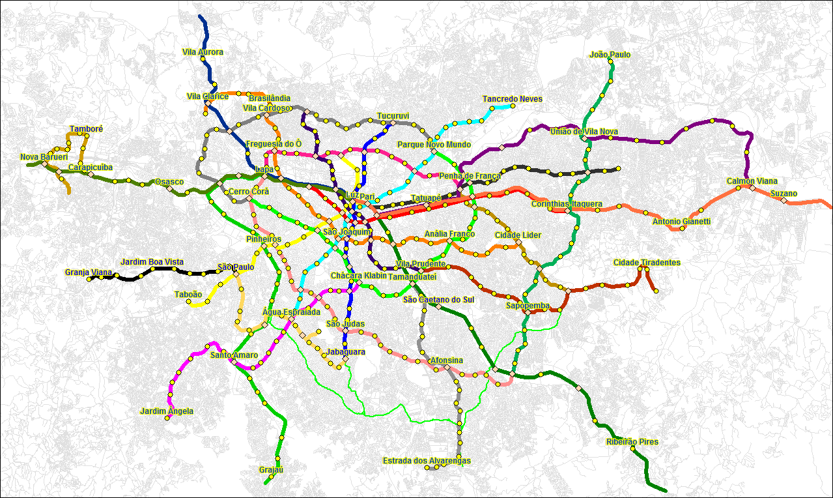
Target Network – Metro + CPTM
618 km

Slide 34
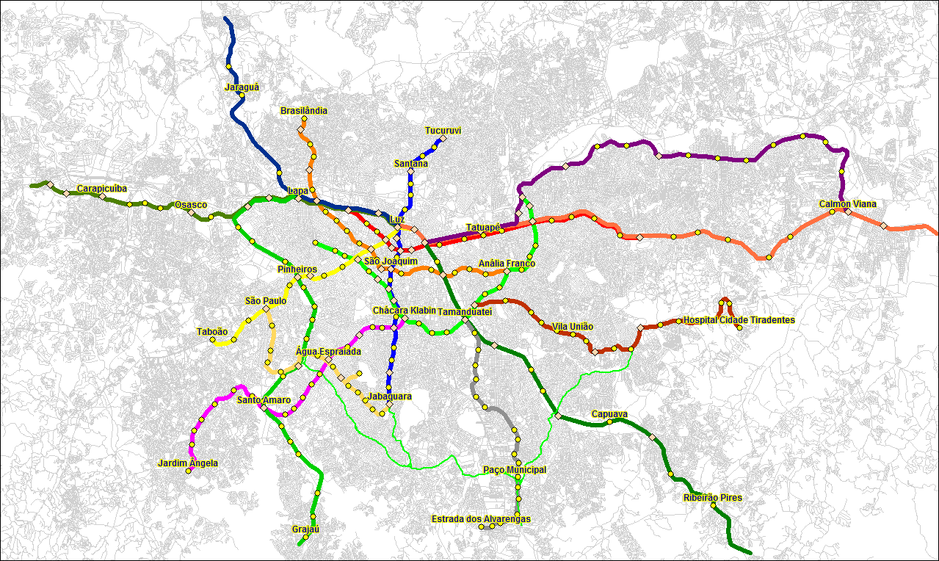
2020 – Metro + CPTM
387 km

Slide 35
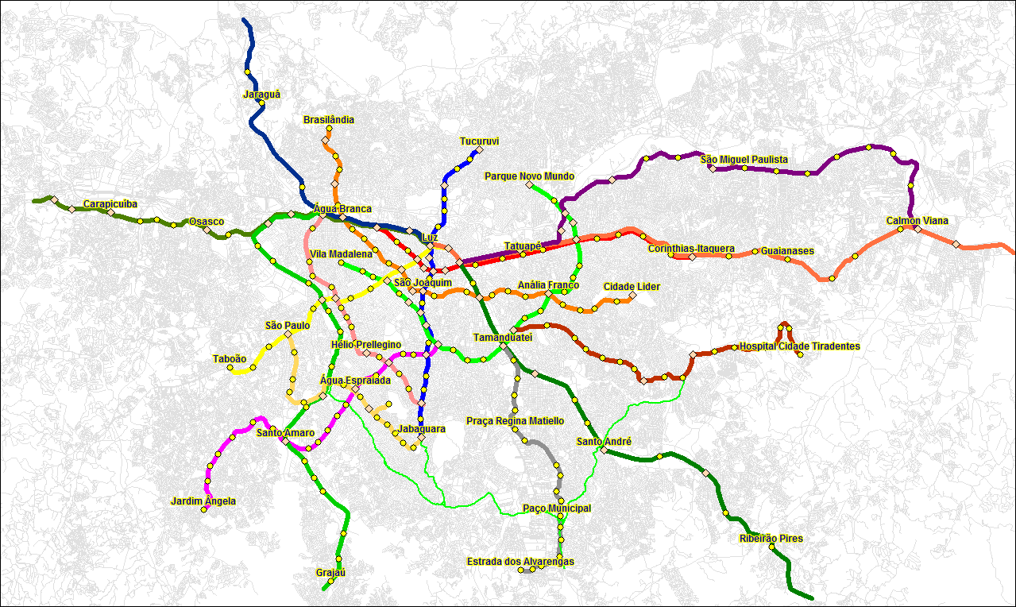
2025 – Metro + CPTM
412 km

Slide 36
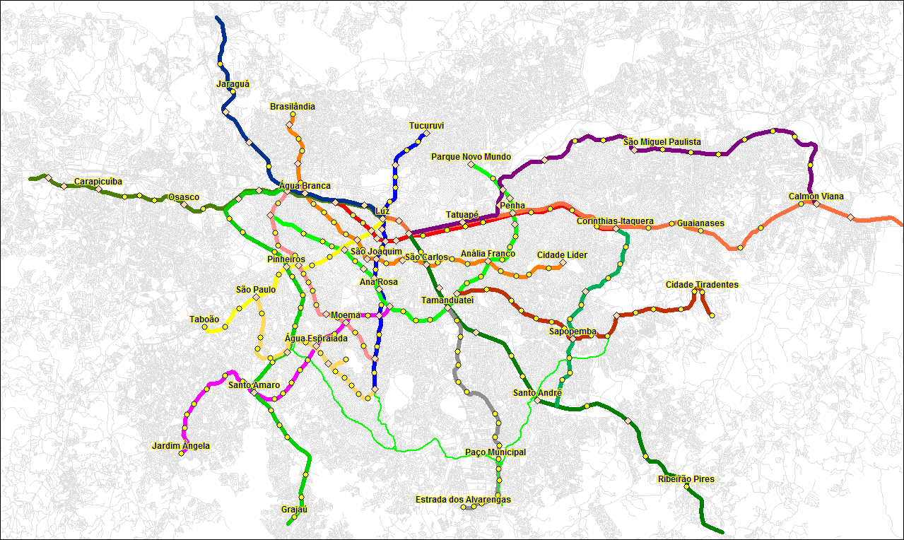
2030 – Metro + CPTM
430 km

Slide 37
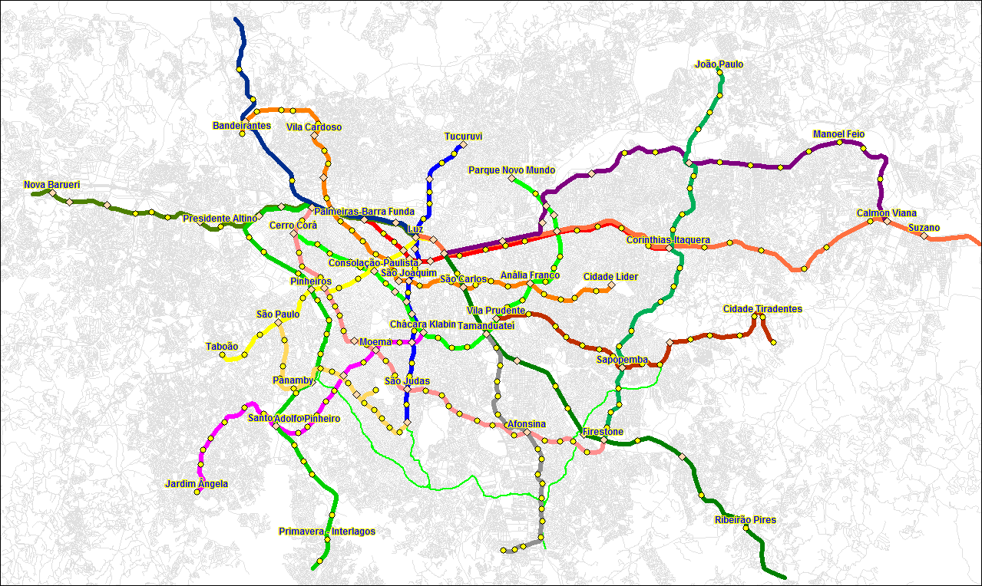
2035 – Metro + CPTM
465 km

Slide 38
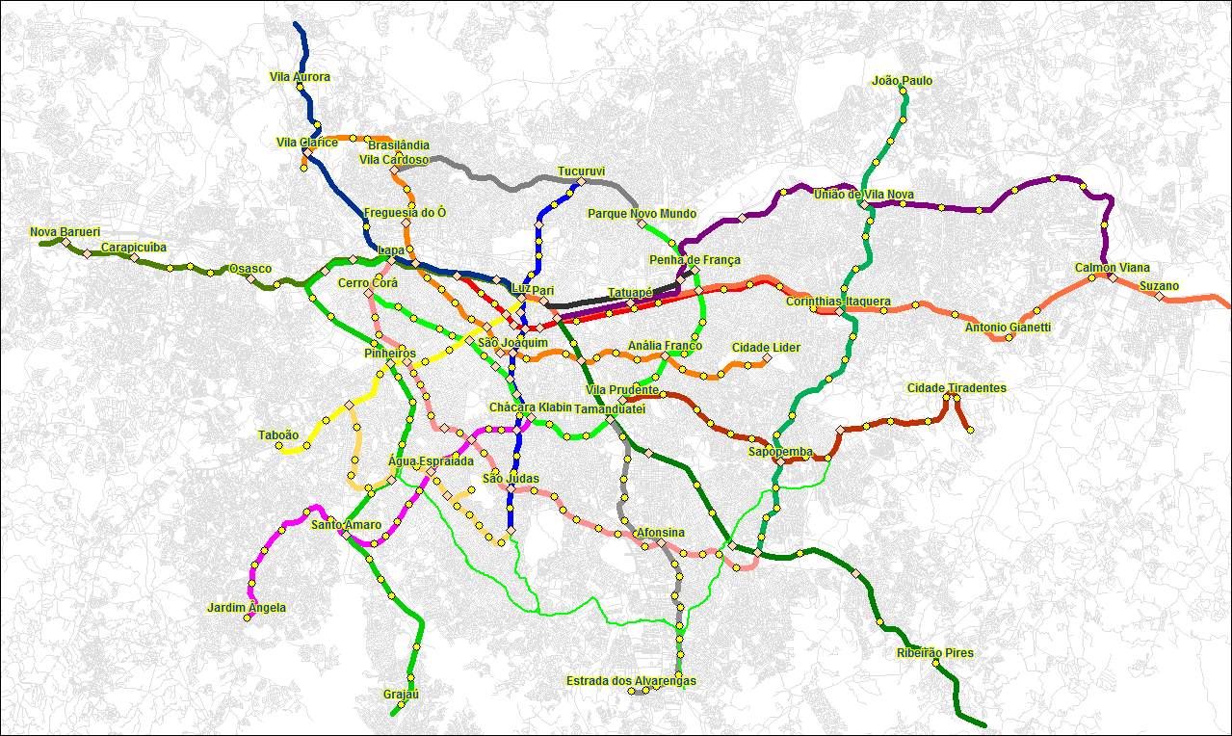
2040 – Metro + CPTM
489 km

Slide 39
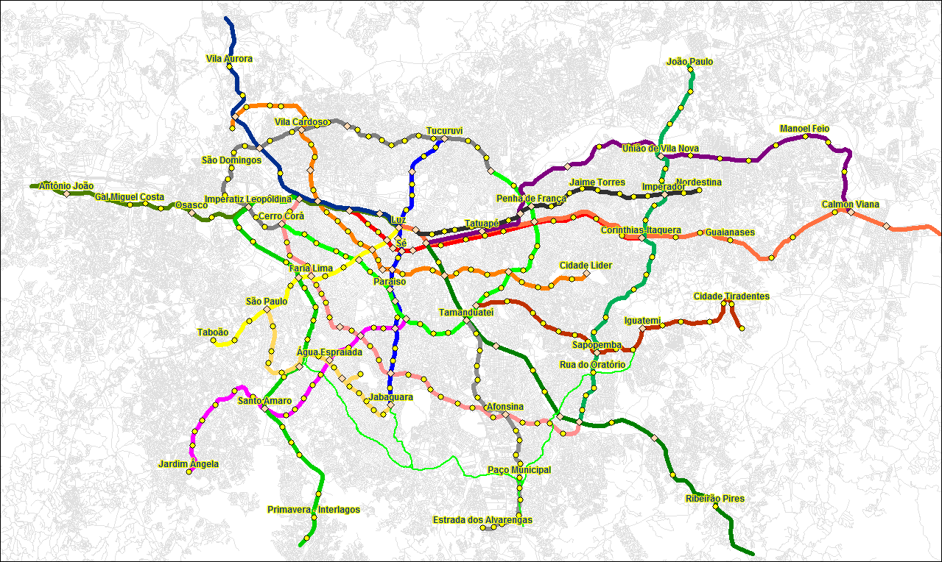
2045 – Metro + CPTM
515 km

Slide 40
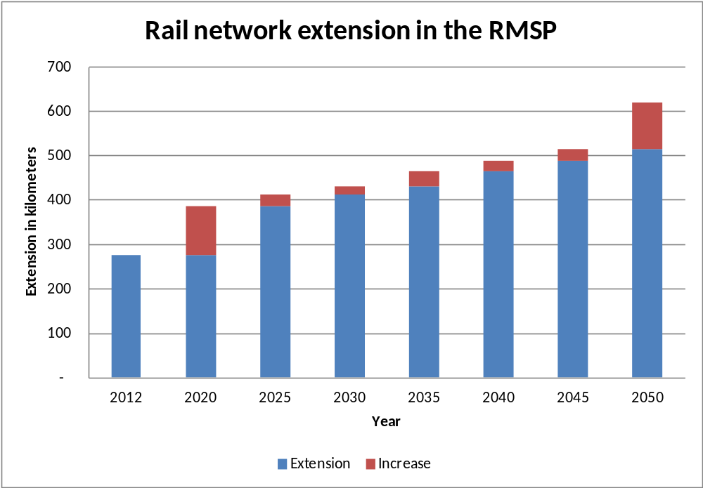
Rail Network

Slide 41
谢谢你
Thank you
Muito Obrigado

