Slide 1
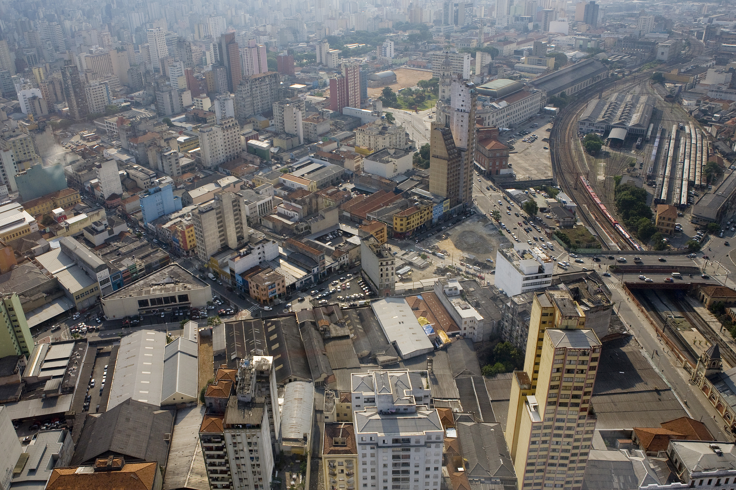
/tmp/PreviewPasteboardItems/10.jpg
Urban leasing as a tool of urban requalification
urban
leasing
/tmp/PreviewPasteboardItems/10.jpg

Slide 2
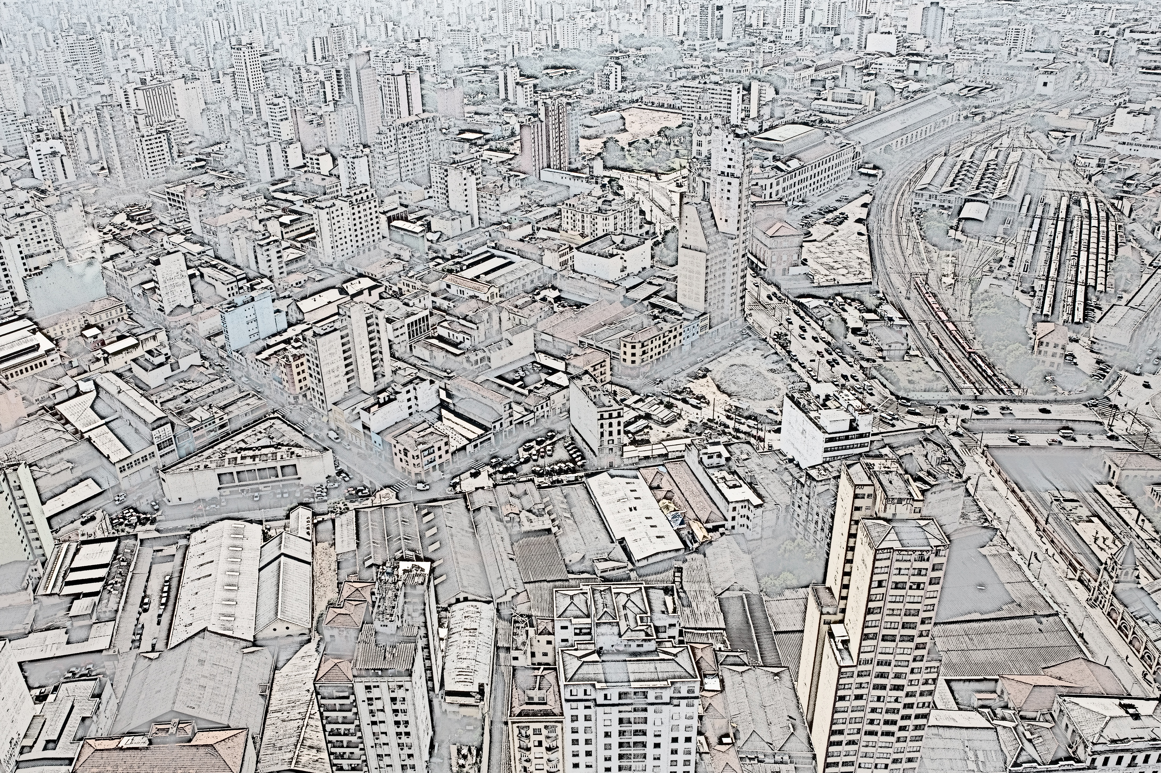
/tmp/PreviewPasteboardItems/10.jpg
Urban leasing as a tool of urban requalification
Urban leasing:
a tool for urban
requalification
/tmp/PreviewPasteboardItems/10.jpg
Alejandra Maria Devecchi

Slide 3
Urban leasing
Urban leasing is a land use policy-making tool enforced by an administrative contract where the local government transfers to the private the duty of implementing public works, using the expropiation as a tool for resource mobilization. These works are detailed in an urban project and are performed by the risk of the particular winning bidder.

Slide 4
It is applied for down-town urban regeneration projects where traditional planning tools have not reached to their objectives.
Mainly in those situations with land mobilization’s problems.

Slide 5
In São Paulo, the urban leasing appears as land-use policy-making tool in the city Strategic Master Plan;
In 2009, a specific law is enacted for regulating the tool application and a second law defines the perimeter knows as Nova Luz as the first place for its implamentation.

Slide 6
Great debate ha resulted from the enactment of this legislation.
According to some, it may encourage real estate speculation.
Understanding the tool’s validity and the situations where its use is appropriate is an important task, the main objective of this presentation.

Slide 7
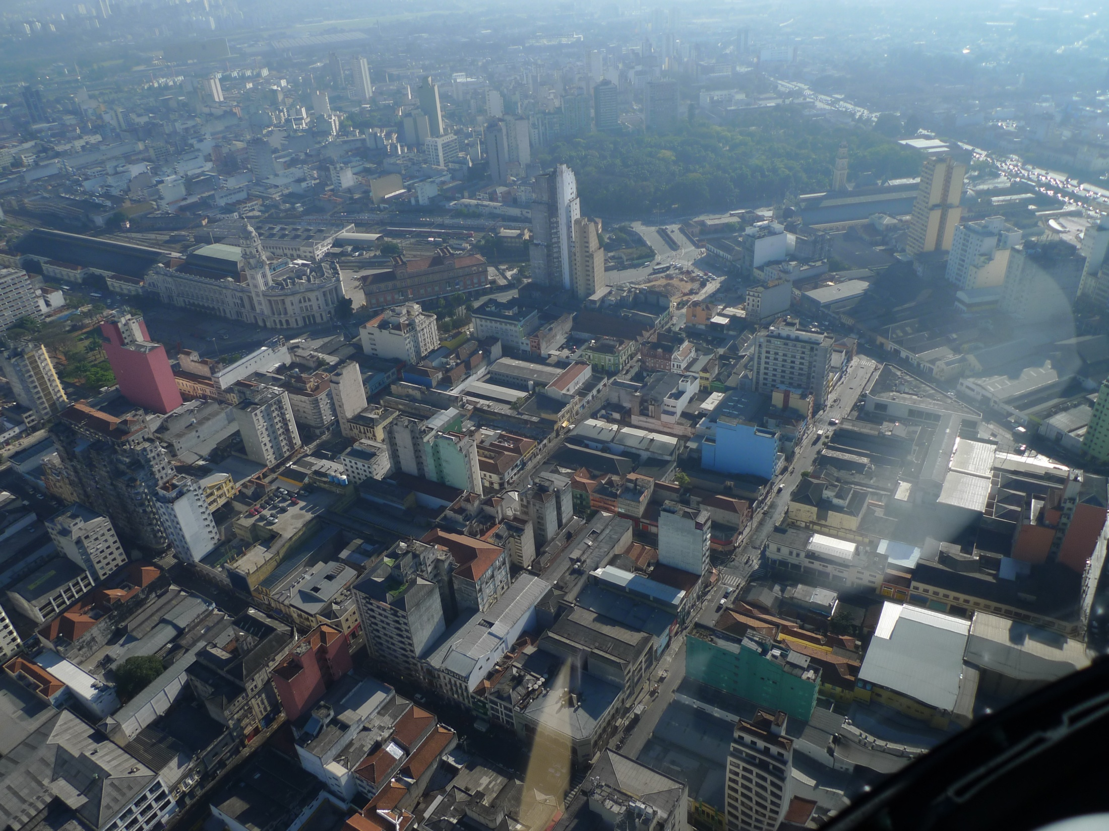
contex

Slide 8
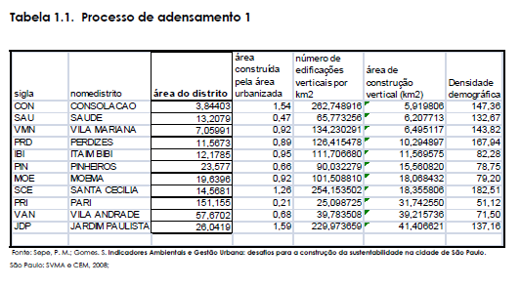
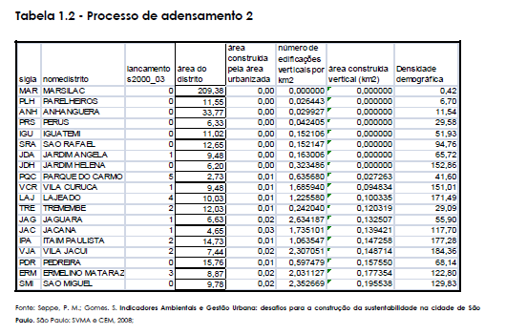


Slide 9
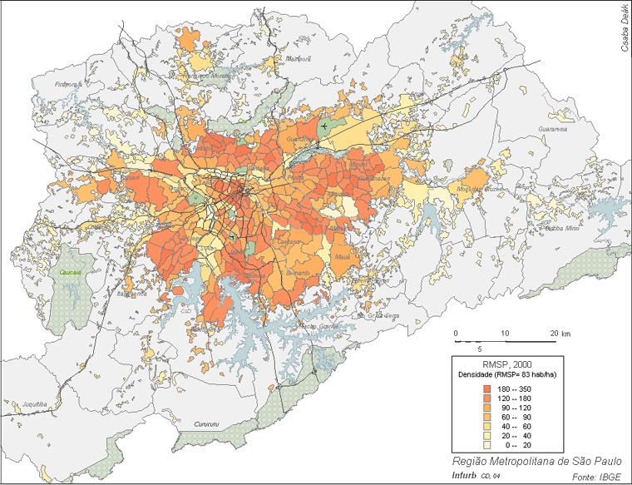
fonte: Csaba Deák

Slide 10
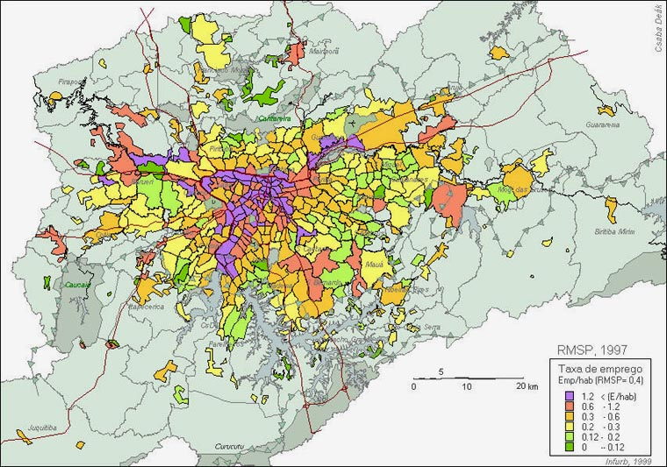

Slide 11
The consequences of this process are the worst possible:
urban sprawl;
lengthy daily commutes;
social class guetos;
environmental degradation.

Slide 12
The city congestion that is perceived daily, it is used as a means of masking a paradoxical reality through three false ideas:
- linking congestion with vertical expansion, which creates a resistance by elites aginst high-rise building and any movement of land use intensification;
- linking congestion with high population densities;
- linking land use intensification with
gentrification.

Slide 13
Need of residential use’s intensification in the surroundings of transportation hubs due to scarcity of adequate urban land needed for population growth;
urban compaction as climate change adaptation policy, with increased demographic densities and reduced daily commutes, bringing the population closer to where they work.

Slide 14
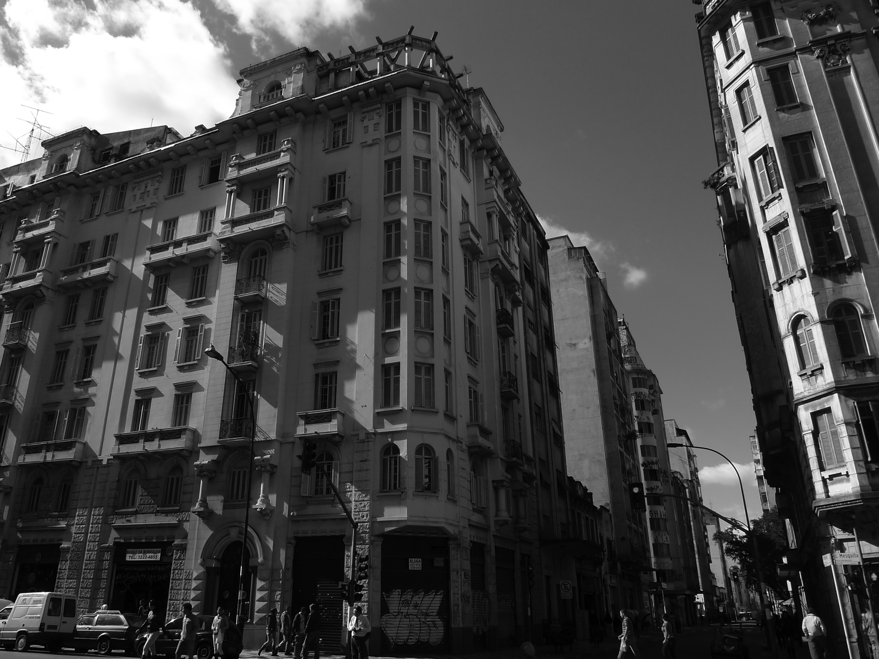
Urban Leasing
Nova Luz

Slide 15
Why urban leasing at this location?
Situated in the surrounding of the main metropolitan transportation hub the with highest accessibility;
Massive people circulation has created real-estate devaluation enabling informal uses (residential and non-residential);
Economies of agglomeration sprawl taking advantage of this particular situation, evicting residential use in the surroundings;
Land mobilization’s problems related to land titling concentration and ownership dispersion.

Slide 16
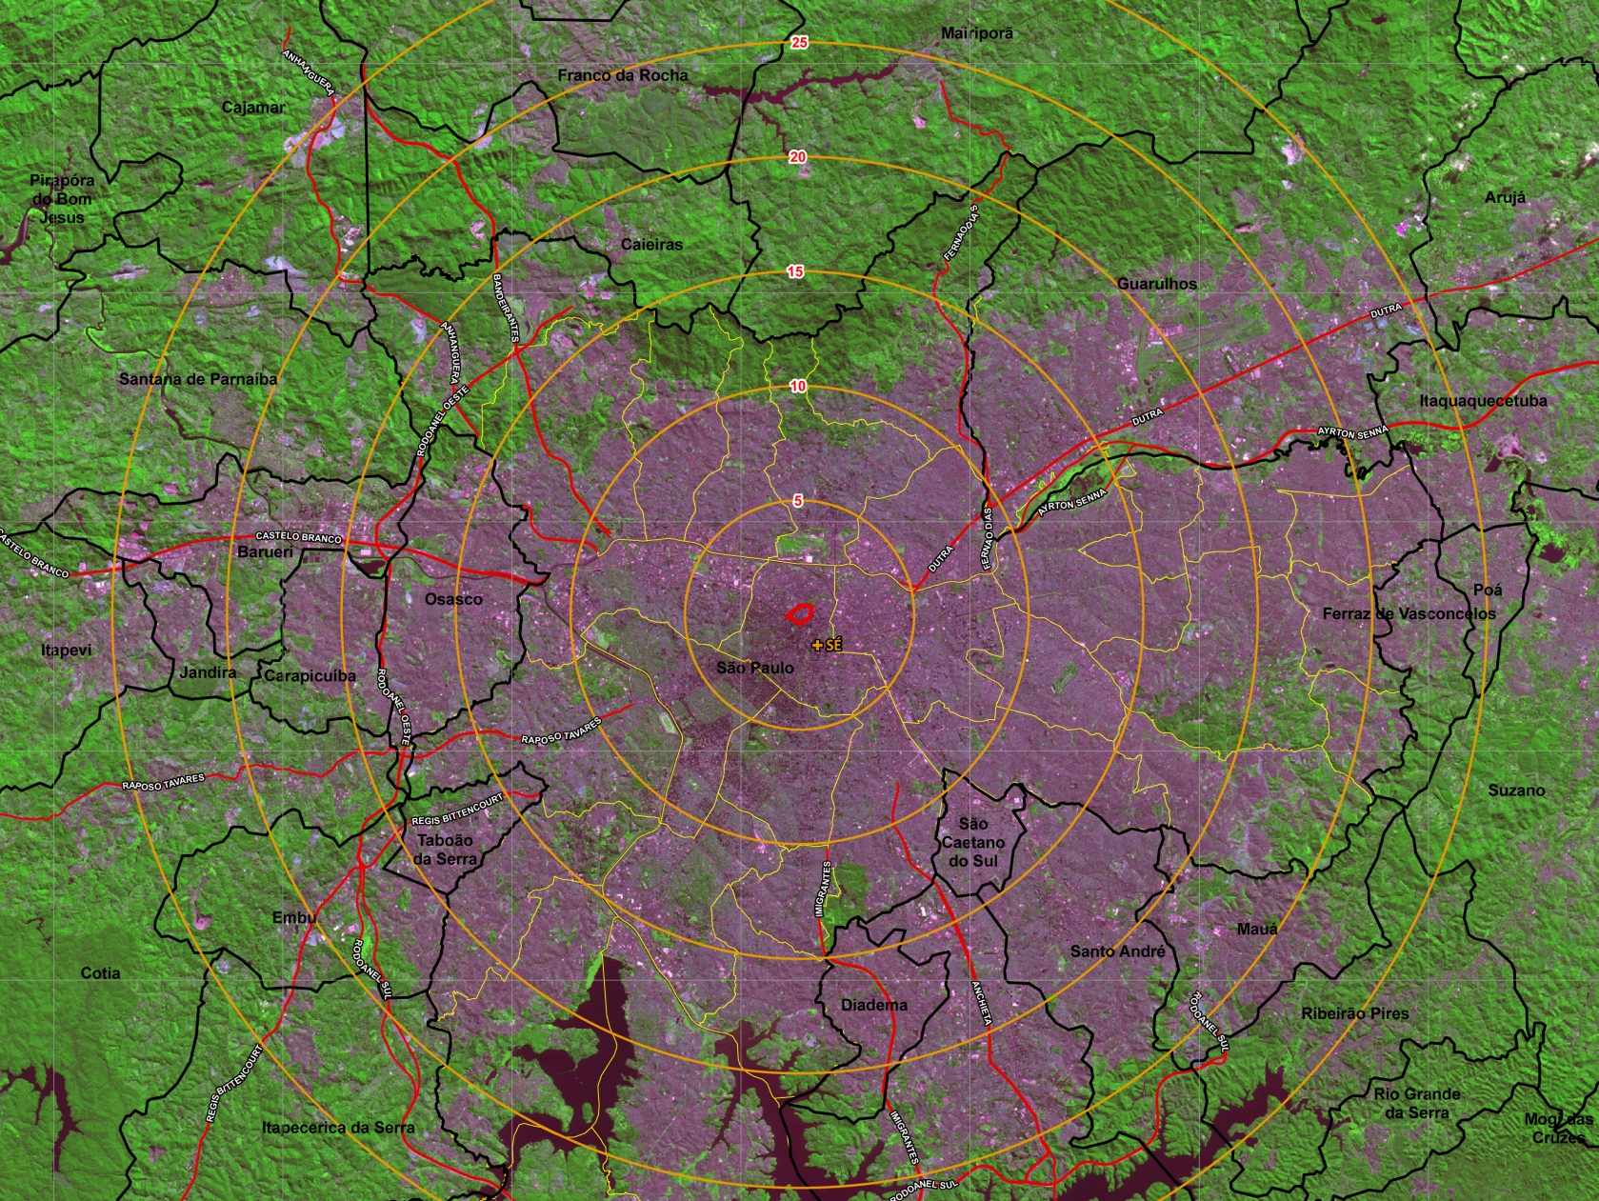
Nova Luz within metroplitan aglomeration

Slide 17
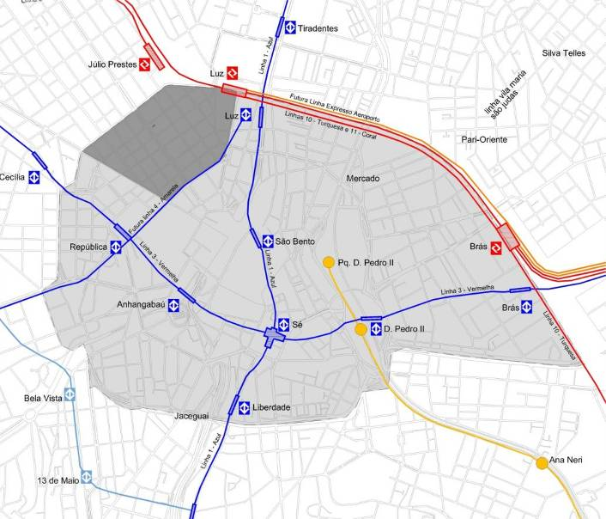
Accessibility Conditions
Perímetro da Operação Urbana Centro
Perímetro da Concessão Urbanística Nova Luz
Linha Metrô
Linha Metrô (2014)
Linha CPTM
Expresso Tiradentes
Expresso Aeroporto
Notes:
17

Slide 18
Nova Luz Urban Leasing
The objectives of Nova Luz´s urban leasing are:
  - increase of demographic density reaching a minimum of 350 hab/ha, achieving the city’s social purpose ;
  - Balance between housing and economic activities;
  - Implementation of social housing;
  - Preservation, restoration and enhancement of historical, cultural and artistic heritage;

Slide 19
urban leasing as a tool to achieve the city’s social purpose (função social da cidade) and increase demographic densities
Concentration of underused properties with FAR less than 1;
Concentration of parking plots;
Concentration of preservation listed buildings;
Land Tenure concentration and ownership dispersion with unified property registration, however belonging to several owners.

Slide 20
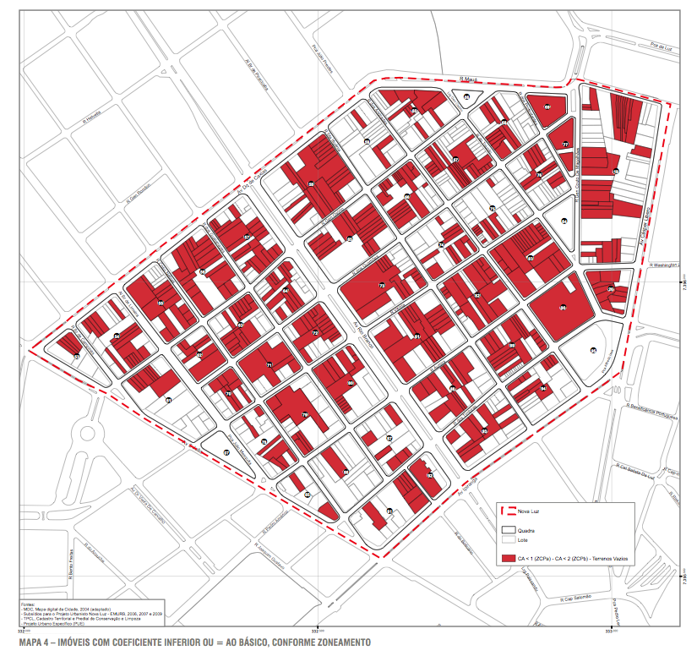
Concentration of underused properties with FAR less than 1

Slide 21
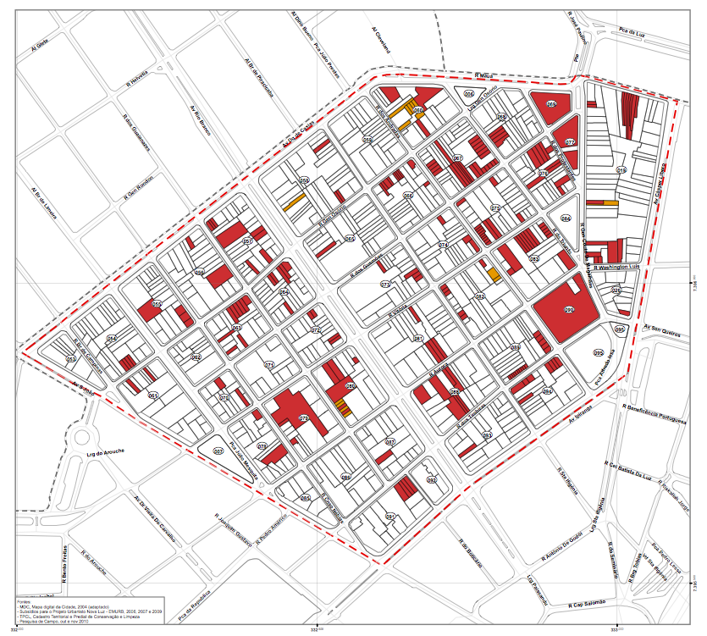
Concentration of empty plots

Slide 22
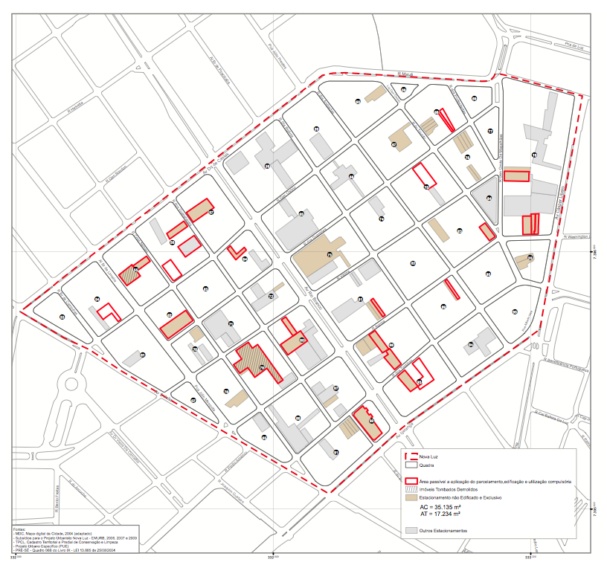
Concentration of parking plots

Slide 23
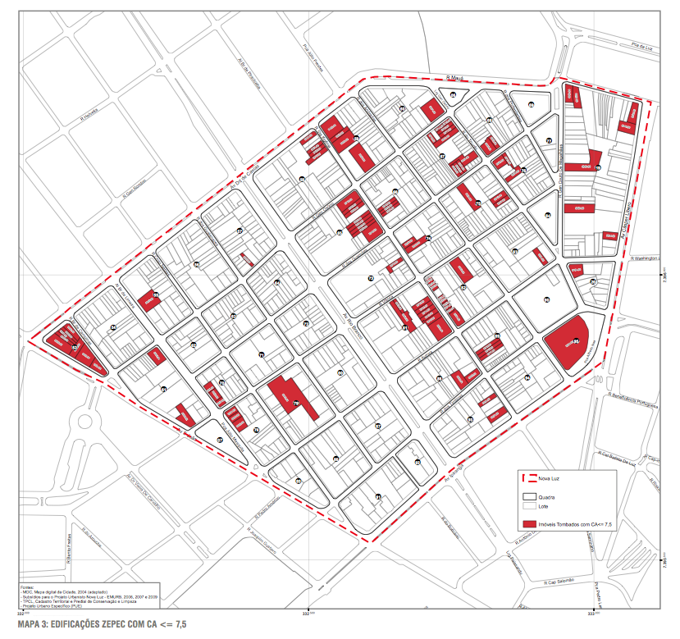
Concentration of heritage buildings

Slide 24
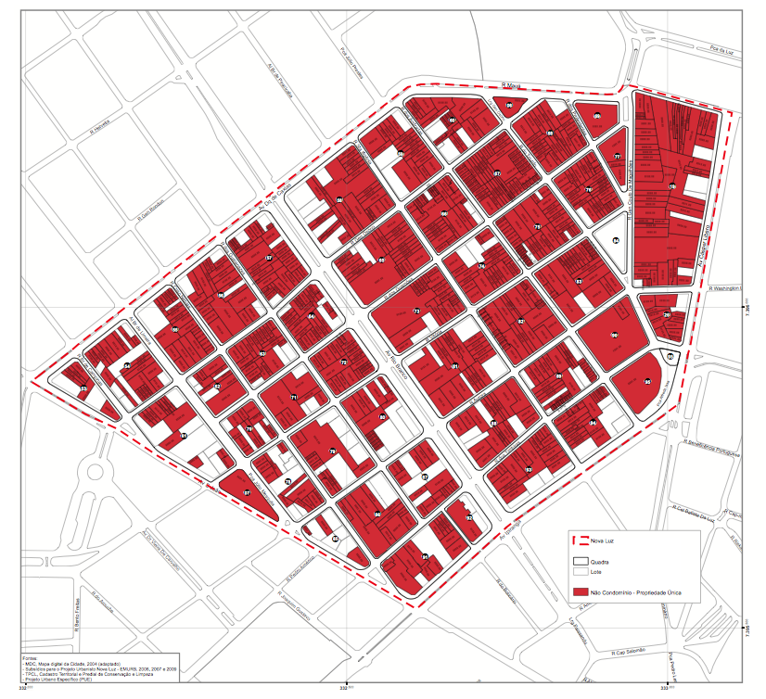
Unique land tenure registry

Slide 25
urban leasing as a tool to increase residential use
Massive people circulation has created real-estate devaluation enabling informal uses’s settlement (residential and non-residential);
Economies of agglomeration have taken advantage of real-estate devaluation, expanding non-residential use over residential;
Great fragmentation of commercial space in the form of out-lets without parking space.

Slide 26
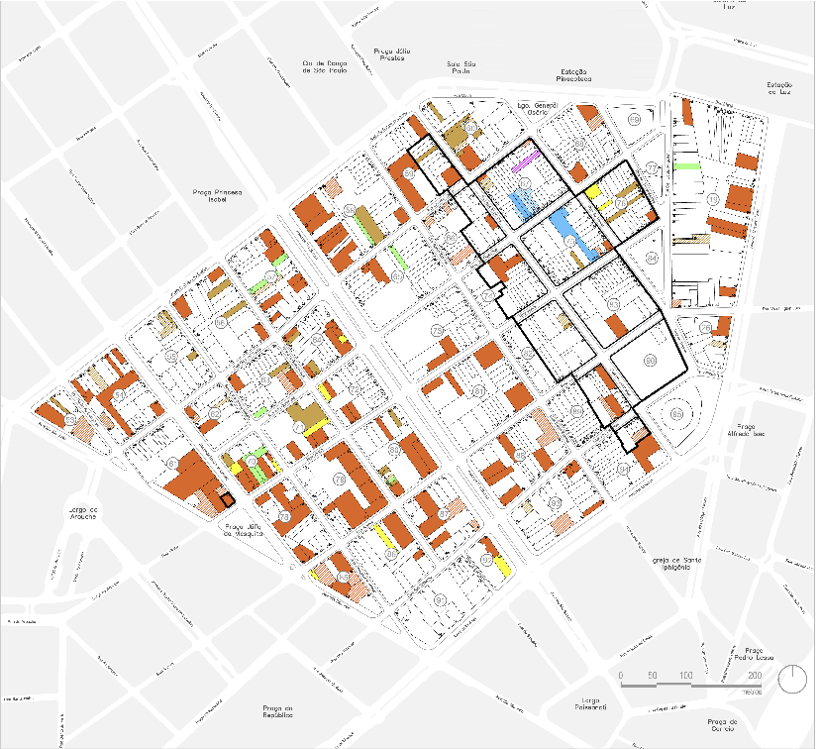

Slide 27
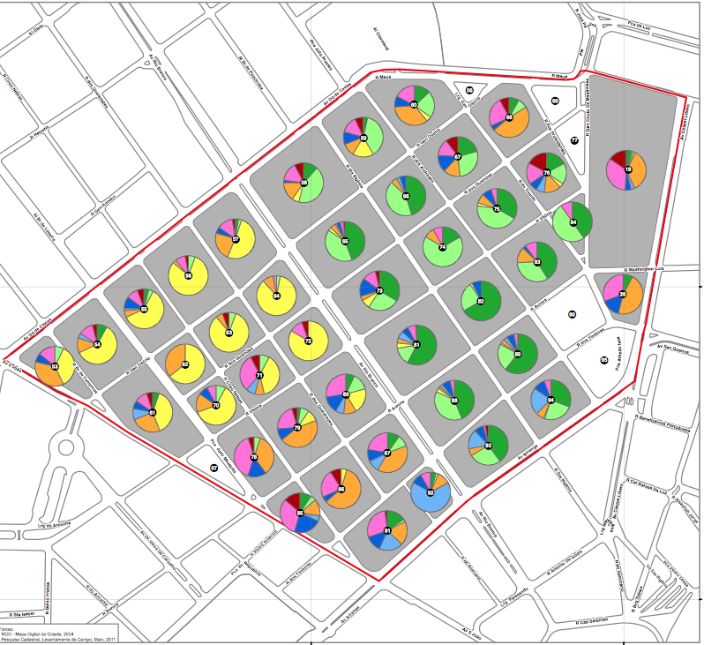
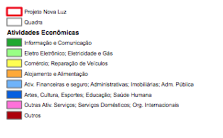

Slide 28
Economies of agglomeration takes advantage from real-estate devaluation, neutralizing the negative effects of its surroundings and creates a perverse topical appreciation process of spaces intended for commercial uses, preventing new uses from emerging.
It creates an urban process of constant incorporation of new areas intended for this purpose,
residential areas are converted into warehouses, heritage sites become parking garages, buildings are demolished to make room for additional parking.

Slide 29
urban leasing as a tool for low-income housing production
The Strategic Master Plan defines 60 ZEIS 3 perimeters in a total of 519.5 ha. These areas provide a land market reserve for the future implementation of social interest housing developments.
Ten years after their enactment most of these areas remain vacant, indicating economic feasibility problems;
Nova Luz urban leasing is going to produce 5.000 housing units being 2500 of social housing, reaching to an increase of 70% .

Slide 30
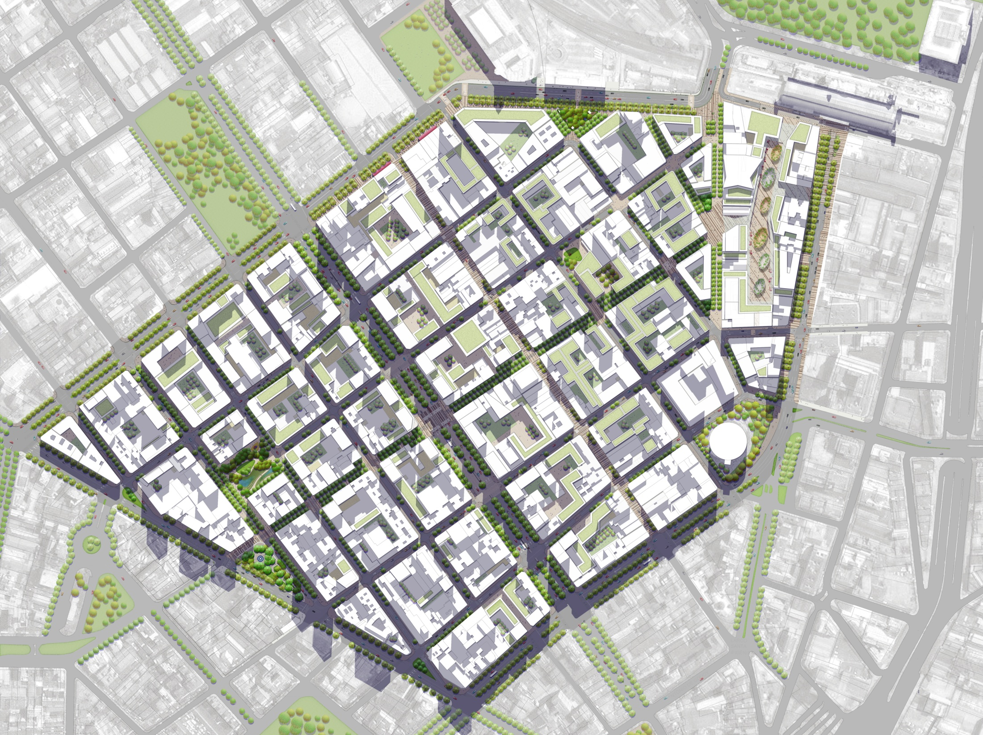
ZEIS Location

Slide 31
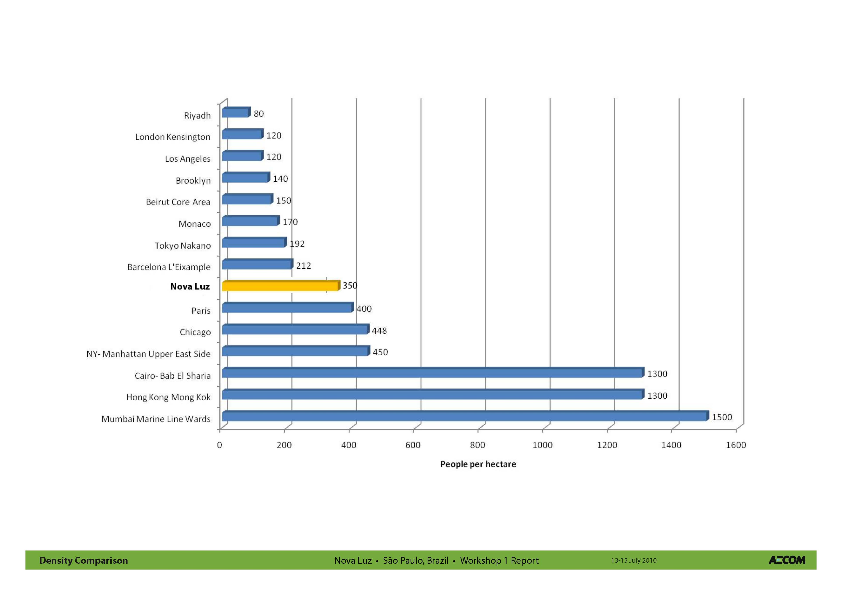

Slide 32
conclusion
The project to be submitted plans to double the number of residents, creating a multi-class neighborhood based on the production of housing for different income brackets.
Such an increase may reduce the need for daily commutes by bringing residents closer to the workplace.
The success of such an initiative depends on an accurate understanding of the social purpose of a sector of the city that concentrates its biggest investments in infrastructure, and transport, making it attractive to society in general and standing as a first step in the construction of a compact, fair and environmentally sustainable city.

Slide 33
/tmp/PreviewPasteboardItems/10.jpg
Urban leasing as a tool of urban requalification
/tmp/PreviewPasteboardItems/10.jpg
Thank you
devecchi@osite.com.br

