Slide 1
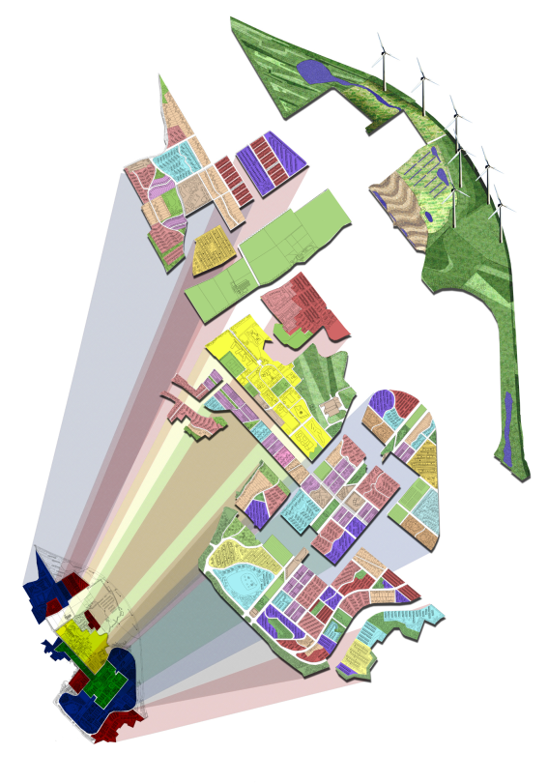



ReVISIONS
Regional Visions of Integrated Sustainable Infrastructure Optimised for Neighbourhoods
Urban Form and
Building Energy
Dr Vicky Cheng
Research Associate
Department of Architecture
Sao Paulo International Symposium 18-19 June 2012

Slide 2
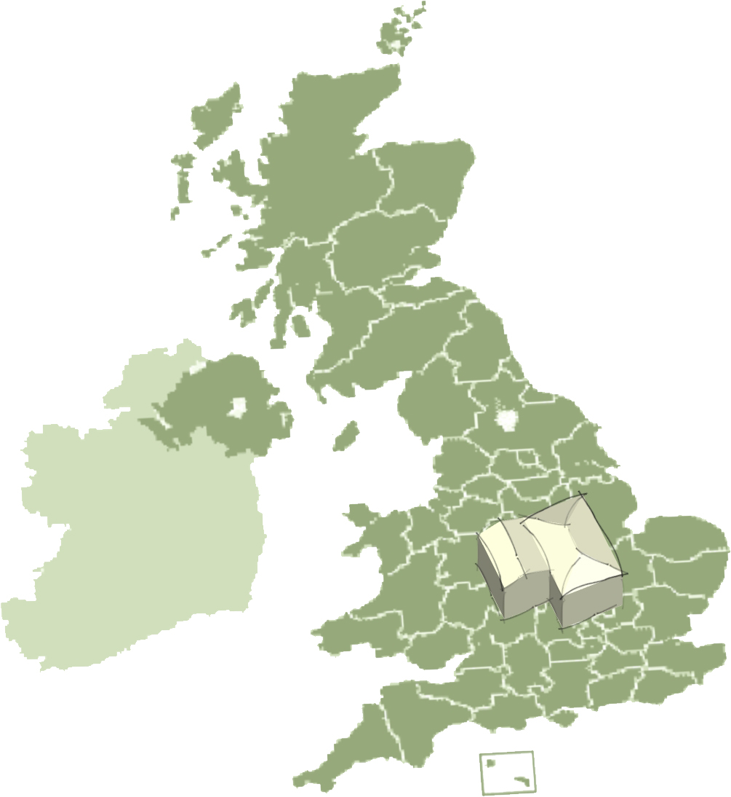
In this presentation…
Development of Generic Tiles
Generic Tiles and Energy Demand
Energy Demand Modelling for Chelmsford

Slide 3
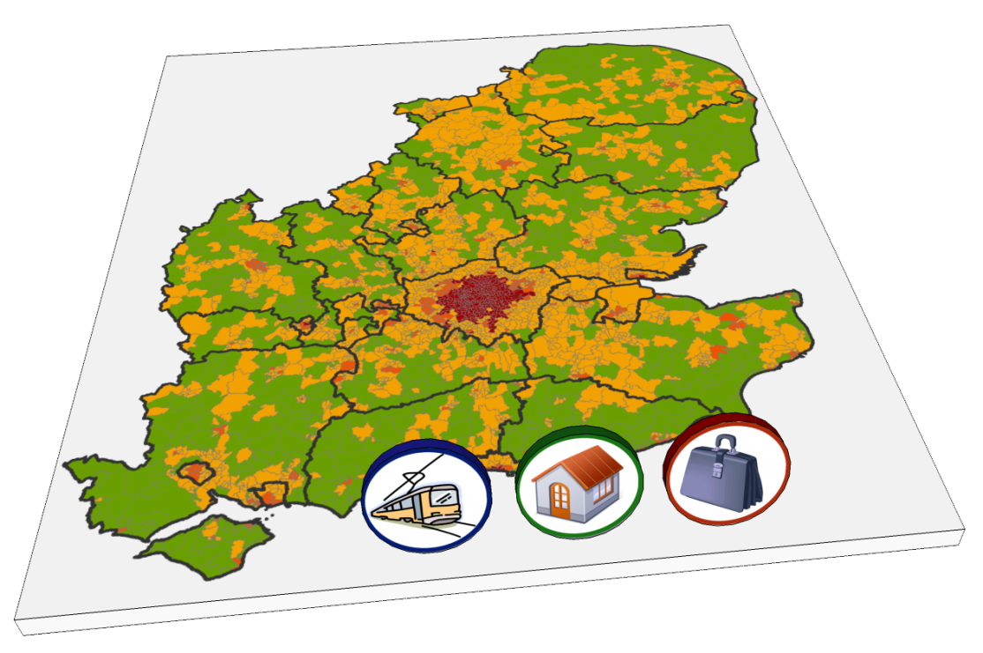
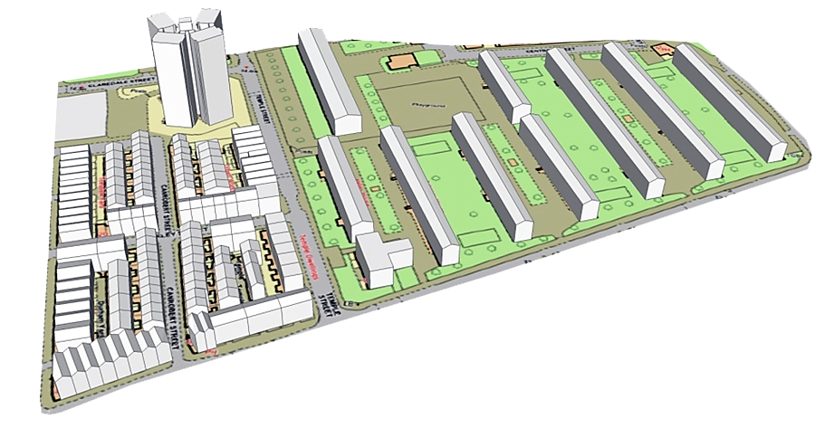
Linking Regional Planning to Neighbourhood Design
High level Planning:
Growths (population, economic, etc.)
Spatial development pattern
Land Use and Transport
Employment and Households
Local Decisions:
Urban Form
Infrastructural Design
(energy, water, waste, etc.)

Slide 4
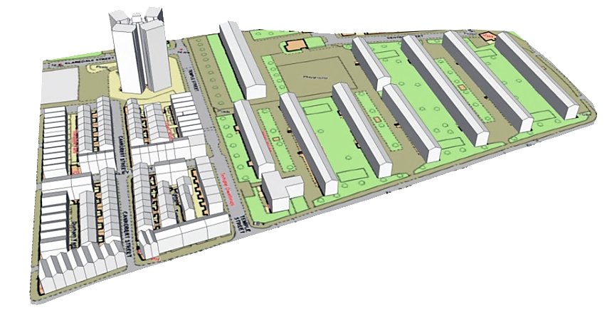
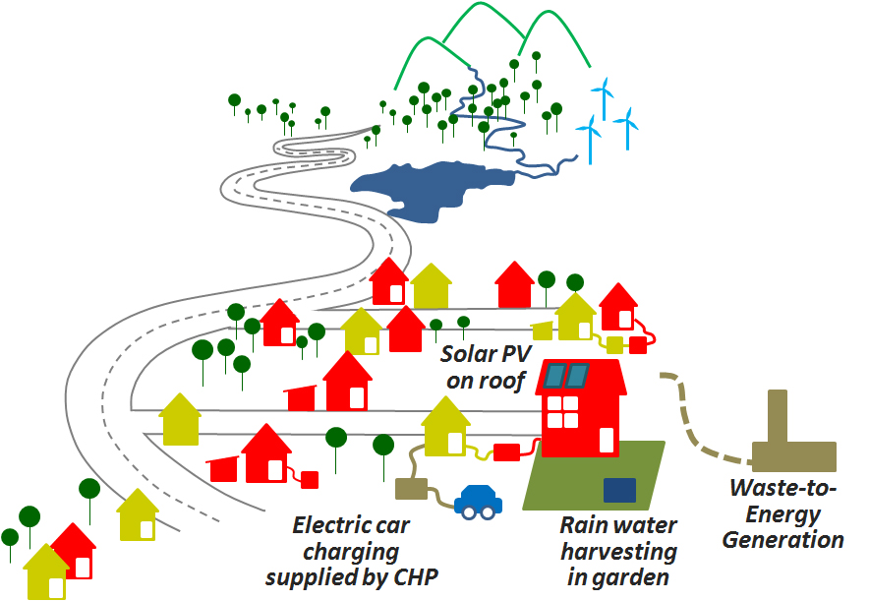
Integration of Infrastructural Design at Local Scale
Local Impacts:
Economy
Environment
Health
Energy
Water
Waste

Slide 5
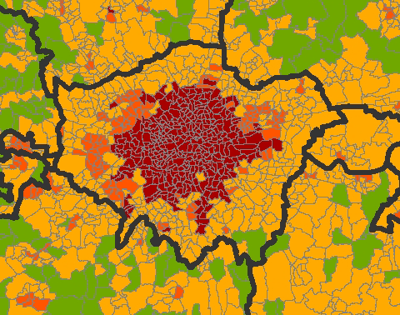
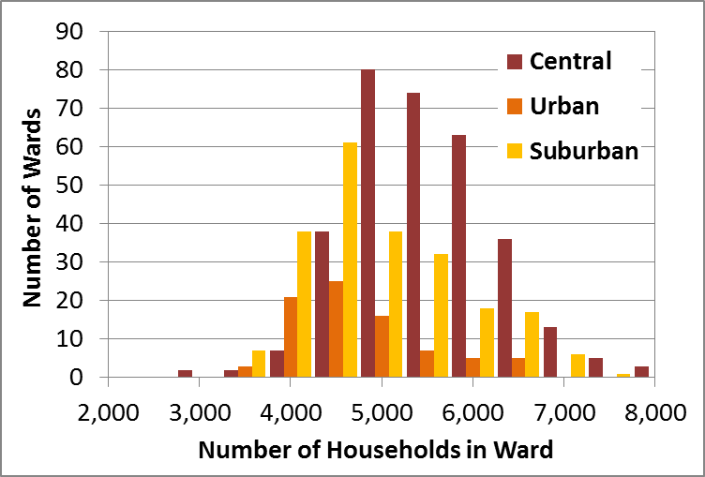
Neighbourhood Scale: Wards
London: 628 Wards
Area Type Classification
Size of Wards (households)
Central | Urban | Suburban
5219 | 4513 | 4729
Central
Urban
Suburban
Rural

Slide 6
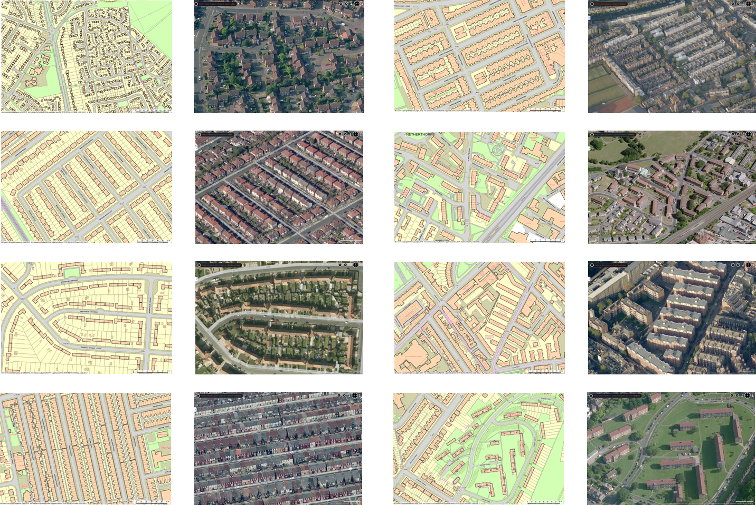
From City Region to Neighbourhood: Generic Tiles Method

Slide 7
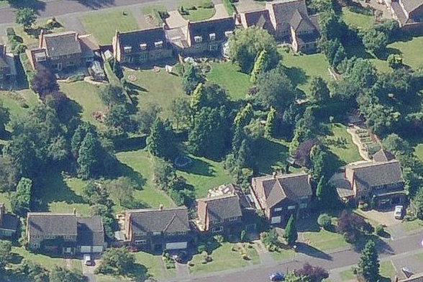
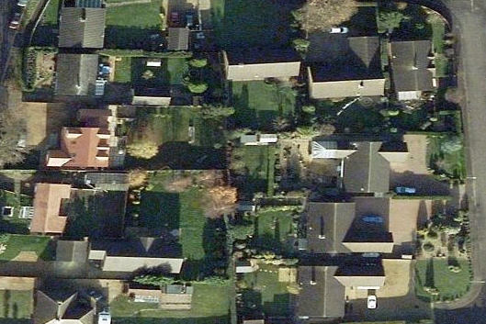
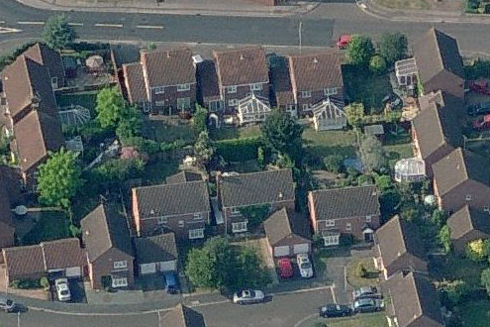
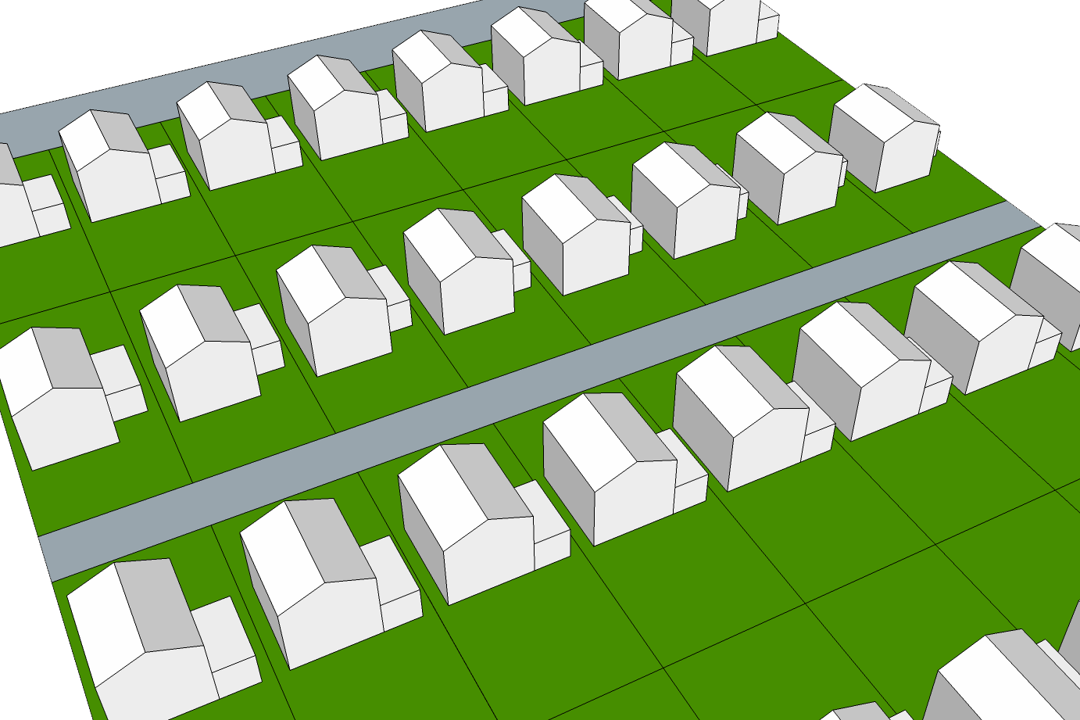
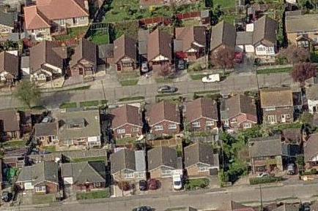
Generic Tiles for Domestic Buildings
Parameters:
Built Form
Density
Land Use
Source of data:
Ordnance Survey Master Map
Generalized Land Use Database (GLUD)
English House Condition Survey (EHCS)
Building
Plot Area
Garden
Road

Slide 8
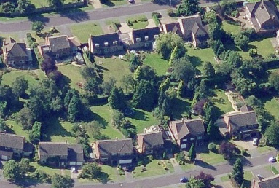
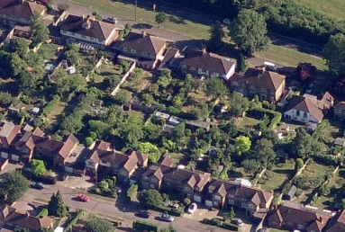
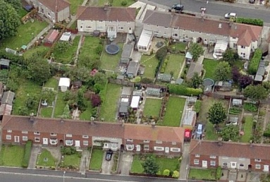
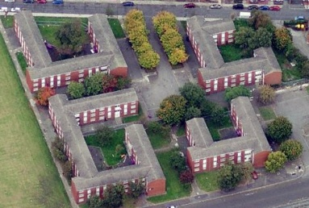
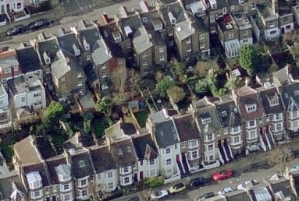
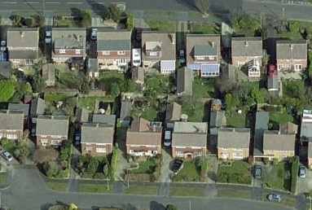
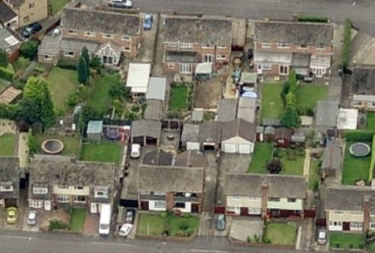
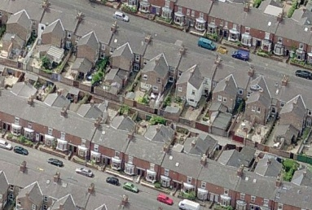
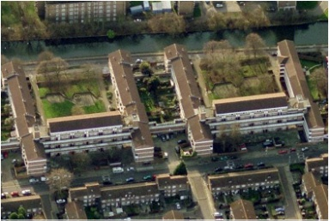
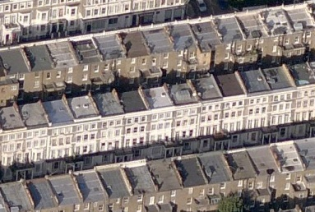
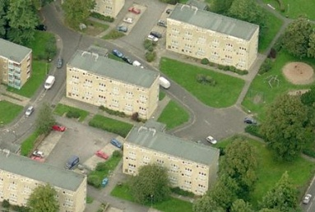
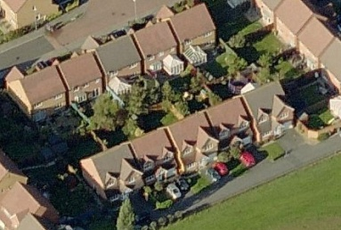
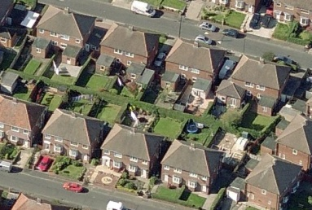
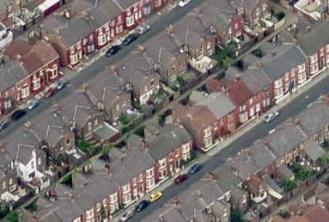
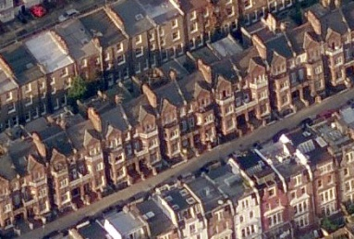
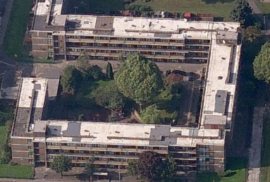
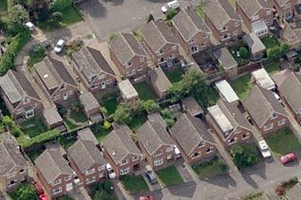
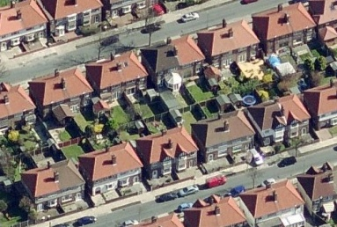
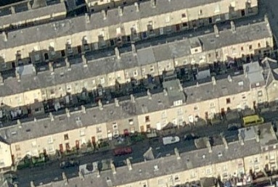
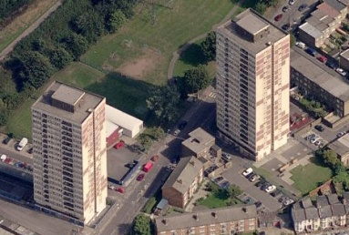
Detached
Semi-detached
Terraced
Flat
(purpose-built)
Flat
(converted)

Slide 9
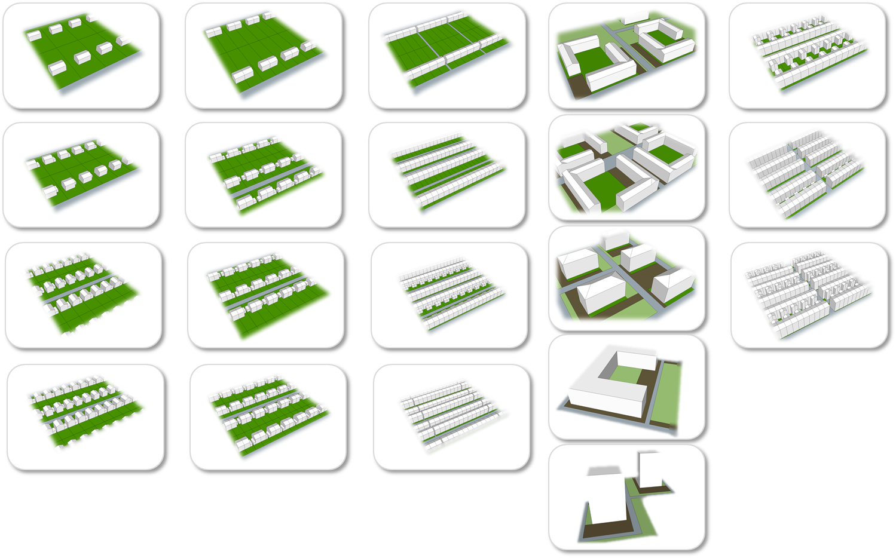
Detached
Semi-detached
Terraced
Flat
(purpose-built)
Flat
(converted)

Slide 10
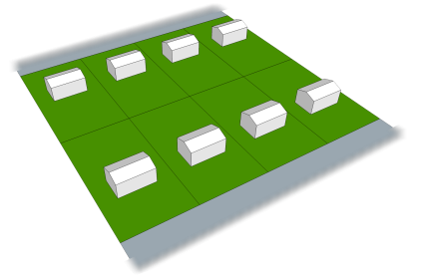
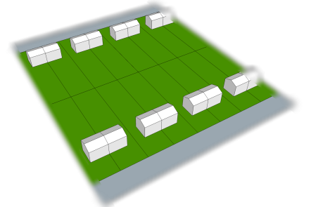
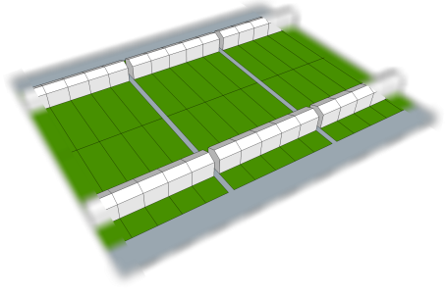
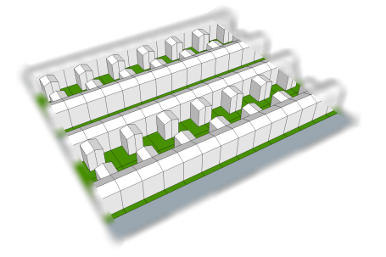
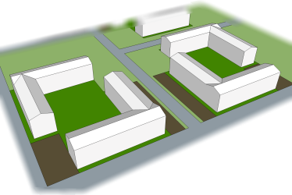
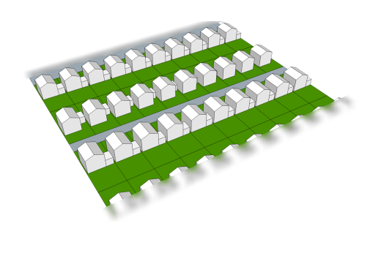
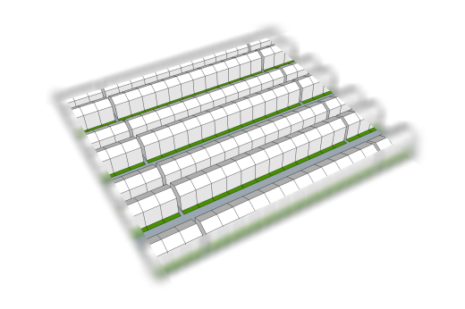
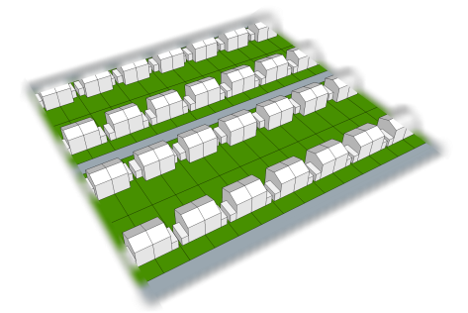
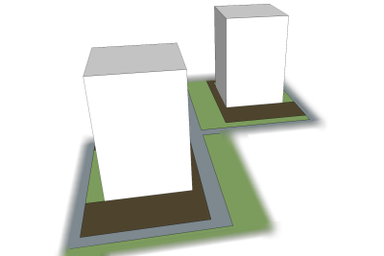
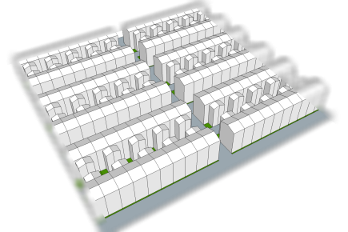
Domestic Tiles
Gross Density (dwelling per hectare)
7
13
22
30
42
77
109
162
330
374
Detached
Semi-detached
Terraced
Flat
(purpose-built)
Flat (converted)
Da
Sa
Ta
Fa
FCa
Dd
Sd
Td
Fe
FCc

Slide 11
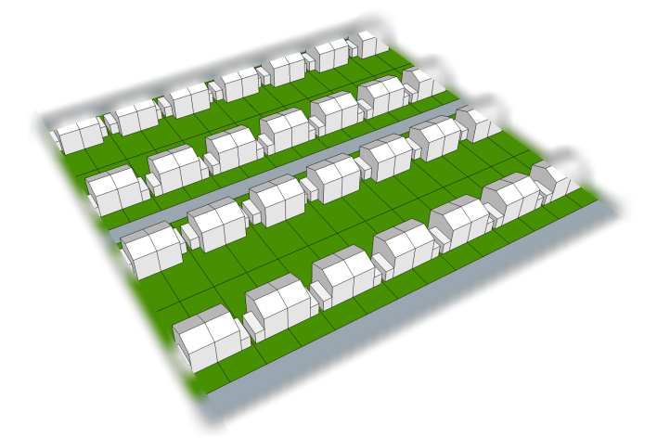
Domestic Tile Dataset
Tile Sd: Semi-detached
Gross Density (dph) | 41.7
Net Density (dph) | 60.0
Floor area (m²) | 85
Building height (m) | 6 (2 storeys)
Land Use (%) | Domestic building Domestic garden Greenspace Road and path Other land | 20.04 49.68 0 30.28 0
Domestic energy demand (kWh/year/dwelling) | Space heating Water heating Cooking – gas Cooling – electricity Electrical appliances Lighting Total | 8780 1846 627 385 2036 506 14180

Slide 12
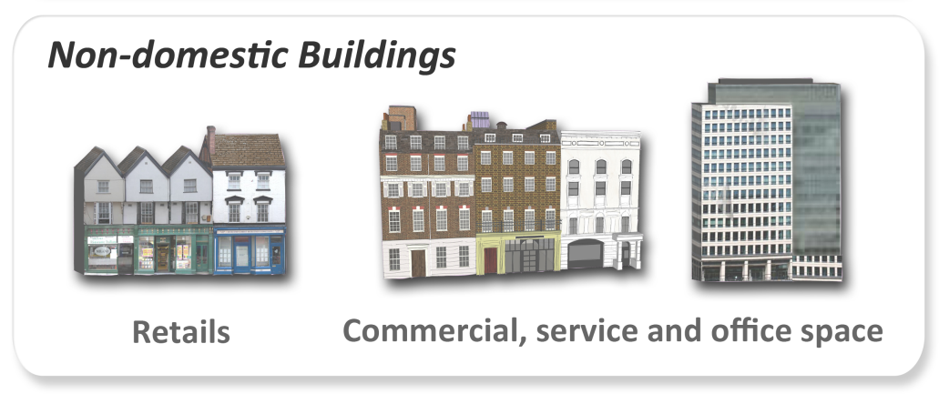
Non-domestic Tiles
Building Types:
Retail
Offices
Factories
Warehouses
Non-bulk
Building Floorspace
Built Area
Plot Ratio:
Building Floorspace
Floorspace: Footprint Ratio = 2
Building Footprint
Built Area
Materials provided by Peter Armitage

Slide 13
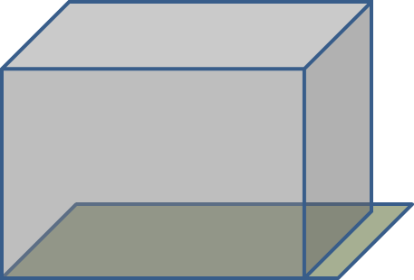

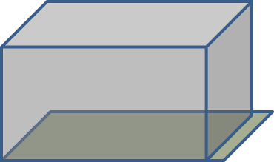


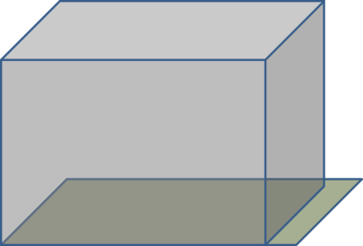











Non-domestic Tiles
Retail (5 Types)
Offices (5 Types)
Factories (3 Types)
Warehouses (4 Types)
Materials provided by Peter Armitage

Slide 14



Non-domestic Tile Examples
Retail – Tile 2
(Plot Ratio = 0.6)
Materials provided by Peter Armitage

Slide 15




Non-domestic Tile Examples
Offices – Tile 5
(Plot Ratio = 4.5)
Materials provided by Peter Armitage

Slide 16




Non-domestic Tile Examples
Factories – Tile 1
(Plot Ratio = 0.4)
Materials provided by Peter Armitage

Slide 17
Non-domestic Tiles
Further Work
1. Generic Tiles
Sub-types: Retail Warehouses, Business Parks, Department Stores, Shopping Malls
Adding Road and Green Space to Tiles
Non-domestic Building Energy Demand
Energy model has been built based on the UK Government standard SBEM (Simplified Building Energy Model)
Further develop the energy model and produce outputs for energy supply partner

Slide 18
In this presentation…
Development of Generic Tiles
Generic Tiles and Energy Demand
Energy Demand Modelling for Chelmsford

Slide 19





Domestic Building Energy Model Framework
Domestic Building Stock
National Statistics
INPUT
Building Physics Model
EVALUATE
Modelled Energy Use
↓Dwelling energy
Occupancy
Building Fabric
Services Systems
PROJECTION
LAND USE MODEL
Generic Tile Data
Study Area
Dwelling Number
Dwelling Type
Location
Study Area

Slide 20



Domestic Building Energy Model Evaluation
Gas r_{s}=0.934
Local Authority (LA)
[326 LAs in England]
Electricity r_{s}=0.974
Data:
DECC Gas and electricity consumption 2007

Slide 21





Heat and Electricity Demands by Tile Types
Annual and monthly heat demand (kWh/year per dwelling)
Tile Types
Month | Detached |  |  |  | Semi-detached |  |  |  | Terraces |  |  |  | Flat: purpose-built |  |  |  |  | Flat: coverted
 | Da | Db | Dc | Dd | Sa | Sb | Sc | Sd | Ta | Tb | Tc | Td | Fa | Fb | Fc | Fd | Fe | FCa | FCb | FCc
Annual | 27089 | 19019 | 13855 | 10994 | 18722 | 14573 | 12983 | 11549 | 13383 | 11739 | 11626 | 11807 | 9042 | 7224 | 6538 | 6813 | 7129 | 11823 | 9592 | 7653
1 | 4963 | 3457 | 2472 | 1902 | 3353 | 2592 | 2279 | 1987 | 2325 | 1987 | 1941 | 1964 | 1490 | 1164 | 1031 | 1077 | 1145 | 2002 | 1579 | 1229
2 | 4287 | 2983 | 2130 | 1640 | 2897 | 2240 | 1967 | 1720 | 2022 | 1735 | 1698 | 1718 | 1300 | 1013 | 898 | 937 | 982 | 1755 | 1385 | 1086
3 | 3538 | 2443 | 1734 | 1350 | 2387 | 1811 | 1599 | 1408 | 1659 | 1442 | 1434 | 1459 | 1076 | 837 | 739 | 761 | 789 | 1456 | 1162 | 911
4 | 2271 | 1567 | 1118 | 890 | 1559 | 1180 | 1046 | 937 | 1112 | 984 | 987 | 1004 | 752 | 592 | 538 | 565 | 568 | 1020 | 824 | 663
5 | 1135 | 806 | 608 | 518 | 830 | 647 | 592 | 547 | 632 | 577 | 590 | 608 | 465 | 386 | 362 | 381 | 375 | 588 | 502 | 416
6 | 366 | 301 | 271 | 258 | 324 | 287 | 277 | 274 | 294 | 288 | 296 | 293 | 257 | 224 | 220 | 227 | 234 | 285 | 261 | 228
7 | 269 | 249 | 242 | 231 | 260 | 258 | 250 | 245 | 256 | 247 | 234 | 227 | 226 | 209 | 211 | 225 | 227 | 232 | 207 | 207
8 | 275 | 254 | 244 | 234 | 268 | 260 | 252 | 247 | 259 | 249 | 236 | 228 | 228 | 210 | 212 | 225 | 229 | 234 | 209 | 206
9 | 537 | 399 | 331 | 302 | 424 | 345 | 332 | 321 | 347 | 335 | 347 | 358 | 285 | 254 | 242 | 243 | 259 | 325 | 299 | 248
10 | 1550 | 1072 | 782 | 639 | 1088 | 839 | 757 | 682 | 788 | 709 | 717 | 732 | 567 | 461 | 429 | 455 | 474 | 735 | 612 | 490
11 | 3354 | 2323 | 1660 | 1289 | 2267 | 1746 | 1547 | 1359 | 1573 | 1367 | 1362 | 1398 | 1033 | 810 | 718 | 745 | 801 | 1371 | 1104 | 850
12 | 4544 | 3166 | 2264 | 1740 | 3064 | 2368 | 2086 | 1822 | 2116 | 1818 | 1785 | 1818 | 1362 | 1064 | 938 | 971 | 1047 | 1818 | 1448 | 1119
Month

Slide 22

Adjustment for local characteristics at the ward level
Regression Curves

Slide 23
Domestic Energy Demand for Future Scenarios
Generic Tiles: New Build for Future Scenarios (2030/2050)
UK Government Proposed Targets for New Homes
Date | 2010 | 2013 | 2016
Carbon improvement as compared to Part L (BRs 2006) | 25% | 44% | Zero carbon
Equivalent energy/carbon standard in the Code | Code Level 3 | Code Level 4 | Code Level 6
Building Standard: Code for Sustainable Homes – Level 6 (‘Zero carbon’ Home)
General Specification
Mode of Ventilation | Mechanical Ventilation with Heat Recovery (MVHR)
Door | Number: 2 for houses and 1 for flats U-value: 0.70 W/m²K
Windows | Type: Triple glazed (Low-E, soft-coat) Frame: uPVC U-value: 0.70 W/m²K
Ground Floor | U-value: 0.10 W/m²K (Note 1)
External Wall | Type: Solid with internal insulation U-value: 0.15 W/m²K (Note 2)
Roof | U-value: 0.10 W/m²K (Note 1)
Air Permeability q₅₀ | 1 m³/m²/hr
Thermal Bridge y-value | 0.02 W/m²K
Lighting and appliances | Electricity use: 68% (2031) / 49% (2051) relative to 2010 level

Slide 24



Domestic Energy Demand for Future Scenarios
Tile Sd: Semi-detached
Gross Density (dph) | 41.7
Net Density (dph) | 60.0
Floor area (m²) | 85
Building height (m) | 6 (2 storeys)

Slide 25
In this presentation…
Development of Generic Tiles
Generic Tiles and Energy Demand
Energy Demand Modelling for Chelmsford

Slide 26

Chelmsford Case Study

Slide 27




Chelmsford: 2001 Base Year
Population
Dwelling Density (dph)
30 | 24 | 12
5k
8k
Urban
Suburban
Rural
Annual Heat Demand (kWh/capita)

Slide 28







Market Led
Chelmsford: 2031 Future Scenarios
2001 Base Year
Population
Trend
Compaction
Urban
Suburban
Rural
Growth in dwelling numbers from 2001 (%)
0
50
100
150
300
500

Slide 29




Base Year
Chelmsford: 2031 Trend
Growth Pattern
Heat Demand per capita
(change from 2001)
Net Dwelling Density (dph)
54 | 36 | 14
(+81%) | (+48%) | (+20%)
Heat Demand per capita (kWh/year)
2738 | 2886 | 4571
(-53%) | (-51%) | (-45%)
Share of Total Heat Demand
9% | 74% | 17%
-35%
-65%
Growth in dwelling numbers from 2001 (%)
0
50
100
150
300
500

Slide 30



Base Year
Chelmsford: 2031 Market Led
Growth Pattern
Heat Demand per capita
(change from 2001)
Net Dwelling Density (dph)
45 | 34 | 12
(+48%) | (+40%) | (+3%)
Heat Demand per capita (kWh/year)
2796 | 2793 | 5080
(-52%) | (-52%) | (-39%)
Share of Total Heat Demand
9% | 76% | 15%
-35%
-65%
Growth in dwelling numbers from 2001 (%)
0
50
100
150
300
500

Slide 31



Base Year
Chelmsford: 2031 Compaction
Growth Pattern
Heat Demand per capita
(change from 2001)
Net Dwelling Density (dph)
97 | 35 | 14
(+224%) | (+44%) | (+15%)
Heat Demand per capita (kWh/year)
2255 | 3025 | 4566
(-61%) | (-48%) | (-45%)
Share of Total Heat Demand
13% | 70% | 17%
-35%
-65%
Growth in dwelling numbers from 2001 (%)
0
50
100
150
300
500

Slide 32



Chelmsford: 2031 Future Scenarios Comparison
Trend
Scenarios | Urban | Suburban | Rural
Net Dwelling Density (dph)
Trend | 54 | 36 | 14
Market Led | 45 | 34 | 12
Compaction | 97 | 35 | 14
Heat Demand Reduction per capita
Trend | -53% | -51% | -45%
Market Led | -52% | -52% | -39%
Compaction | -61% | -48% | -45%
Share of Total Heat Demand
Trend | 9% | 74% | 17%
Market Led | 9% | 76% | 15%
Compaction | 13% | 70% | 17%
Market
Led
Compact

Slide 33


Modelling of the Wider South East
Area Type Classification
Heat Demand per capita:
January (kWh/month)
Central
Urban
Suburban
Rural

Slide 34


Low Carbon Energy Supply Options
Building Level Technologies
Tile Db: Detached House (12 dph)
Solar PV:
Electricity Supply
Ground Source Heat Pump:
Heat Supply
Image of solar PV panel extracted from Google 3D warehouse

Slide 35


Low Carbon Energy Supply Options
Building Level Technologies
Tile Fb: Purpose-built Flat (101 dph)
Solar Thermal:
Hot Water Supply
Solar PV:
Electricity Supply
Image of solar PV panel extracted from Google 3D warehouse

Slide 36

Low Carbon Energy Supply Options
Community Level Technologies
Communal Infrastructure
Supply Technology at Building Level
Supply infrastructure at Community Level
(e.g. Combined Heat and Power)
Image of solar PV panel extracted from Google 3D warehouse

Slide 37

Modelling of the Wider South East
Energy Supply: Emissions

Slide 38
Low Carbon Energy Supply Options
Infrastructure for Different Sectors
Energy
Water
Transport
Waste

Slide 39


ReVISIONS website:
http://www.regionalvisions.ac.uk
Contact Information:
Vicky Cheng (bkc25@cam.ac.uk)
Publication:
Environmental Modelling & Software
Vol. 26 (2011), pp. 1186-1198

